Slide 1
引力子光子振荡
李淼

Slide 2
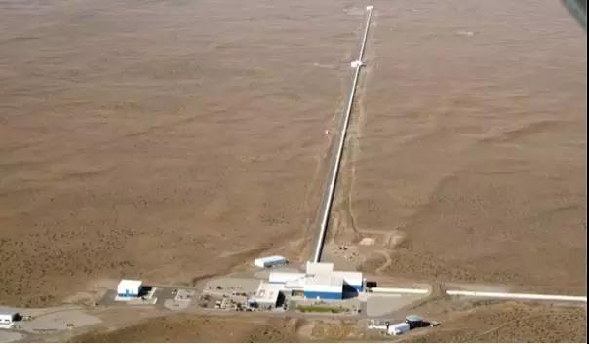
Gravitational Wave
Gravity is weak between common objects
Need to look in the universe for strong gravity
Need to rotate celestial very fast, better close to speed of light, to generate strong gravitational wave
Gravitational wave has been detected when two blackholes merge
LIGO has detected many cases
  Frequency up to more than 100Hz

Slide 3
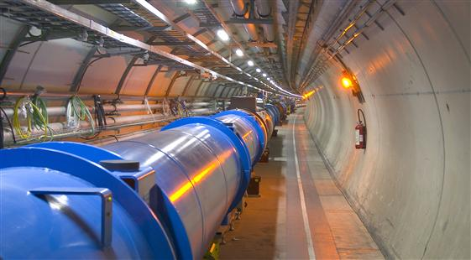
Gravitons
Always assumed by physics community to exist
E = hf
Need high frequency to observe quantum properties
  At least visible light frequency
  Better f > 10^14 Hz
Impossible for celestial objs.
Need 10^19 Gev for particles
  LHC 10^4 GeV

Slide 4
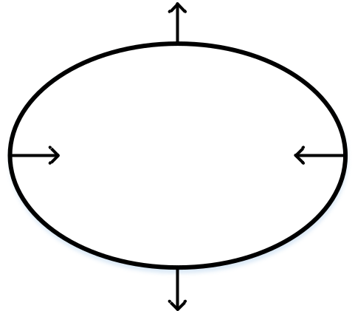

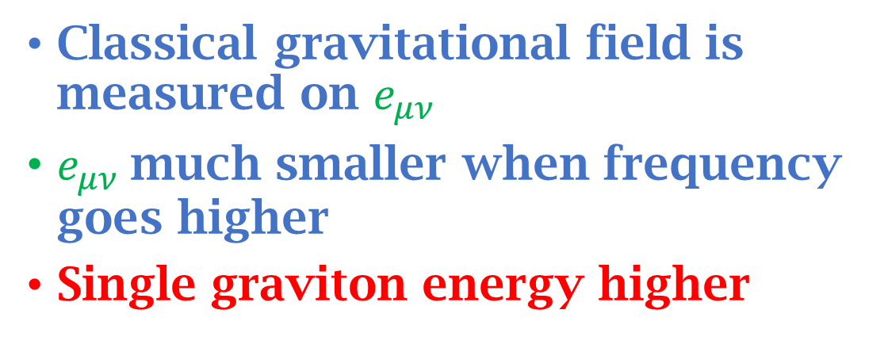
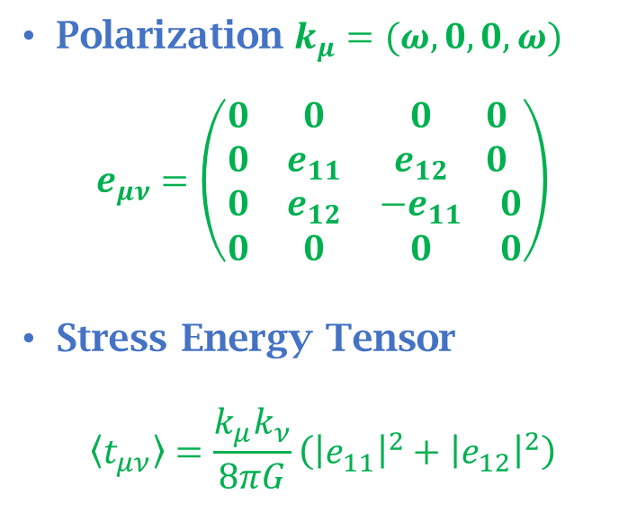
Gravitational Wave and Gravitons
Plane wave
$$g_{μν}=η_{μν}+h_{μν}$$
$$h_{μν}=e_{μν}e^{ikx}+{e^{∗}}_{μν}e^{−ikx}$$
Polarization $k_{μ}=(ω,0,0,ω)$
$$e_{μν}=\left(\begin{matrix}\begin{matrix}0 & 0 \\ 0 & e_{11}\end{matrix} & \begin{matrix}0 & 0 \\ e_{12} & 0\end{matrix} \\ \begin{matrix}0 & e_{12} \\ 0 & 0\end{matrix} & \begin{matrix}{−e}_{11} & 0 \\ 0 & 0\end{matrix}\end{matrix}\right)$$
Stress Energy Tensor
$$〈t_{μν}〉=\frac{k_{μ}k_{ν}}{8πG}\left({\left|e_{11}\right|}^{2}+{\left|e_{12}\right|}^{2}\right)$$
Classical gravitational field is measured on $e_{μν}$
$e_{μν}$much smaller when frequency goes higher
Single graviton energy higher

Slide 5
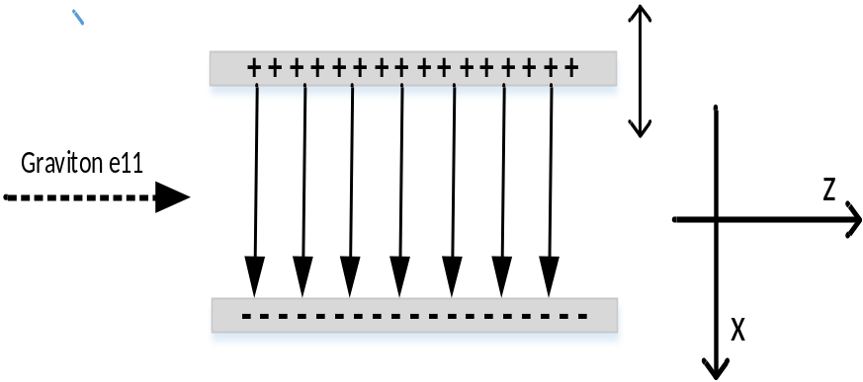
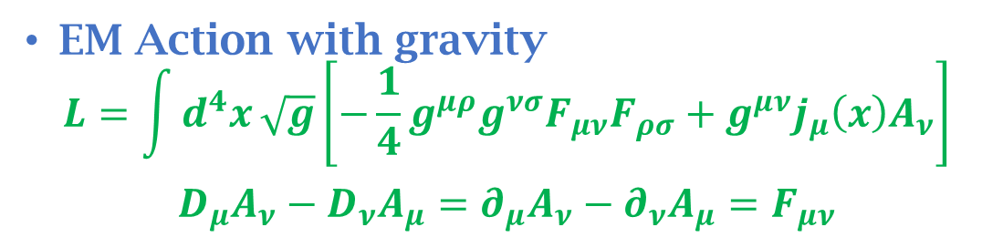
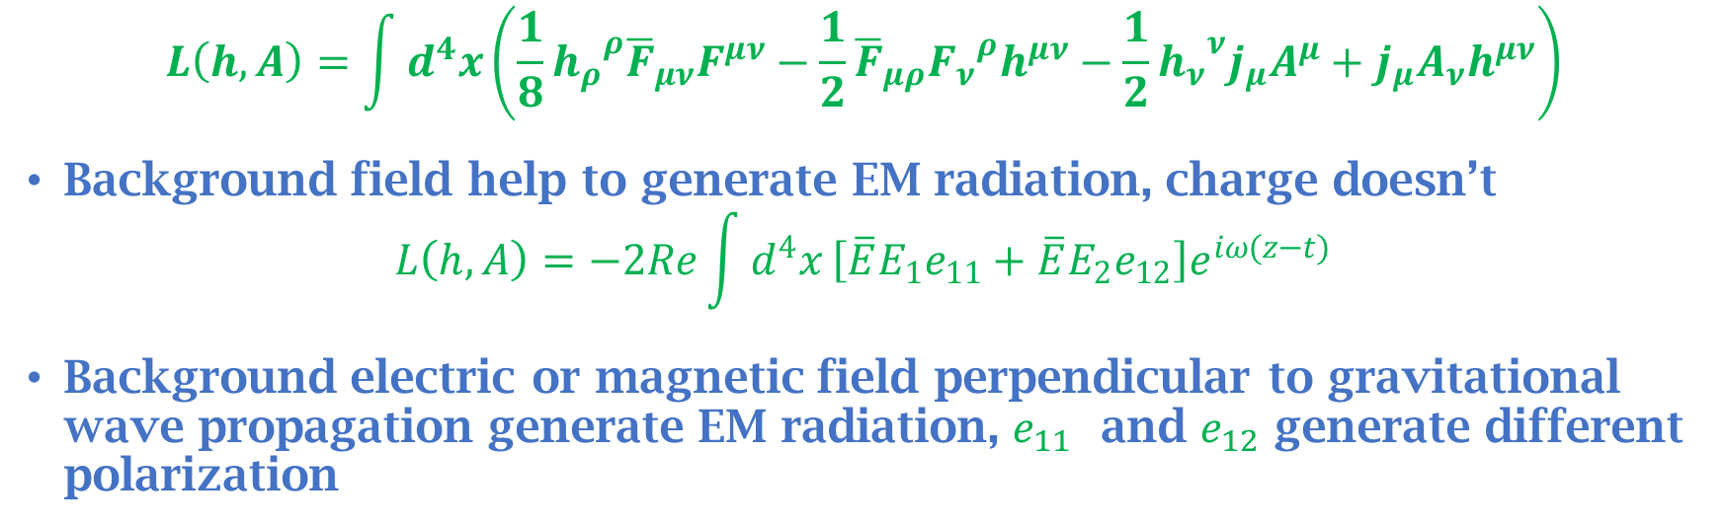
From Gravitons to Photons
EM Action with gravity
$$L=\int{d^{4}x}\sqrt{g}\left[−\frac{1}{4}g^{μρ}g^{νσ}F_{μν}F_{ρσ}+g^{μν}j_{μ}\left(x\right)A_{ν}\right]$$
$$D_{μ}A_{ν}−D_{ν}A_{μ}=∂_{μ}A_{ν}−∂_{ν}A_{μ}=F_{μν}$$
$$L\left(h,A\right)=\int{d^{4}x}\left(\frac{1}{8}{h_{ρ}}^{ρ}{\overline{F}}_{μν}F^{μν}−\frac{1}{2}{\overline{F}}_{μρ}{F_{ν}}^{ρ}h^{μν}−\frac{1}{2}{h_{ν}}^{ν}j_{μ}A^{μ}+j_{μ}A_{ν}h^{μν}\right)$$
Background field help to generate EM radiation, charge doesn’t
$$L\left(h,A\right)=−2Re\int{d^{4}x}\left[\overline{E}E_{1}e_{11}+\overline{E}E_{2}e_{12}\right]e^{iω(z−t)}$$
Background electric or magnetic field perpendicular to gravitational wave propagation generate EM radiation, $e_{11}$ and $e_{12}$ generate different polarization

Slide 6
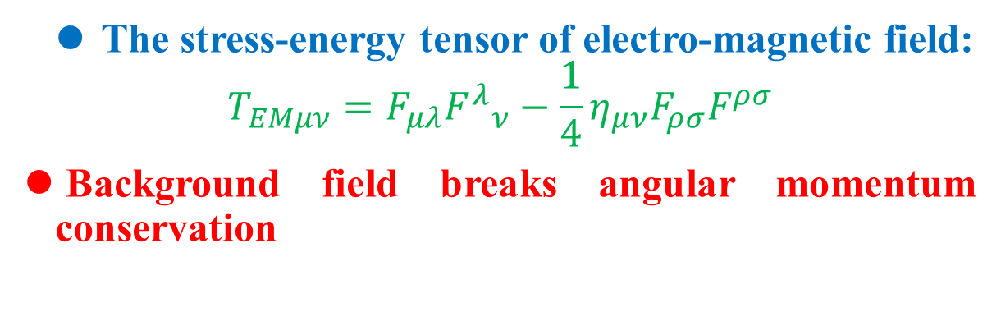
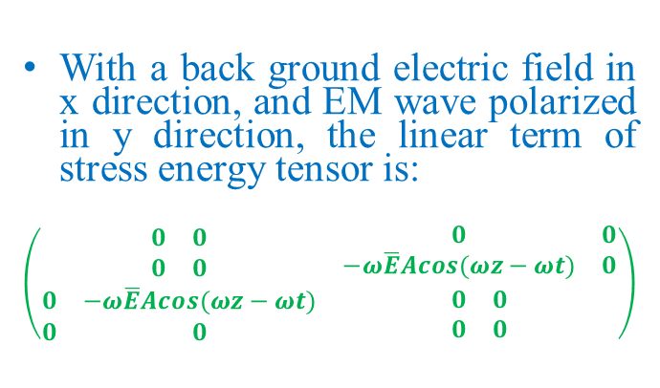
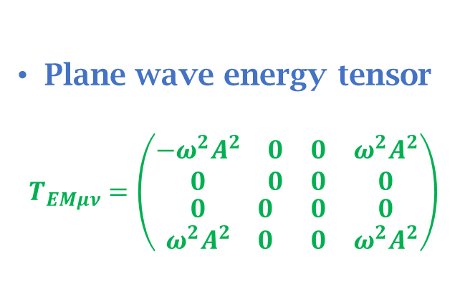
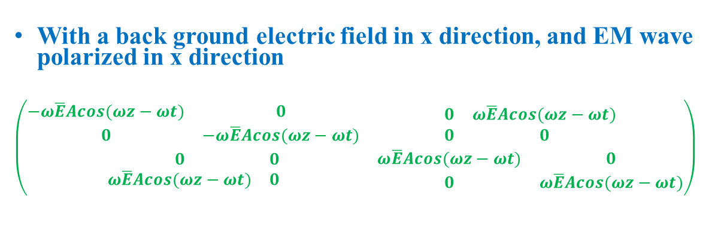
From Photon to Graviton
The stress-energy tensor of electro-magnetic field:
$$T_{EMμν}=F_{μλ}{F^{λ}}_{ν}−\frac{1}{4}η_{μν}F_{ρσ}F^{ρσ}$$
Background field breaks angular momentum conservation
Plane wave energy tensor
$$T_{EMμν}=\left(\begin{matrix}\begin{matrix}{−ω^{2}A}^{2} & 0 \\ 0 & 0\end{matrix} & \begin{matrix}0 & {ω^{2}A}^{2} \\ 0 & 0\end{matrix} \\ \begin{matrix}0 & 0 \\ {ω^{2}A}^{2} & 0\end{matrix} & \begin{matrix}0 & 0 \\ 0 & {ω^{2}A}^{2}\end{matrix}\end{matrix}\right)$$
With a back ground electric field in x direction, and EM wave polarized in x direction
$$\left(\begin{matrix}\begin{matrix}−ω\overline{E}Acos(ωz−ωt) & 0 \\ 0 & −ω\overline{E}Acos(ωz−ωt)\end{matrix} & \begin{matrix}0 & ω\overline{E}Acos(ωz−ωt) \\ 0 & 0\end{matrix} \\ \begin{matrix}0 & 0 \\ ω\overline{E}Acos(ωz−ωt) & 0\end{matrix} & \begin{matrix}ω\overline{E}Acos(ωz−ωt) & 0 \\ 0 & ω\overline{E}Acos(ωz−ωt)\end{matrix}\end{matrix}\right)$$
With a back ground electric field in x direction, and EM wave polarized in y direction, the linear term of stress energy tensor is:
$$\left(\begin{matrix}\begin{matrix}0 & 0 \\ 0 & 0\end{matrix} & \begin{matrix}0 & 0 \\ −ω\overline{E}Acos(ωz−ωt) & 0\end{matrix} \\ \begin{matrix}0 & −ω\overline{E}Acos(ωz−ωt) \\ 0 & 0\end{matrix} & \begin{matrix}0 & 0 \\ 0 & 0\end{matrix}\end{matrix}\right)$$

Slide 7
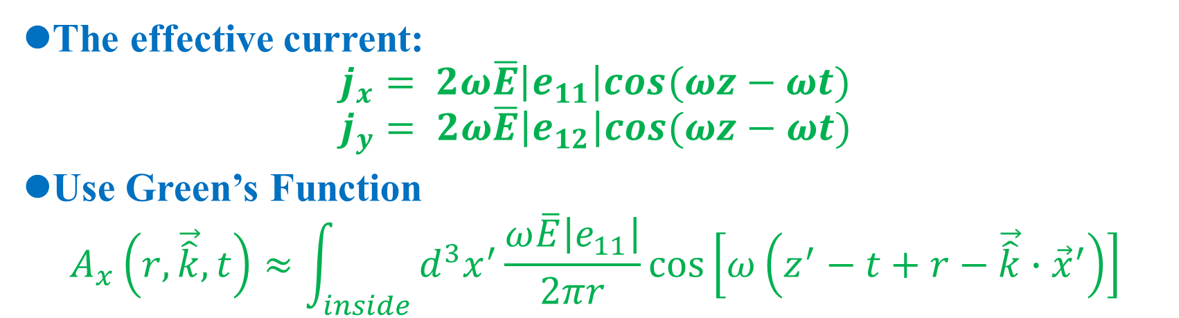
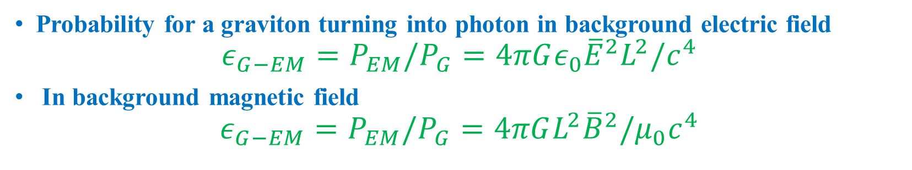
Computation
The effective current:
$$j_{x}= 2ω\overline{E}\left|e_{11}\right|cos(ωz−ωt)$$
$$j_{y}= 2ω\overline{E}\left|e_{12}\right|cos(ωz−ωt)$$
Use Green’s Function
$$A_{x}\left(r,\vec{\hat{k}},t\right)≈\int_{inside}{d^{3}x^{′}\frac{ω\overline{E}\left|e_{11}\right|}{2πr}}\cos\left[ω\left(z^{′}−t+r−\vec{\hat{k}}∙{\vec{x}}^{′}\right)\right]$$
Probability for a graviton turning into photon in background electric field
$$ε_{G−EM}=P_{EM}/P_{G}=4πGε_{0}{\overline{E}}^{2}L^{2}/c^{4}$$
In background magnetic field
$${ε_{G−EM}=P}_{EM}/P_{G}=4πGL^{2}{\overline{B}}^{2}/μ_{0}c^{4}$$

Slide 8
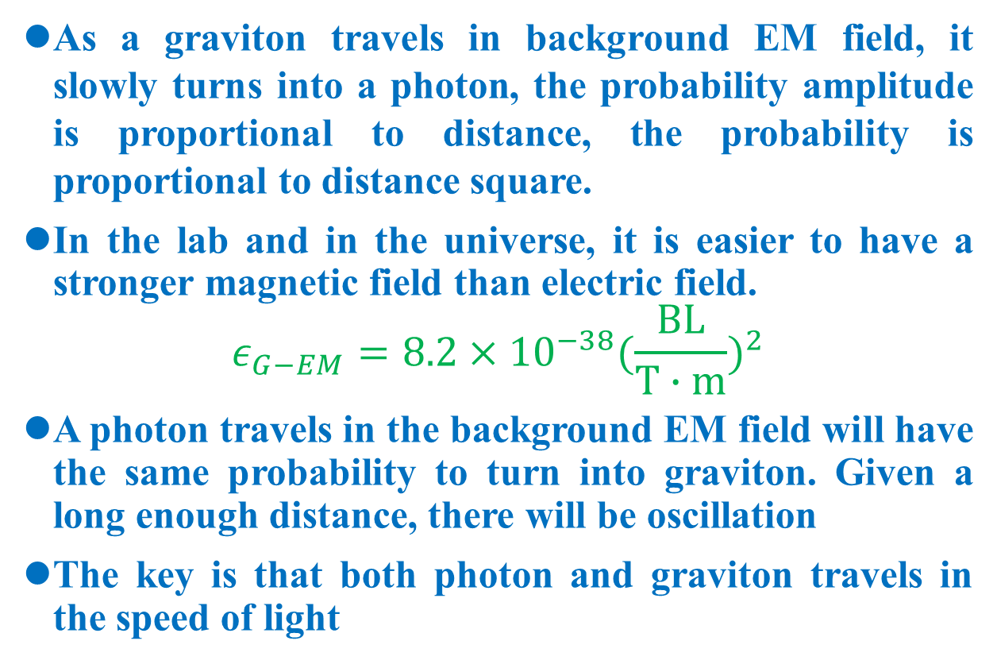
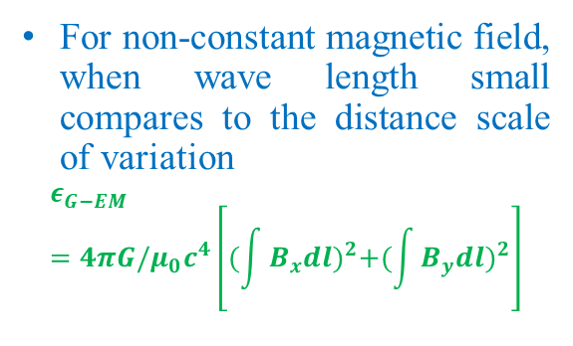
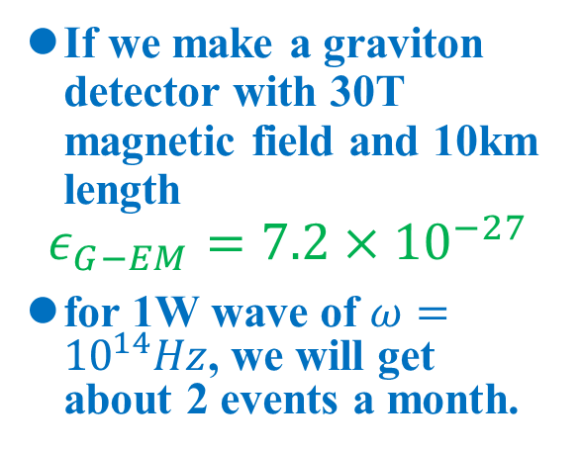
Analysis
As a graviton travels in background EM field, it slowly turns into a photon, the probability amplitude is proportional to distance, the probability is proportional to distance square.
In the lab and in the universe, it is easier to have a stronger magnetic field than electric field.
$$ε_{G−EM}=8.2×{10}^{−38}{(\frac{BL}{T∙m})}^{2}$$
A photon travels in the background EM field will have the same probability to turn into graviton. Given a long enough distance, there will be oscillation
The key is that both photon and graviton travels in the speed of light
If we make a graviton detector with 30T magnetic field and 10km length
$$ε_{G−EM}=7.2×{10}^{−27}$$
for 1W wave of $ω={10}^{14}Hz$, we will get about 2 events a month.
For non-constant magnetic field, when wave length small compares to the distance scale of variation
$$ε_{G−EM}=4πG/μ_{0}c^{4}\left[{(\int{B_{x}dl})}^{2}+{(\int{B_{y}dl})}^{2}\right]$$

Slide 9
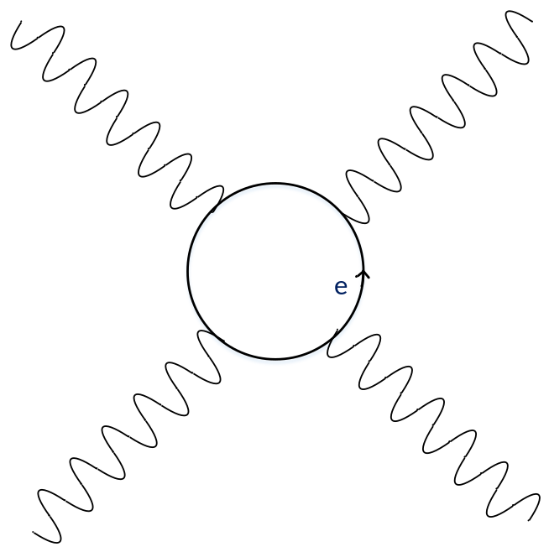
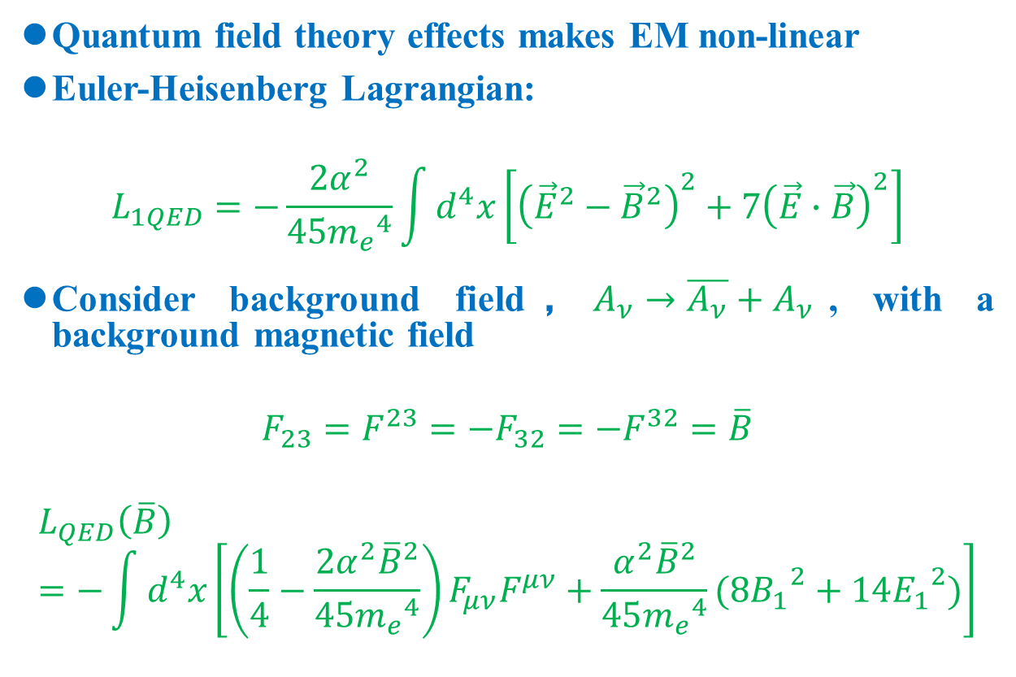
QED 1-loop Correction
Quantum field theory effects makes EM non-linear
Euler-Heisenberg Lagrangian:
$$L_{1QED}=−\frac{2α^{2}}{45{m_{e}}^{4}}\int{d^{4}x}\left[{\left({\vec{E}}^{2}−{\vec{B}}^{2}\right)}^{2}+7{\left(\vec{E}∙\vec{B}\right)}^{2}\right]$$
Consider background field，$A_{ν}→\overline{A_{ν}}+A_{ν}$, with a background magnetic field
$$F_{23}=F^{23}=−F_{32}=−F^{32}=\overline{B}$$
$$L_{QED}\left(\overline{B}\right)=−\int{d^{4}x}\left[\left(\frac{1}{4}−\frac{2α^{2}{\overline{B}}^{2}}{45{m_{e}}^{4}}\right)F_{μν}F^{μν}+\frac{α^{2}{\overline{B}}^{2}}{45{m_{e}}^{4}}(8{B_{1}}^{2}+14{E_{1}}^{2})\right]$$
For non-constant magnetic field, when wave length small compares to the distance scale of variation
$$ε_{G−EM}=4πG/μ_{0}c^{4}\left[{(\int{B_{x}dl})}^{2}+{(\int{B_{y}dl})}^{2}\right]$$

Slide 10
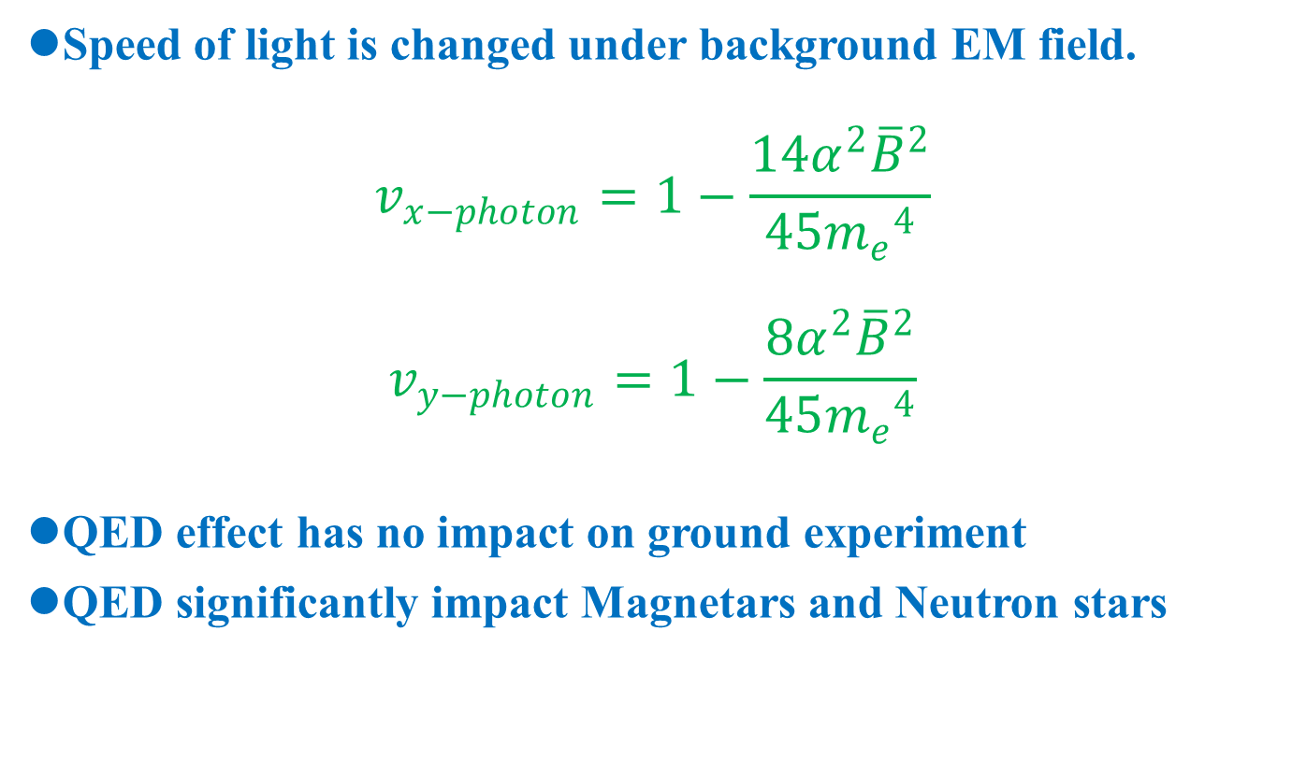
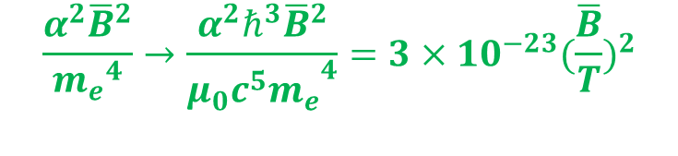
QED 1-loop Correction
Speed of light is changed under background EM field.
$$v_{x−photon}=1−\frac{14α^{2}{\overline{B}}^{2}}{45{m_{e}}^{4}}$$
$$v_{y−photon}=1−\frac{8α^{2}{\overline{B}}^{2}}{45{m_{e}}^{4}}$$
QED effect has no impact on ground experiment
QED significantly impact Magnetars and Neutron stars
$$\frac{α^{2}{\overline{B}}^{2}}{{m_{e}}^{4}}→\frac{α^{2}ℏ^{3}{\overline{B}}^{2}}{{μ_{0}c^{5}m_{e}}^{4}}=3×{10}^{−23}{(\frac{\overline{B}}{T})}^{2}$$

Slide 11
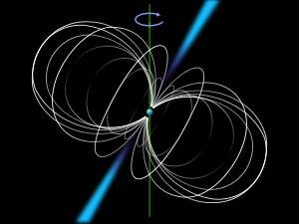
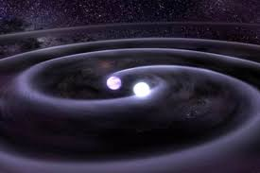
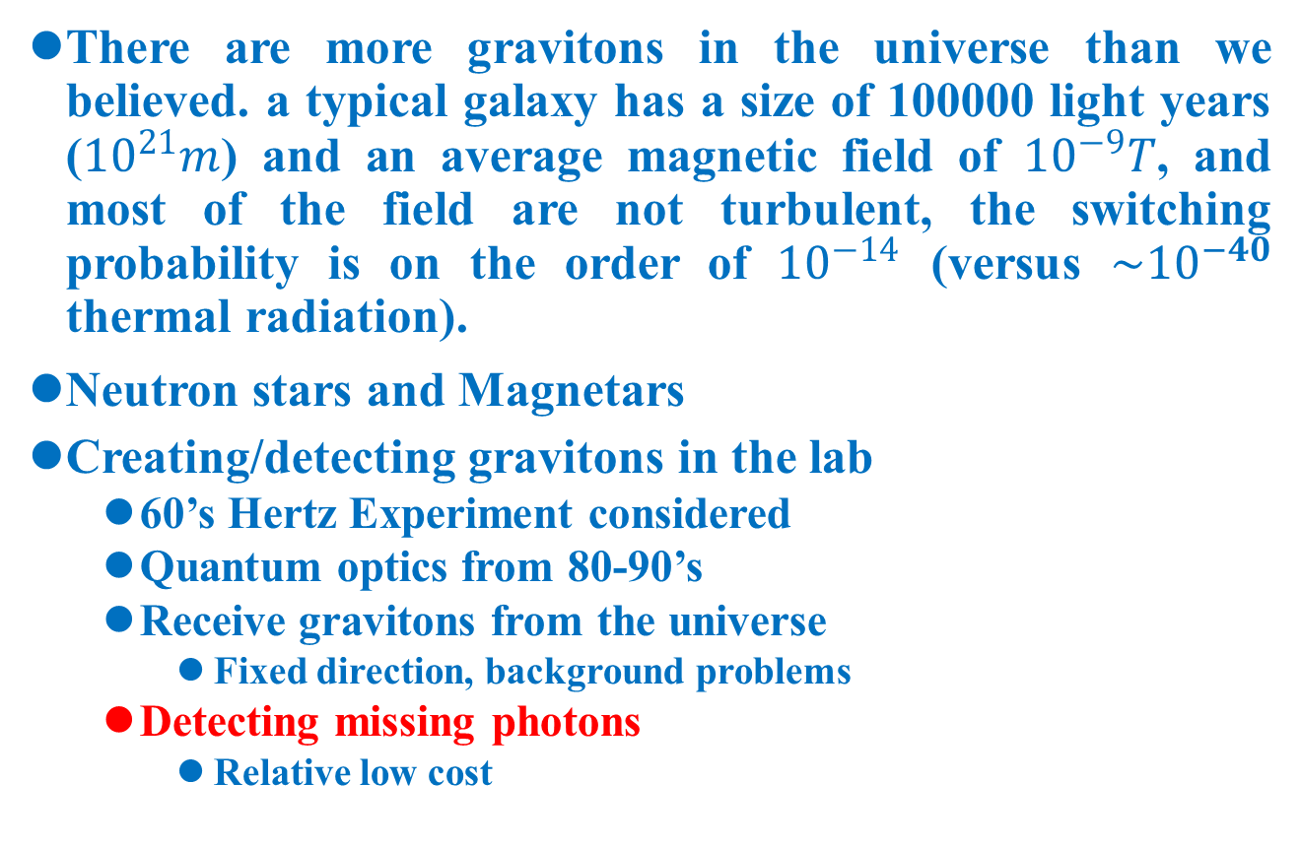
Implications
There are more gravitons in the universe than we believed. a typical galaxy has a size of 100000 light years (${10}^{21}m$) and an average magnetic field of ${10}^{−9}T$, and most of the field are not turbulent, the switching probability is on the order of ${10}^{−14}$ (versus ${\sim 10}^{−40}$ thermal radiation).
Neutron stars and Magnetars
Creating/detecting gravitons in the lab
  60’s Hertz Experiment considered
  Quantum optics from 80-90’s
  Receive gravitons from the universe
    Fixed direction, background problems
  Detecting missing photons
    Relative low cost

Slide 12
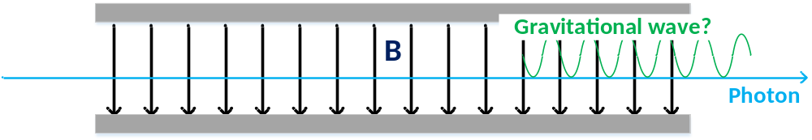
Is Gravitational Field a Quantum Field?
Can gravitational field remain classic while others are quantized?
Blackbody radiation? Weak
From this phenomenon, we know that classical general relativity + Quantum Electro-Magnetism is not consistent
Quantum general relativity is not consistent so far
This is THE experiment that can prove the existence of gravitons!
More convincing than seeing photon from gravitons

Slide 13
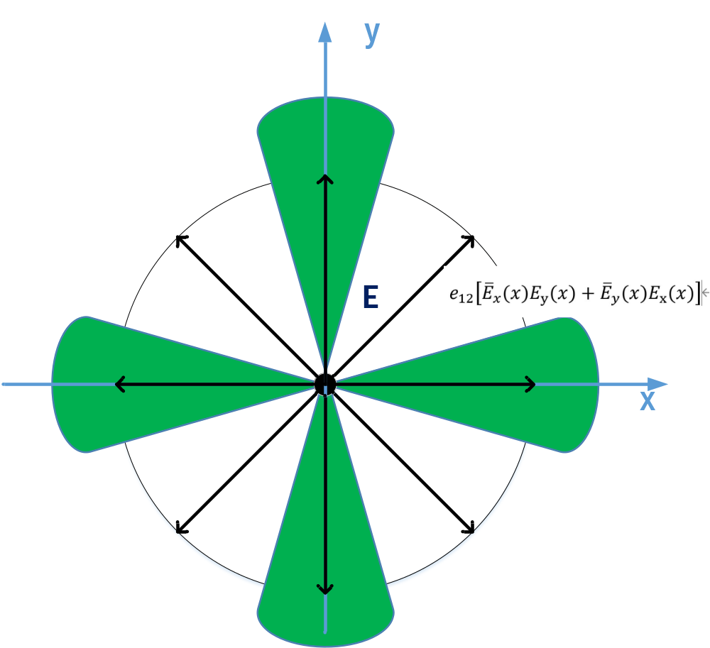
On-going Research
Graviton-Atom interfaction
Crystal
Ordinary matters
Neutrino Experiment

Slide 14
Conclusion
In gravity, experiments lags behind theory for ~100 years
  Newton’s gravitational law – Cavendish experiment
  Einstein general relativity – discovery of gravitational wave
Quantum gravity phenomenology and experiment can make important progress in this century
No need to go to Planck Energy

