Slide 1
Entanglement dynamics between non-inertial Unruh-DeWitt detectors
Hunan Normal University
Jiawei Hu
Peng Huanwu Center for Fundamental Theory
2021.12.10

Slide 2
Outline:
Motivation
Entanglement dynamics for uniformly accelerated Unruh-DeWitt detectors:
A. Coupled with various kinds of quantum fields in vacuum
B. In the presence of a reflecting boundary
C. With environment-induced interaction
Summary

Slide 3
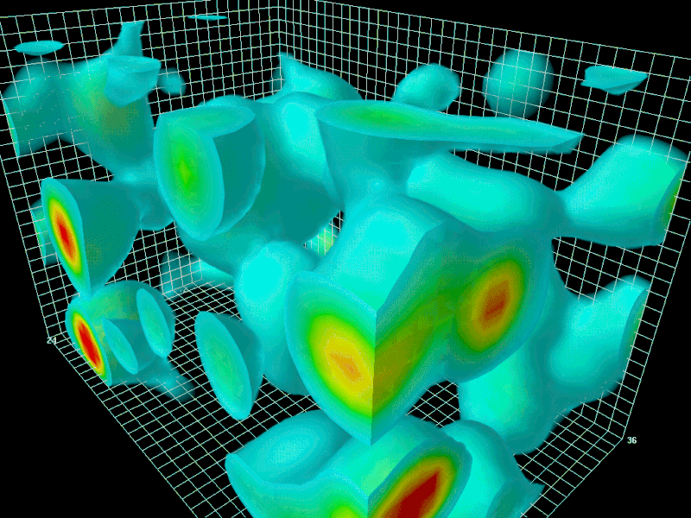
Motivation:
Vacuum fluctuates as necessitated by the uncertainty principle

Slide 4
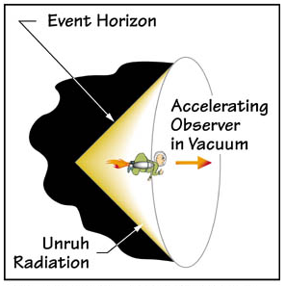
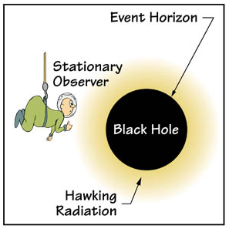
The Unruh effect:
A uniformly accelerated observer perceives the Minkowski vacuum as a thermal bath at a temperature proportional to its proper acceleration
S.A. Fullling, PRD 1973, P.C.W. Davies JPA 1975, G.W. Unruh PRD 1976

Slide 5
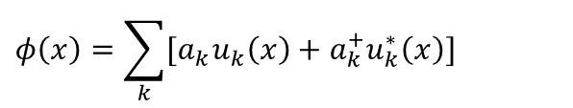
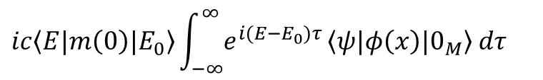
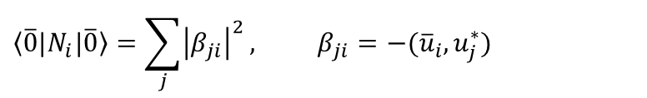
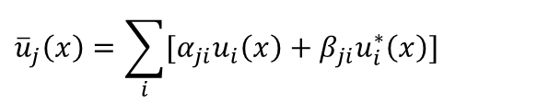
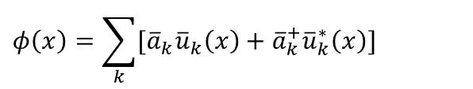
Minkowski spacetime:
$$φ\left(x\right)=\sum_{k}{[{\overline{a}}_{k}{\overline{u}}_{k}\left(x\right)+{\overline{a}}_{k}^{+}{\overline{u}}_{k}^{∗}\left(x\right)]}$$
Bogoliubov transformation
Rindler spacetime:
$$φ\left(x\right)=\sum_{k}{[a_{k}u_{k}\left(x\right)+a_{k}^{+}u_{k}^{∗}\left(x\right)]}$$
Bogoliubov transformation:
Unruh effect
$${\overline{u}}_{j}\left(x\right)=\sum_{i}{[α_{ji}u_{i}\left(x\right)+β_{ji}u_{i}^{∗}\left(x\right)]}$$
$$\left\langle \overline{0}|\right.N_{i}|\left.\overline{0}\right\rangle =\sum_{j}{{\left|β_{ji}\right|}^{2}}, β_{ji}=−({\overline{u}}_{i},u_{j}^{∗})$$
Unruh-DeWitt detector
Transition rate:
$$ic\left\langle E|m\left(0\right)|E_{0}\right\rangle \int_{−∞}^{∞}{e^{i(E−E_{0})τ}}\left\langle ψ|φ\left(x\right)|0_{M}\right\rangle dτ$$

Slide 6
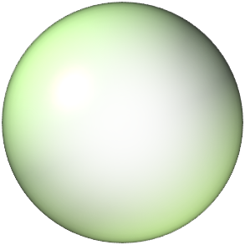




Theory of open quantum system
bath
system
$$HB$$
$$Hs$$
$$HI$$

Slide 7
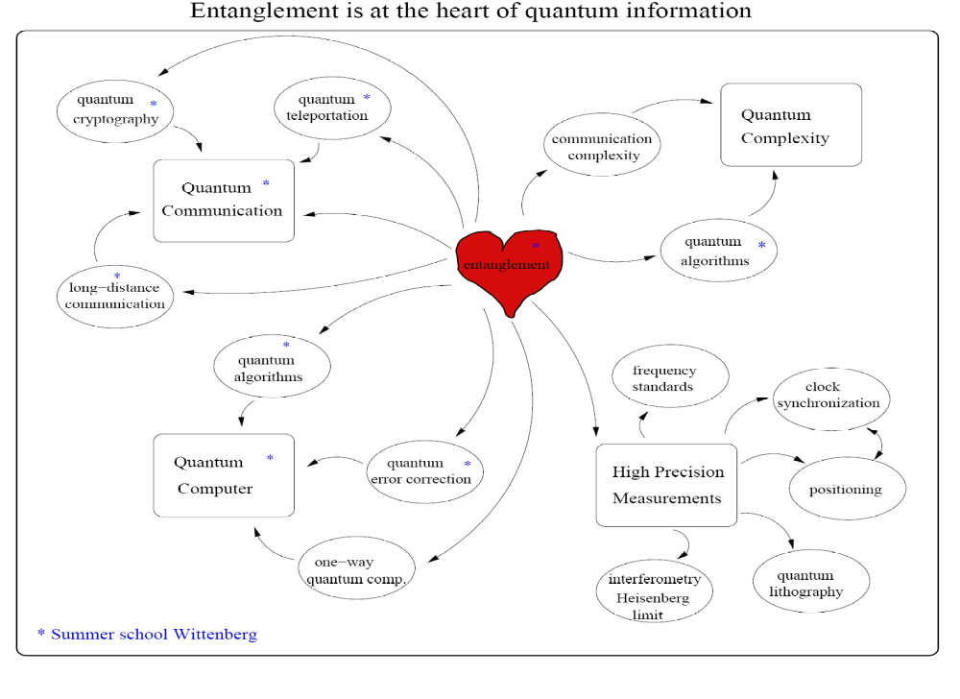

Slide 8
ω
ω
Decoherence, dissipation, disentanglement
Entanglement creation

Slide 9


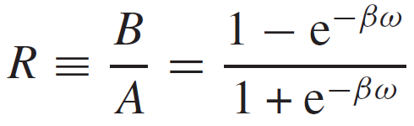
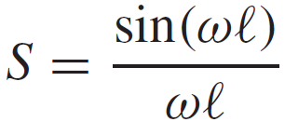
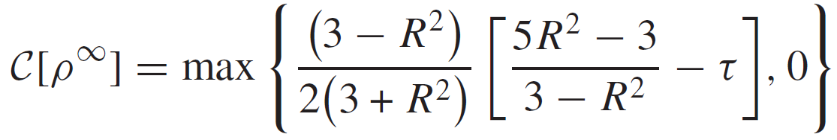
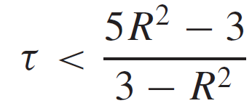


Controlling Entanglement Generation in External Quantum Fields
Initial state:
$t→0$
The criterion:
$t→∞$
F. Benatti, R. Floreanini JOB, 7 (2005) S429

Slide 10
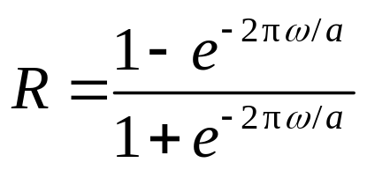

Uniformly accelerated atoms
$t→∞$
F. Benatti, R. Floreanini, PRA 70, 012112 (2004)

Slide 11
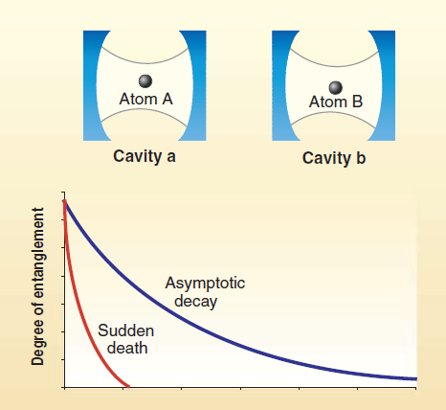
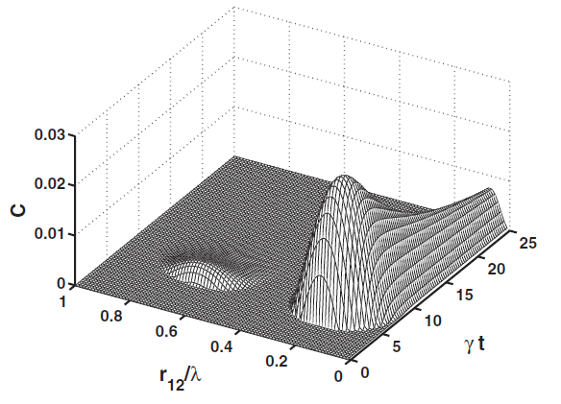
Sudden death and delayed sudden birth of Entanglement
Motivation 1: The whole evolution process of entanglement
T. Yu and J.H. Eberly, PRL (2004); Z. Ficek and R. Tanaś, PRA (2008)

Slide 12
The anti-Unruh effect:
The transition rate may decrease with acceleration
W. G. Brenna, R. B. Mann, Phys. Lett. B 757, 307 (2016)
L. J. Garay, E. Martín-Martínez and J. de Ramón, Phys. Rev. D 94, 104048 (2016)
Within a certain parameter regime, the anti-Unruh effect can be viewed as an amplification mechanism for quantum entanglement
T. Li, B. Zhang, and L. You, Phys. Rev. D 97, 045005 (2018)
Motivation 2: The anti-Unruh effect in terms of entanglement generation

Slide 13




Entanglement dynamics for uniformly accelerated
Unruh-DeWitt detectors
Model A. Uniformly accelerated atoms coupled with fluctuating massless scalar fields in the Minkowski vacuum
Accelerated atoms vs. static ones in a thermal bath
Direction of acceleration
JH and H. Yu, PRA 91, 012327 (2015)

Slide 14



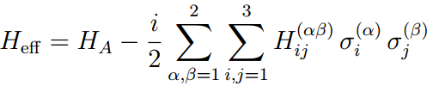
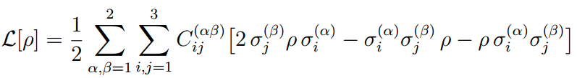

Slide 15
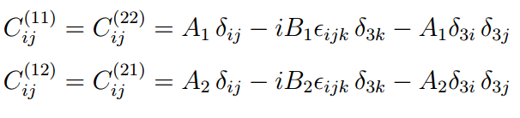
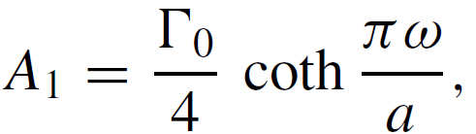
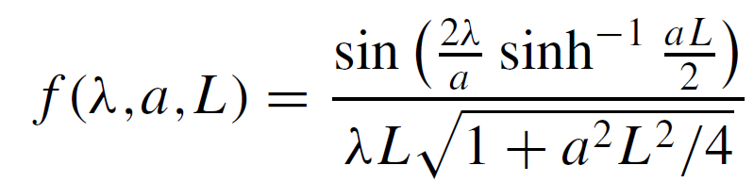
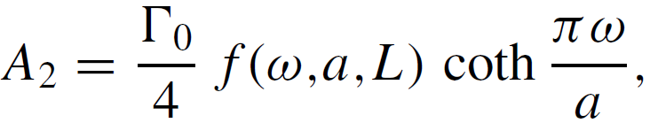
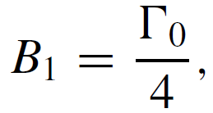
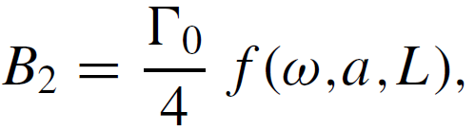

Slide 16

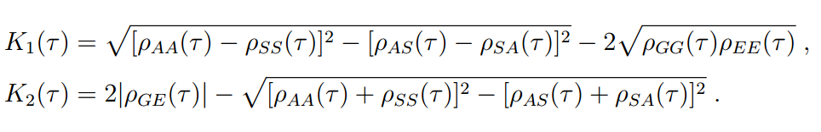
Measure of entanglement: concurrence
Density Matrix: “X” State

Slide 17
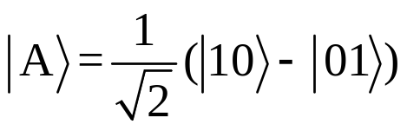
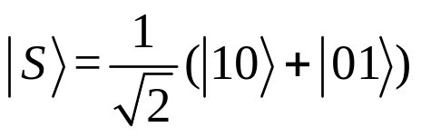
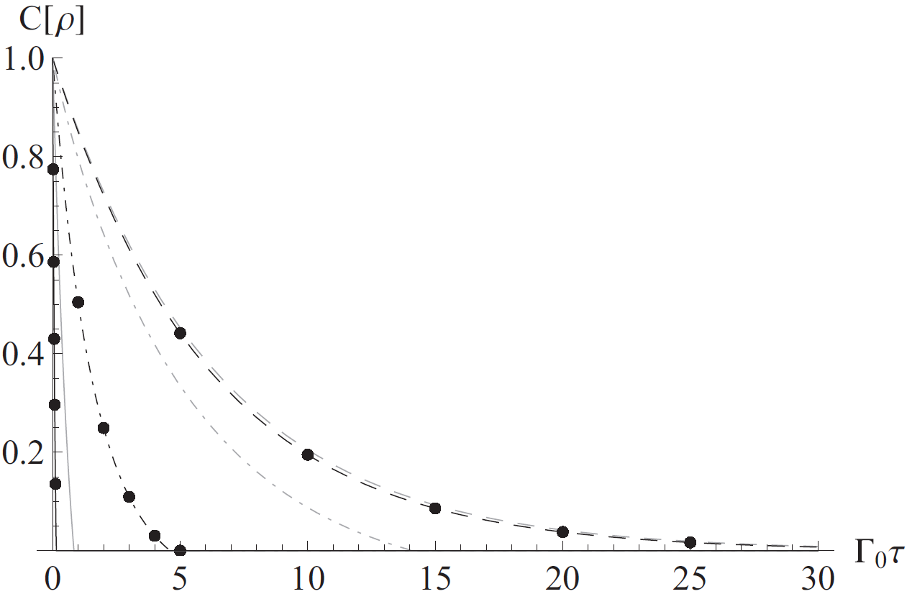
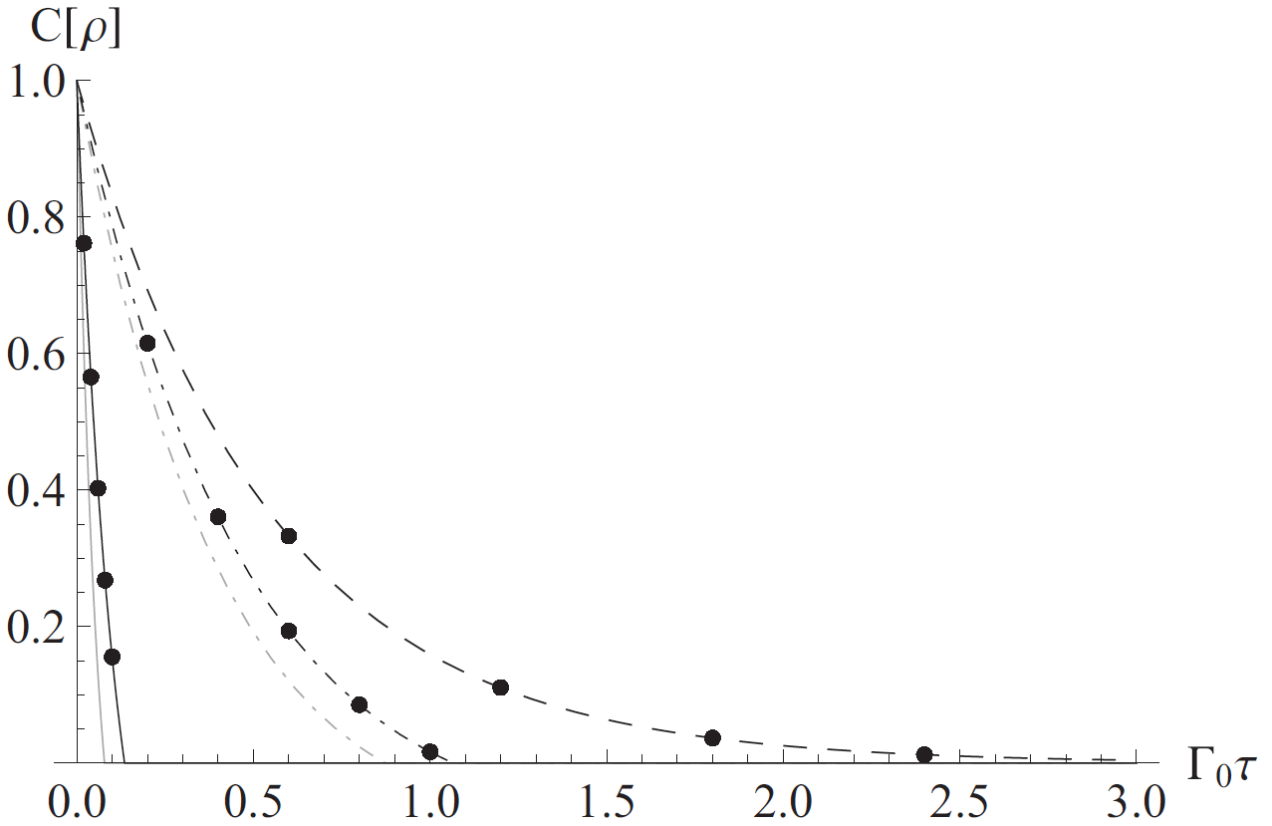
Maximally entangled initial states: entanglement sudden death
dots: accelerated
ωL=1
The dashed, dot-dashed, and solid lines correspond to a/ω = 2/10,a/ω = 2, and a/ω = 20.
Finite-time disentanglement
Acceleration vs temperature
A vs S
Decay rated of entanglement increases with a or T

Slide 18
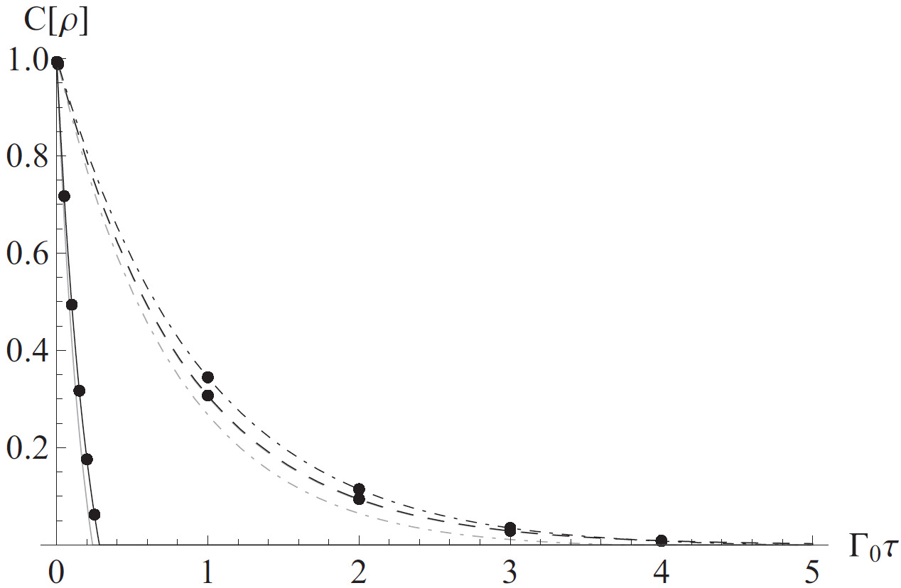
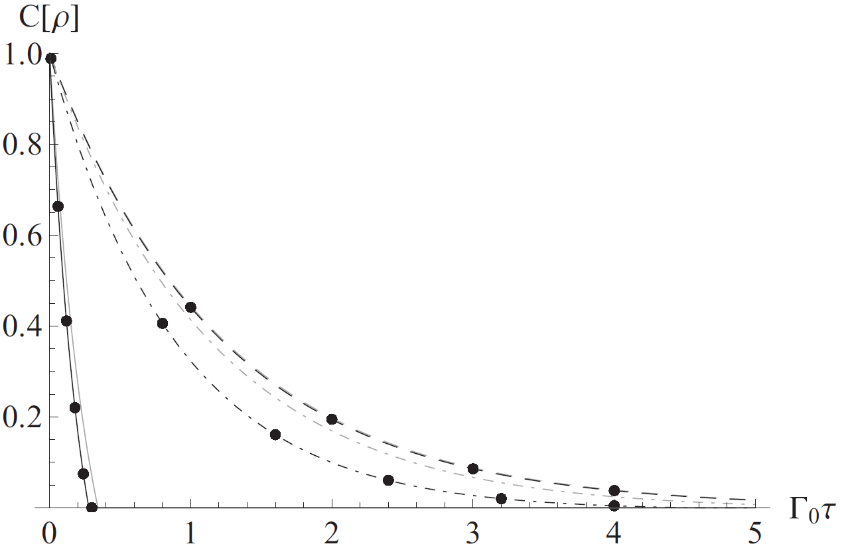
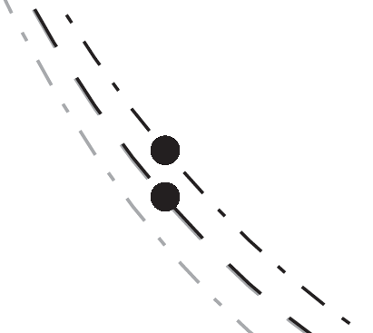
Maximally entangled initial states: entanglement sudden death
dots: accelerated
ωL=4
The dashed, dot-dashed, and solid lines correspond to a/ω = 2/10,a/ω = 2, and a/ω = 20.
Decay rates may not increase with acceleration.
“Anti-Unruh” effect

Slide 19

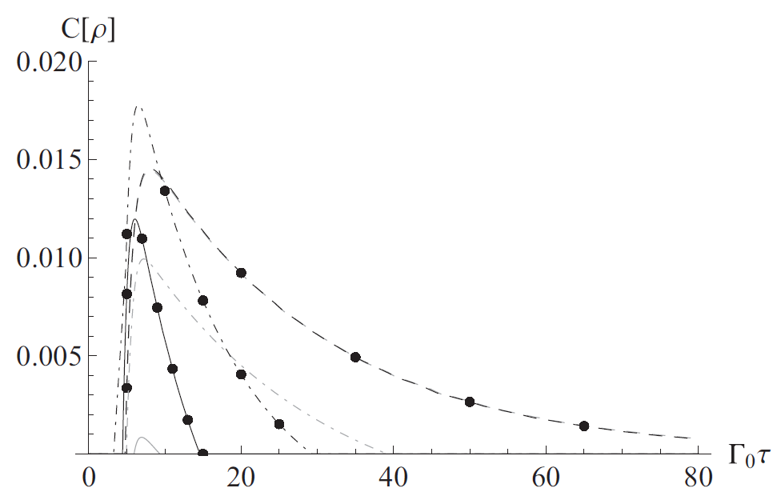
Separable initial states: delayed entanglement generation
ωL=1/2
The dashed, dot-dashed, and solid lines correspond to a/ω = 1/10, a/ω = 1, and a/ω = 6/5.
Delayed birth of entanglement
Acceleration vs temperature

Slide 20
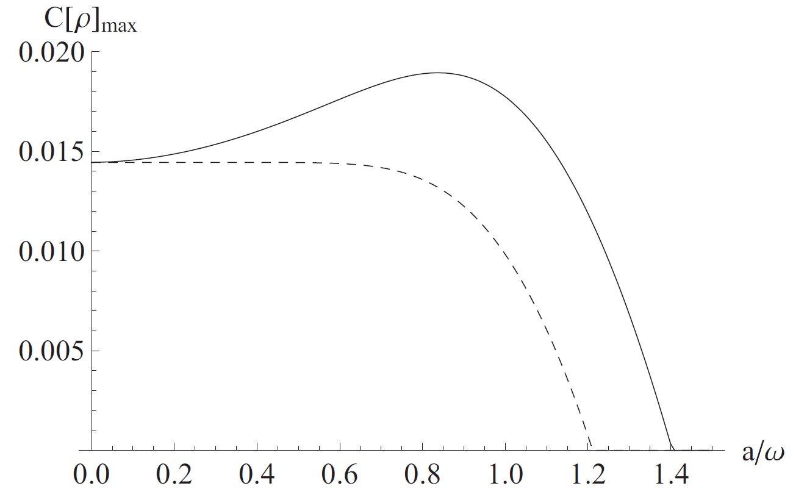
maximum of concurrence during evolution
Solid: accelerate, dashed: thermal, ωL =1/2.
“Anti-Unruh” effect in terms of the entanglement generated

Slide 21
Entanglement dynamics for uniformly accelerated
Unruh-DeWitt detectors
Model B. Uniformly accelerated atoms coupled with fluctuating EM fields in the Minkowski vacuum
Accelerated atoms vs. static ones in a thermal bath
The effect of atomic polarization direction to entanglement evolution
Direction of acceleration
Y. Yang, JH and H. Yu, PRA 94, 032337 (2016)

Slide 22

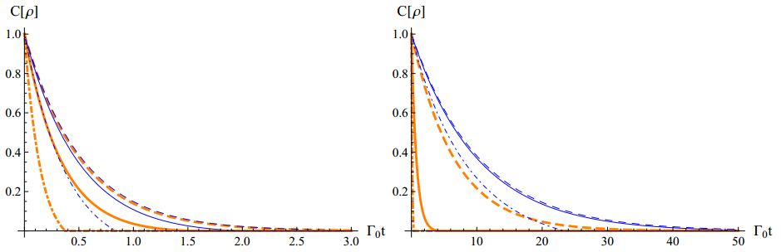



Maximally entangled initial states: entanglement sudden death
Polarization directions: ZZ
Accelerated
Thermal bath

Slide 23
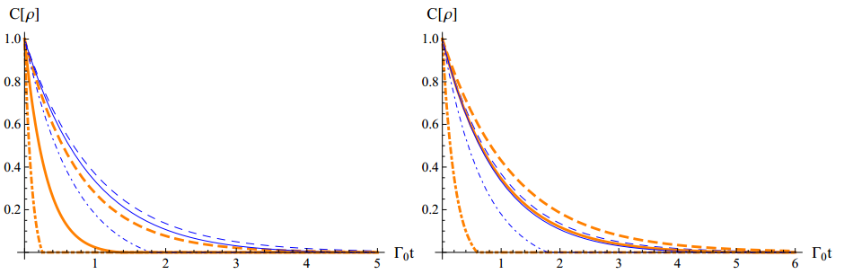
Maximally entangled initial states: entanglement sudden death
Polarization directions: ZX
Accelerated
Thermal bath

Slide 24
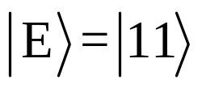

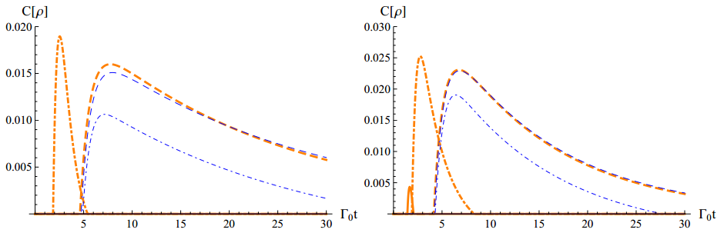



Separable initial states: delayed entanglement generation
Initial state:
Accelerated
Polarization directions: ZZ
Polarization directions: YY
Thermal bath

Slide 25

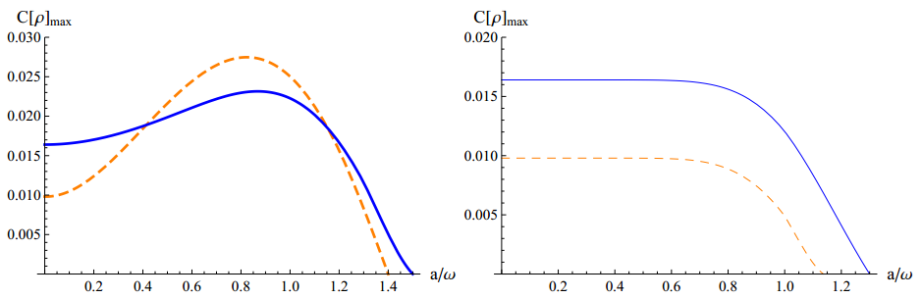
The maximal concurrence generated during evolution
Initial state:
Polarization directions: YY
Polarization directions: ZZ
Accelerated
Thermal bath
“Anti-Unruh” effect in terms of the entanglement generated

Slide 26
Entanglement dynamics for uniformly accelerated
Unruh-DeWitt detectors
Model C. Uniformly accelerated atoms coupled with fluctuating massive scalar fields in the Minkowski vacuum
Accelerated atoms vs. static ones in a thermal bath
The effect of the mass of the field
Direction of acceleration
Y. Zhou, JH, and H. Yu, JHEP 09 (2021) 088

Slide 27
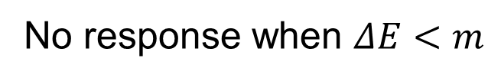
The response of a single detector coupled with a massive scalar field
Inertial case:
fluctuating scalar fields
No response when $ΔE<m$
E₂
atom
Selection rules
E₁
Accelerated case:
Transitions still happen when $ΔE<m.$ No selection rules
Y. Zhou, H. Yu and Z. Zhu, Comm. Theo. Phys. 57, 3 (2012).

Slide 28
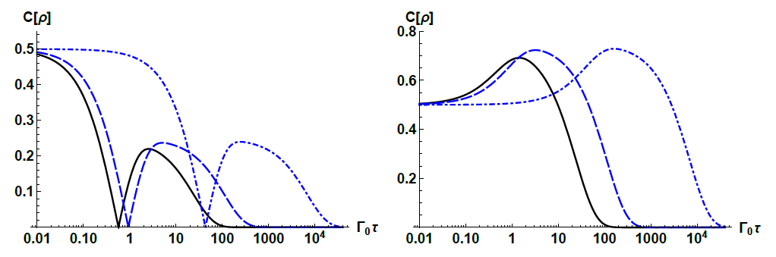



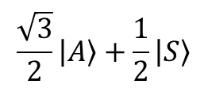
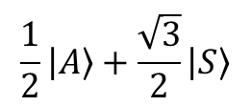

The time-delay effect
A. The mass effects
$$m/ω=0$$
$$m/ω=0.8$$
$$m/ω=1.2$$
$$\frac{1}{2}|A〉+\frac{\sqrt{3}}{2}|S〉$$
$$\frac{\sqrt{3}}{2}|A〉+\frac{1}{2}|S〉$$
$Lω=0.5, a/ω=0.1$
Notes:
Compared with the massless case, the entanglement evolution in the massive case is generally slower

Slide 29
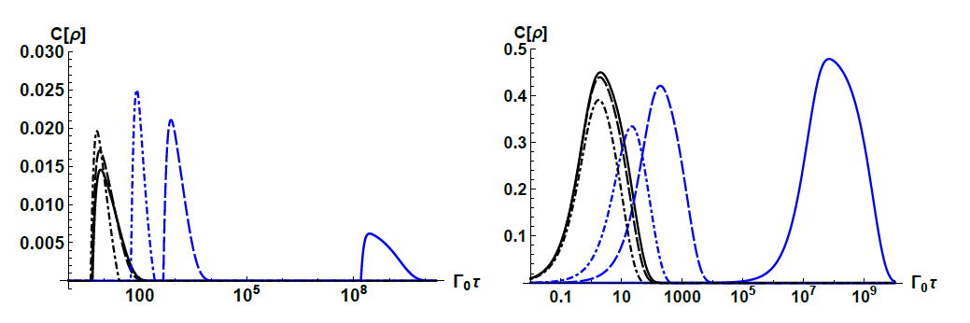








The time-delay effect
B. The acceleration effects
$$a/ω=0.1$$
$$a/ω=0.5$$
$$a/ω=1.0$$
$$m/ω=2$$
$$m/ω=0$$
$$|11〉$$
$$|10〉$$
$Lω=0.5, m/ω=2$
Notes:
That is, the time-delay effect brought about by field being massive can be counteracted by a large enough acceleration.
This is in sharp contrast to the case of a static quantum system in a thermal bath, where this time delay brought about by the field being massive is not affected by the temperature.

Slide 30
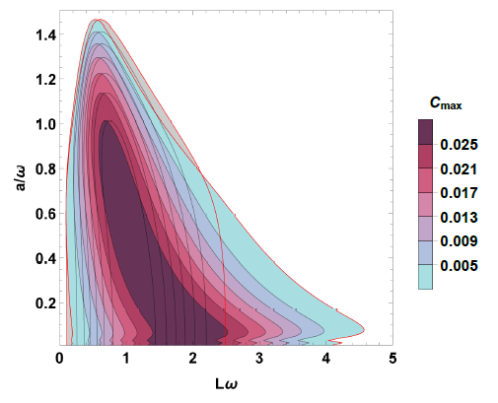
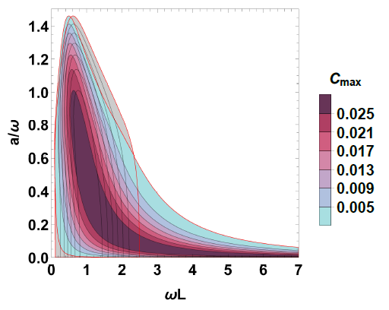


The entanglement generation effect
A. The mass effects
$$m/ω=0.8$$
$$m/ω=1.2$$
Notes:
Compared with the massless case, the region of separation \omega L within which entanglement can be created is expanded when
the acceleration a is smaller than a critical value determined by the field mass, and is compressed when a is larger than the critical value.

Slide 31
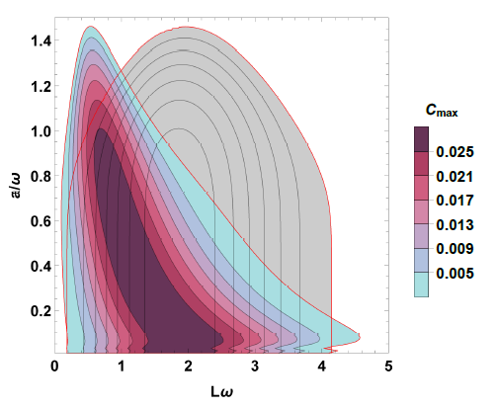
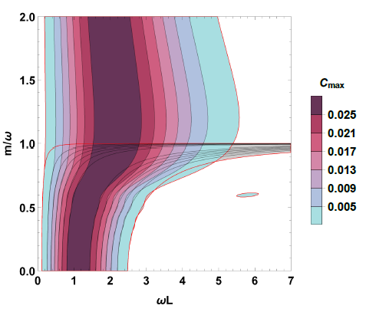

The entanglement generation effect
B. The acceleration effects
$$m/ω=0.8$$
$$a/ω=0.1$$

Slide 32
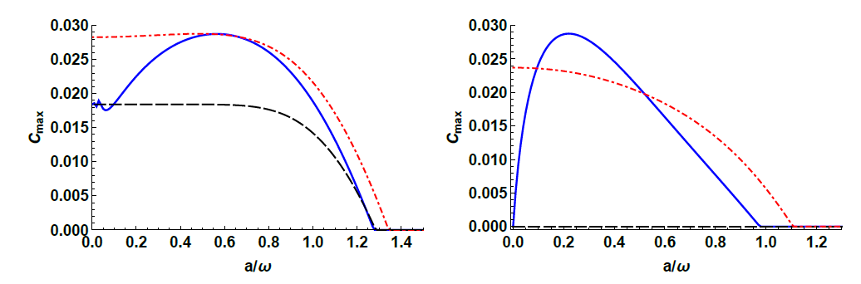


The anti-Unruh effect
$m/ω=0.8$, $ωL=1.0$
$m/ω=1.2$, $ωL=1.$5

Slide 33
Entanglement dynamics for uniformly accelerated
Unruh-DeWitt detectors
Model D. Uniformly accelerated atoms coupled with vacuum EM fields with a boundary
Two atoms are aligned parallel to or vertically to a reflecting boundary
Boundary effect, acceleration effect, polarization effect
The atoms are accelerating along the x direction
S. Cheng, H. Yu, JH, PRD 98 025001 (2018)

Slide 34






Maximally entangled initial states
Initial state:
free
Parallel case
Vertical case
For the parallel case, the initial entanglement of two transversely polarizable atoms very close to the boundary can be preserved as if it were a closed system.
For the vertical case, entanglement revival is possible for two atoms initially in $|S〉$, while the concurrence always decays monotonically in the free space.

Slide 35



Separable initial states
Initial state:
free
Parallel case
Vertical case
The birth time of entanglement can be noticeably advanced or postponed for the parallel two atom system placed close to the boundary.
The maximal concurrence during evolution can be significantly enhanced when the atoms are vertically aligned.

Slide 36

Separable initial states
Initial state:
boundary
free
Parallel case
Vertical case
Two initially separable atoms, for which entanglement generation can never happen in the free space, can get entangled in the presence of a boundary if they are aligned parallel to the boundary.
The maximal concurrence during evolution can be significantly enhanced when the atoms are vertically aligned.

Slide 37
Entanglement dynamics for uniformly accelerated
Unruh-DeWitt detectors
Model E. Uniformly accelerated atoms coupled with fluctuating massless scalar fields in the Minkowski vacuum
The effects of Environment-Induced Interatomic Interaction (EIII) are considered
Direction of acceleration
Y. Chen, JH, H. Yu, arXiv: 2110.01780

Slide 38









Ground state
Entangled state
L
L
$$|g〉$$
$$|g〉$$
$$|±〉$$
$$L^{−6}, L≪λ$$
$$L^{−3}, L≪λ$$
$$δE\left(L\right)\sim$$
$$δE\left(L\right)\sim$$
$$L^{−7}, L≫λ$$
$$L^{−1}, L≫λ$$
Monotonically
Oscillatory

Slide 39

Master equation:

Slide 40

Entanglement generation
Initial state: $|10〉$
A: without EIII
A + B: with EIII

Slide 41






The rate of entanglement generation
$$ωL=0.3$$
$$ωL=3.0$$
$$ωL=30$$
$$\text{with} \text{EIII}$$
$$\text{without} \text{EIII}$$

Slide 42

The maximum of concurrence during evolution
$$ωL=0.3$$
$$ωL=3.0$$
$$ωL=30$$
The anti-Unruh effect is lost
$$\text{with} \text{EIII}$$
$$\text{without} \text{EIII}$$

Slide 43
Summary
We have studied the entanglement dynamics for uniformly accelerated atoms coupled with fluctuating quantum fields in the Minkowski vacuum in various occasions.
The entanglement dynamics for uniformly accelerated atoms would generally be different from the static ones immersed in a thermal bath at the Unruh temperature.
In certain occasions, there exists anti-Unruh effect in terms of the entanglement generated.
The environment-induced interatomic interaction may assist entanglement generation, and the anti-Unruh effect may disappear when the environment-induced interatomic interaction is considered.

Slide 44
Thanks！

