Slide 1

On the importance of heavy fields in pseudo-scalar inflation
Siyi Zhou
Based on following works
Chong-Bin Chen, Ziwei Wang, SZ 2308.15872
Aditya Varna Iyer, Shi Pi, Yi Wang, Ziwei Wang, SZ 1710.03054
Xi Tong, Yi Wang, SZ 1708.01709
and ongoing work with Shiyun Lu

Slide 2
Outline
Introduction to Cosmological Collider Physics
Partial Effective Field Theory and Strongly Coupled Regime
Aditya Varna Iyer, Shi Pi, Yi Wang, Ziwei Wang, Siyi Zhou
1710.03054
Xi Tong, Yi Wang, Siyi Zhou 1708.01709
On the Importance of Heavy Fields in Pseudo-scalar Inflation
Chong-Bin Chen, Ziwei Wang, Siyi Zhou 2308.15872
Conclusion and Outlook

Slide 3
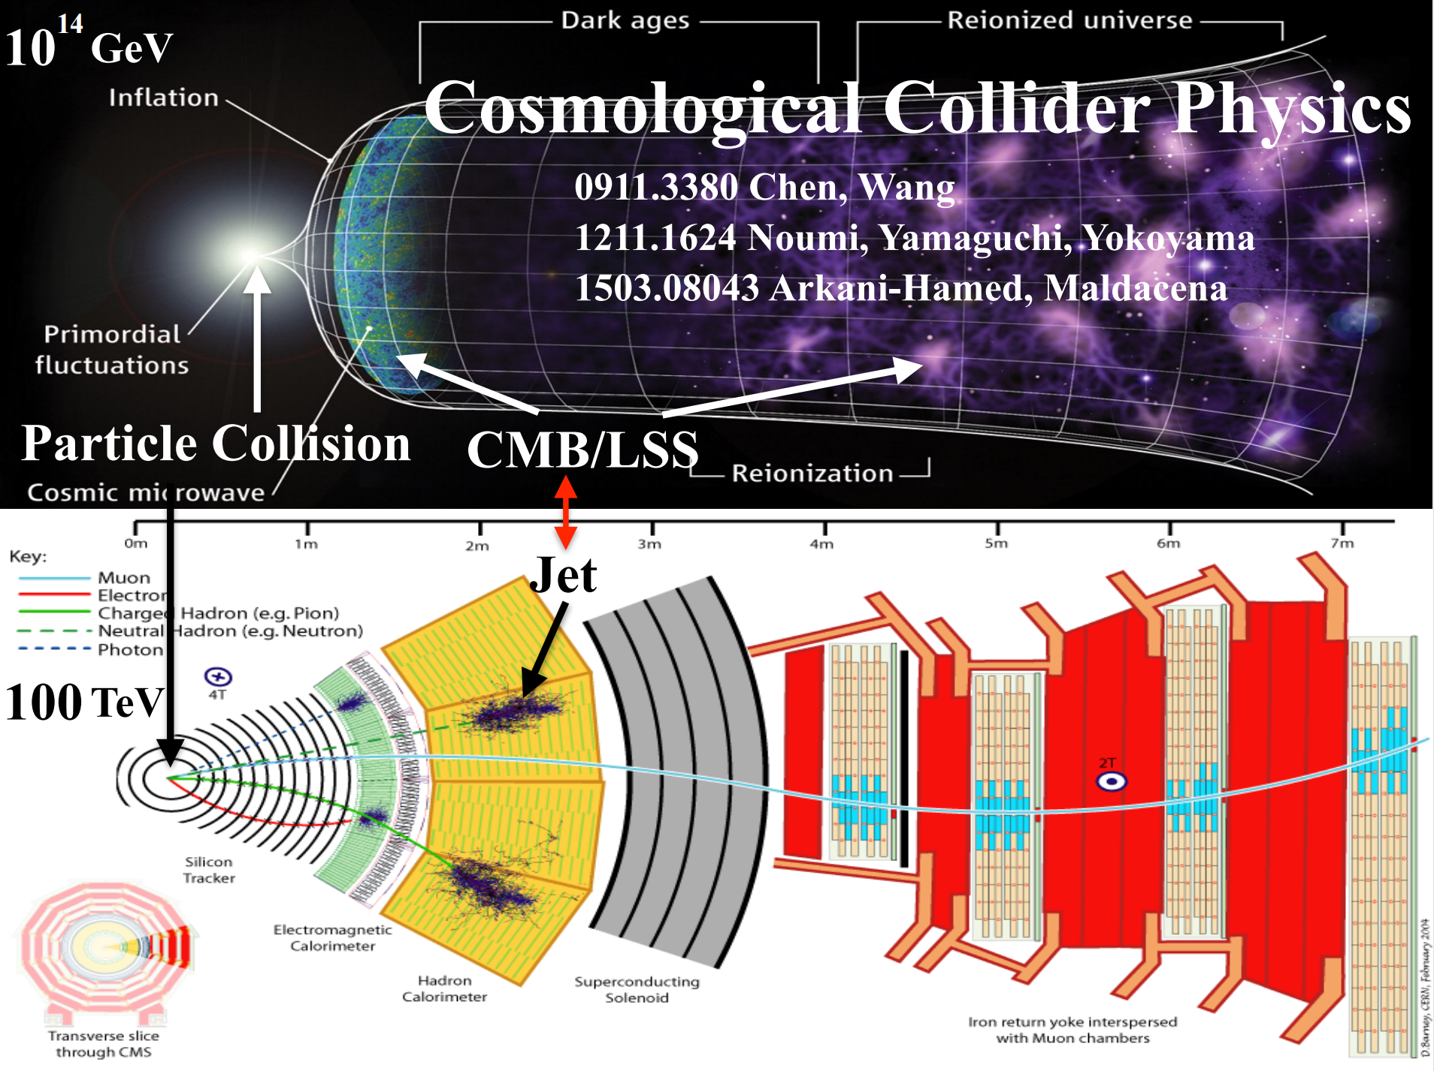

Slide 4
Unsolved Problems in High Energy Physics
the nature of dark matter and dark energy
the stability of the Higgs boson
the origin of neutrino masses
strong CP problem
the physics of inflation
the origin of matter-antimatter asymmetry
The solution of these problems may involve new heavy particles

Slide 5
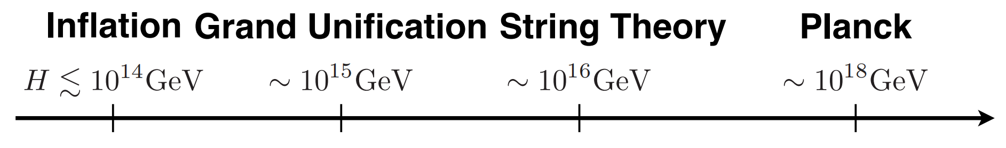
Energy Scale of New Physics
These new particles are too heavy to be produced at LHC~10⁴ GeV
During inflation, very massive fields can be created by the rapid expansion of the spacetime
It is natural to use inflation as a particle collider to explore the physics of new heavy particles

Slide 6
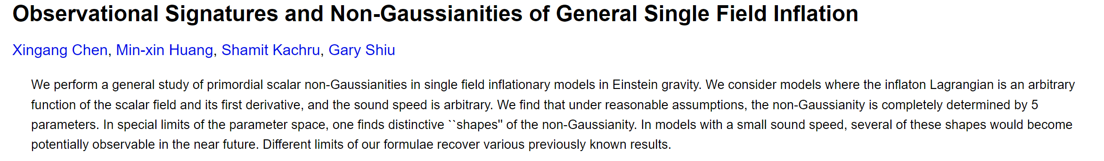
General Single Field Inflation
Xingang Chen, Min-xin Huang, Shamit Kachru, Gary Shiu 0605045
Most people believe that inflation is driven by a massless field called inflaton
This paper talks about the most general single field inflation and its non-Gaussianities

Slide 7
General Single Field Inflation
Xingang Chen, Min-xin Huang, Shamit Kachru, Gary Shiu 0605045
Abstract
We perform a general study of primordial scalar non-Gaussianities in single field inflationary models in Einstein gravity
We consider models where the inflaton Lagrangian is an arbitrary function of the scalar field and its first derivative, and the sound speed is arbitrary

Slide 8
General Single Field Inflation
Xingang Chen, Min-xin Huang, Shamit Kachru, Gary Shiu 0605045
We find that under reasonable assumptions, the non-Gaussianity is completely determined by 5 parameters
In special limits of the parameter space, one finds distinctive ``shapes'' of the non-Gaussianity
In models with a small sound speed, several of these shapes would become potentially observable in the near future
Different limits of our formulae recover various previously known results

Slide 9
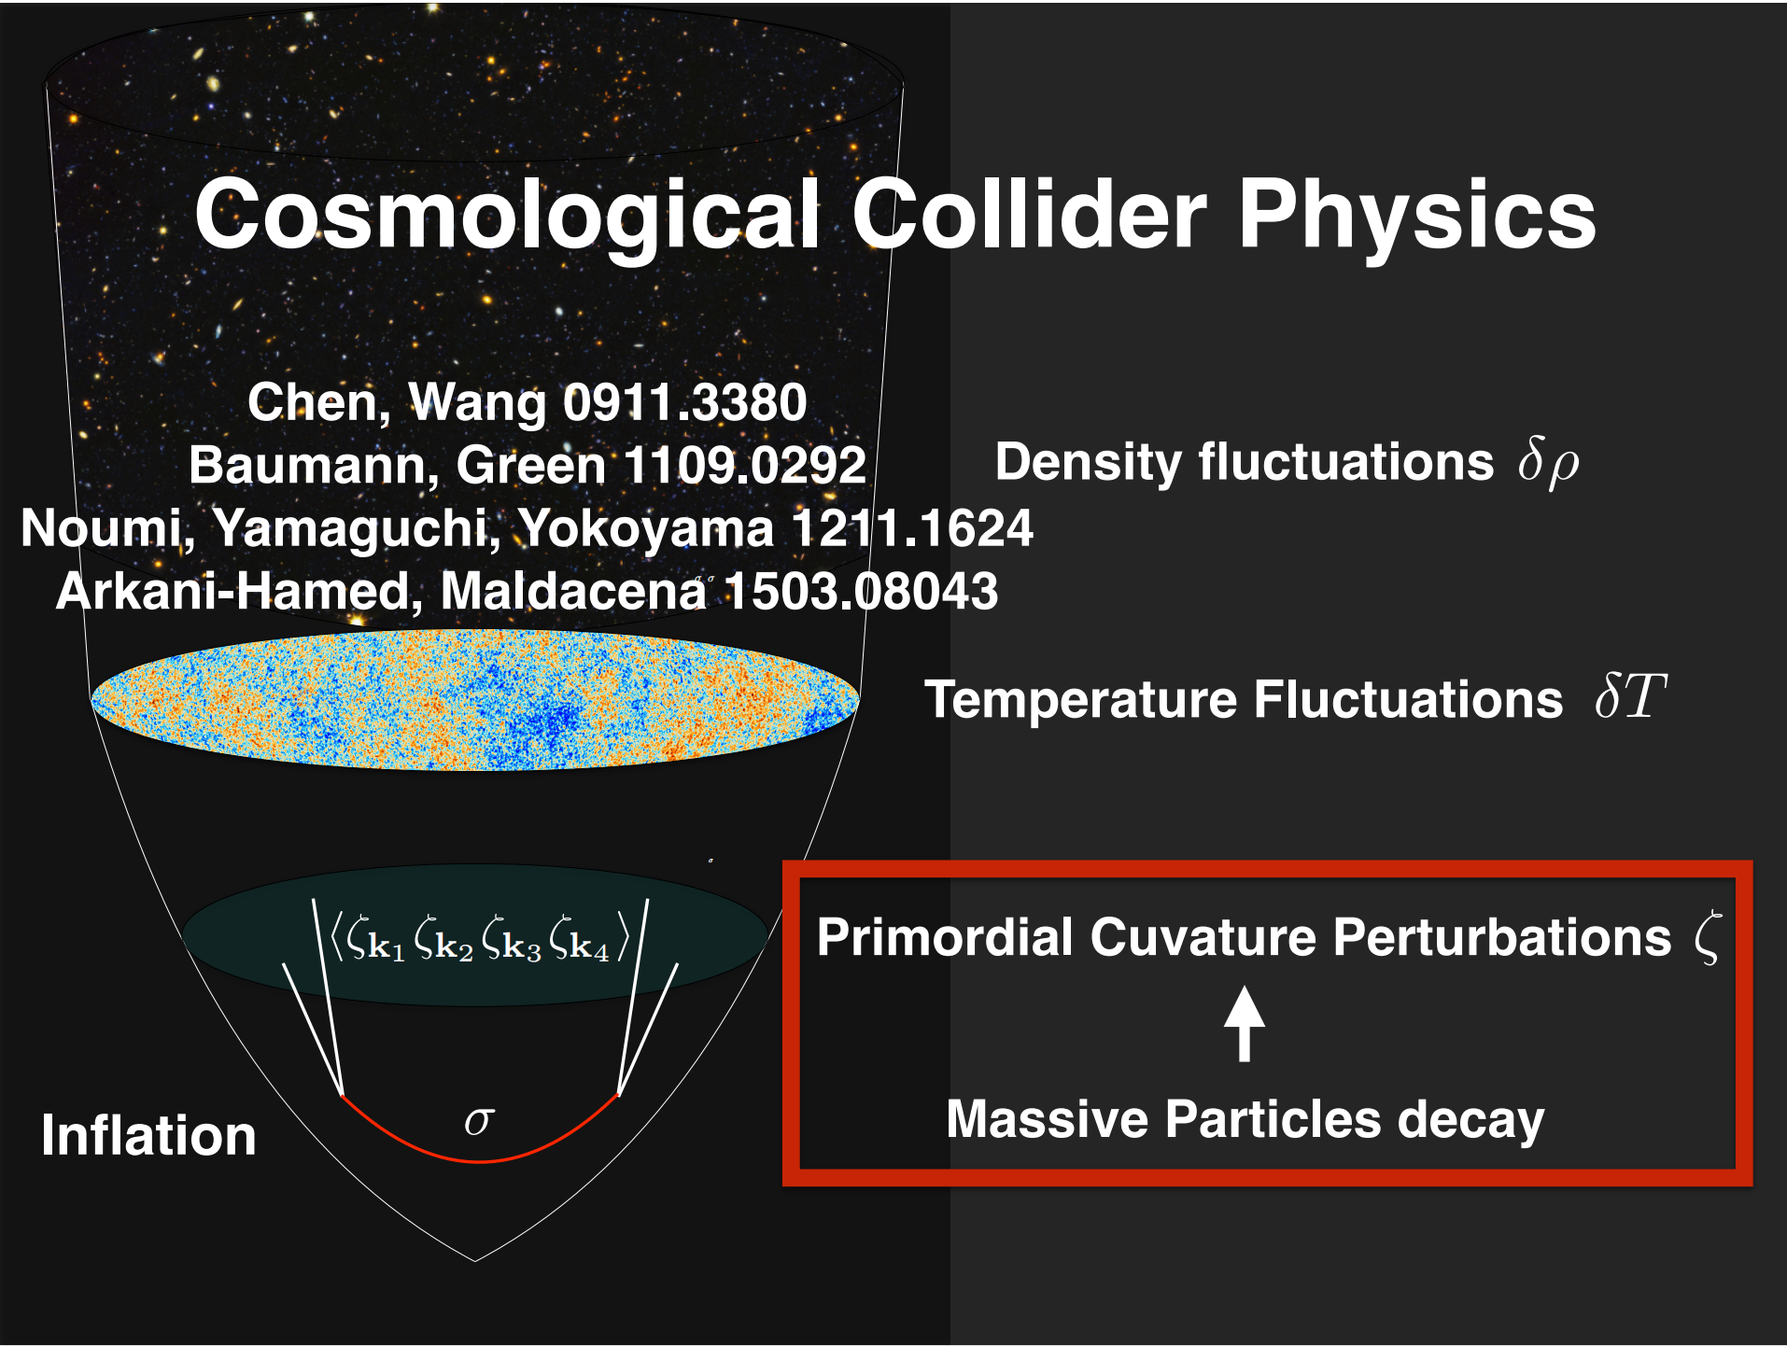

Slide 10
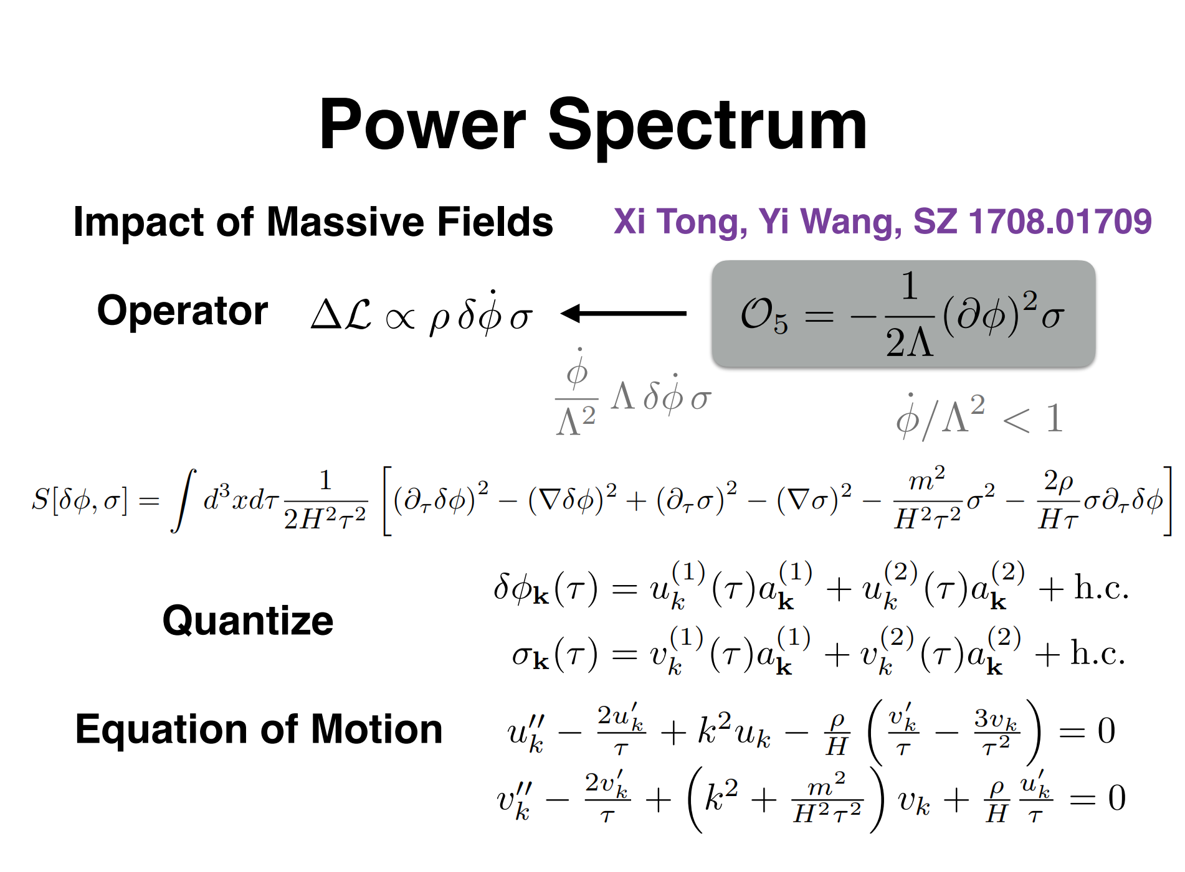

Slide 11
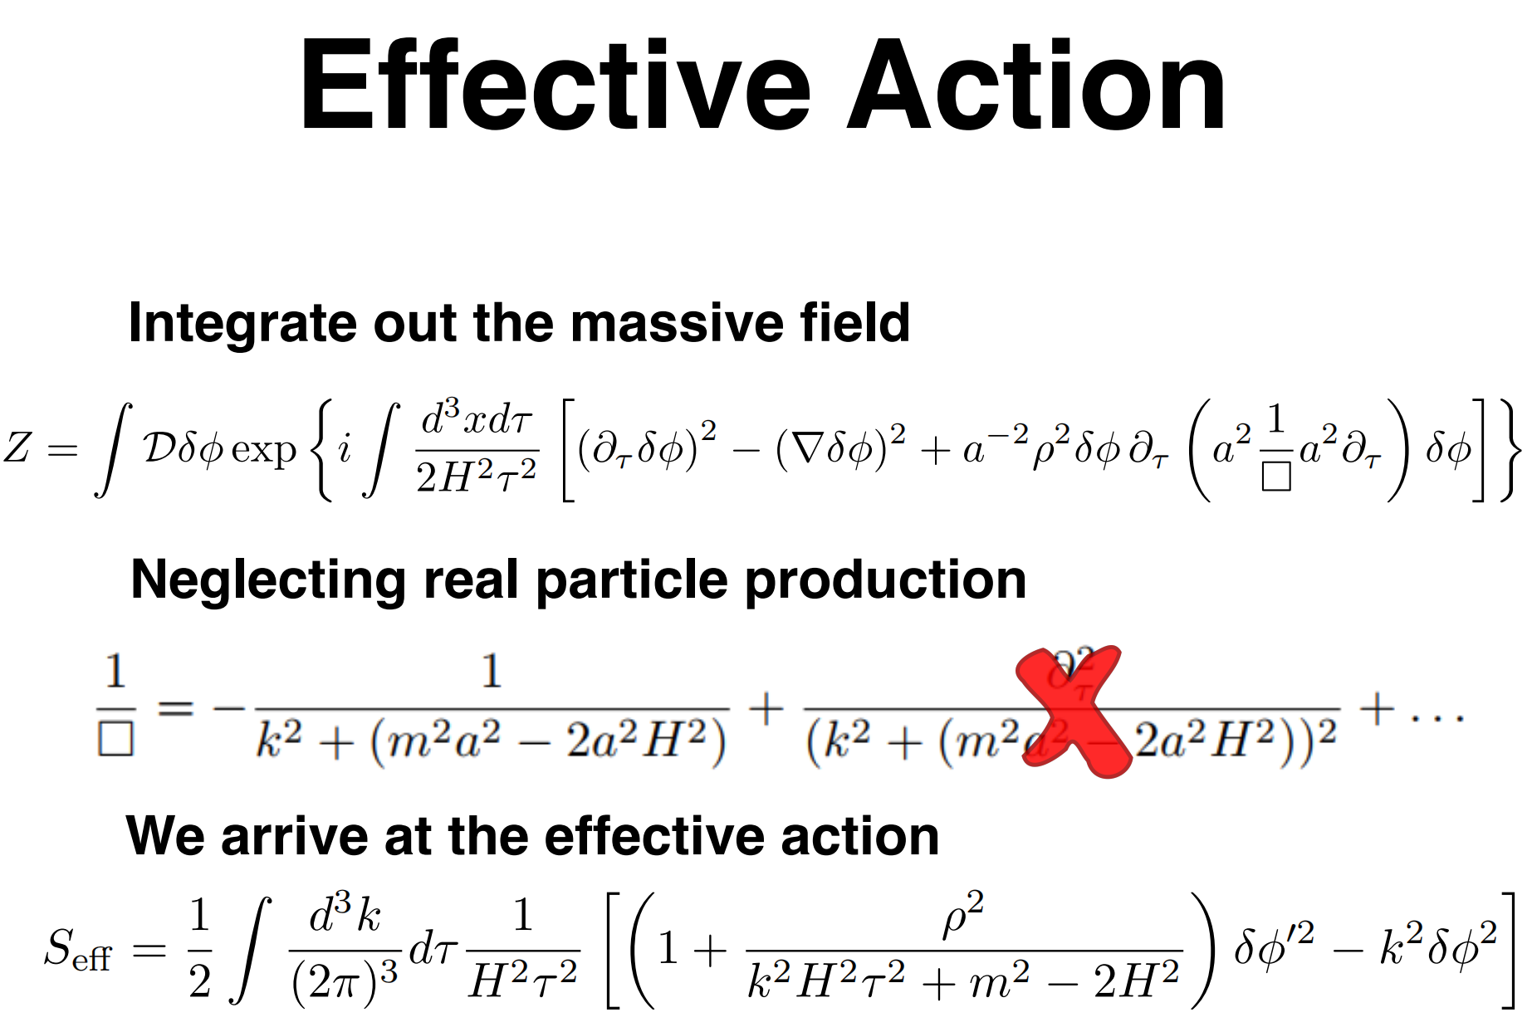

Slide 12
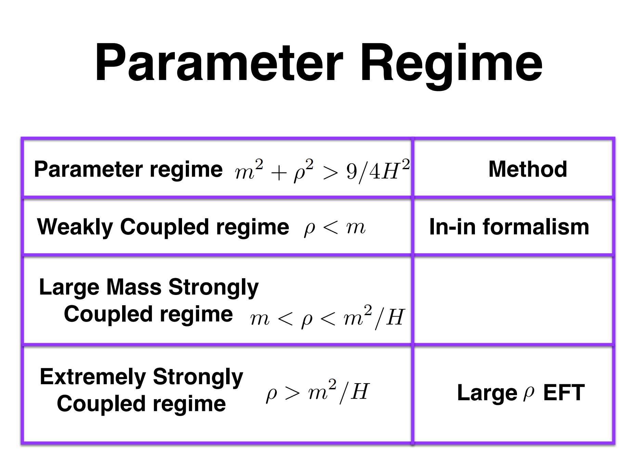

Slide 13
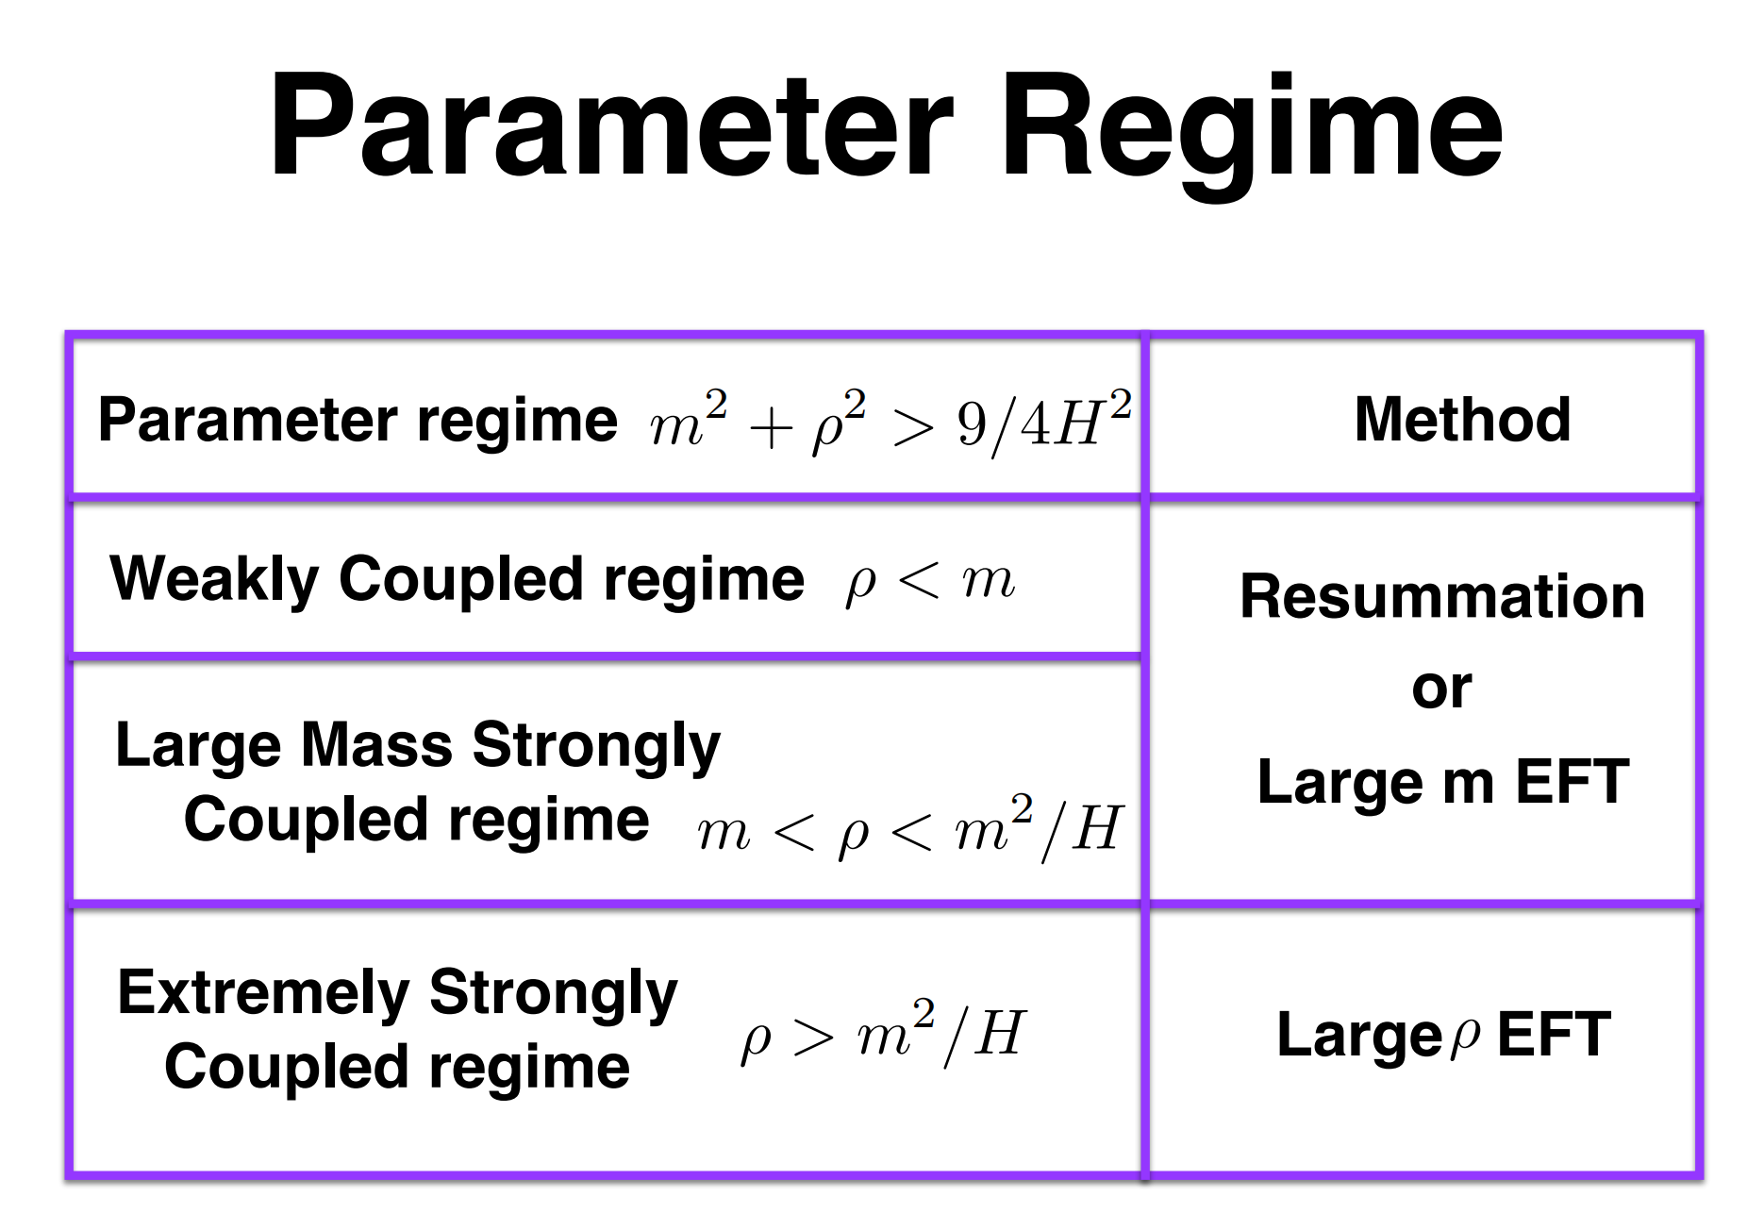

Slide 14
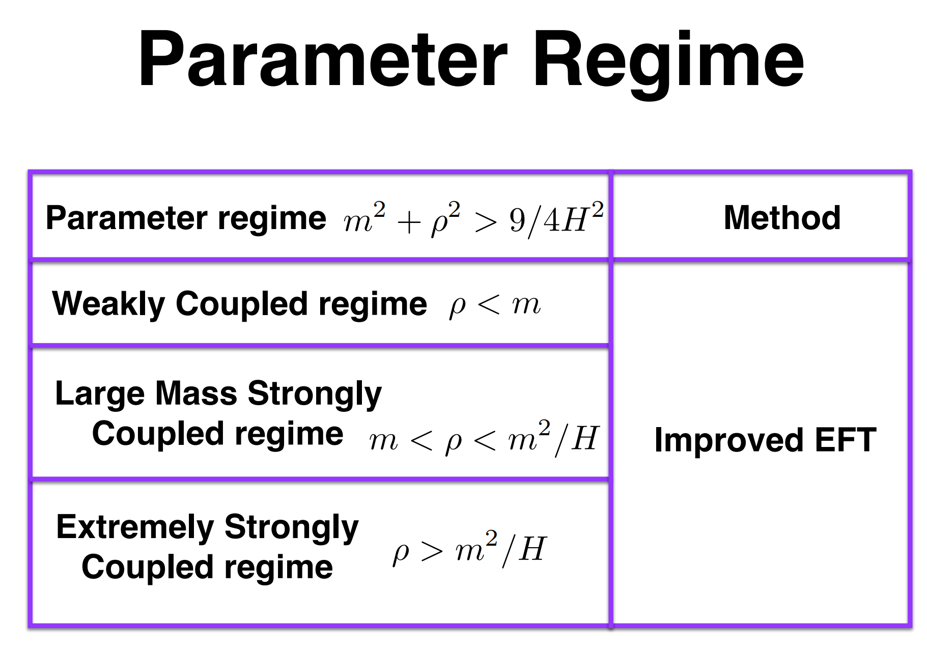

Slide 15
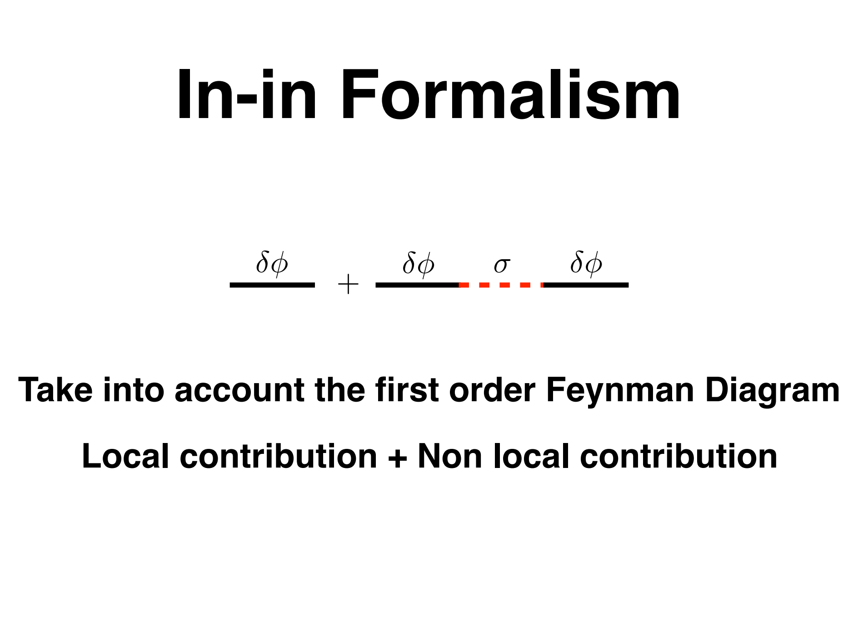

Slide 16
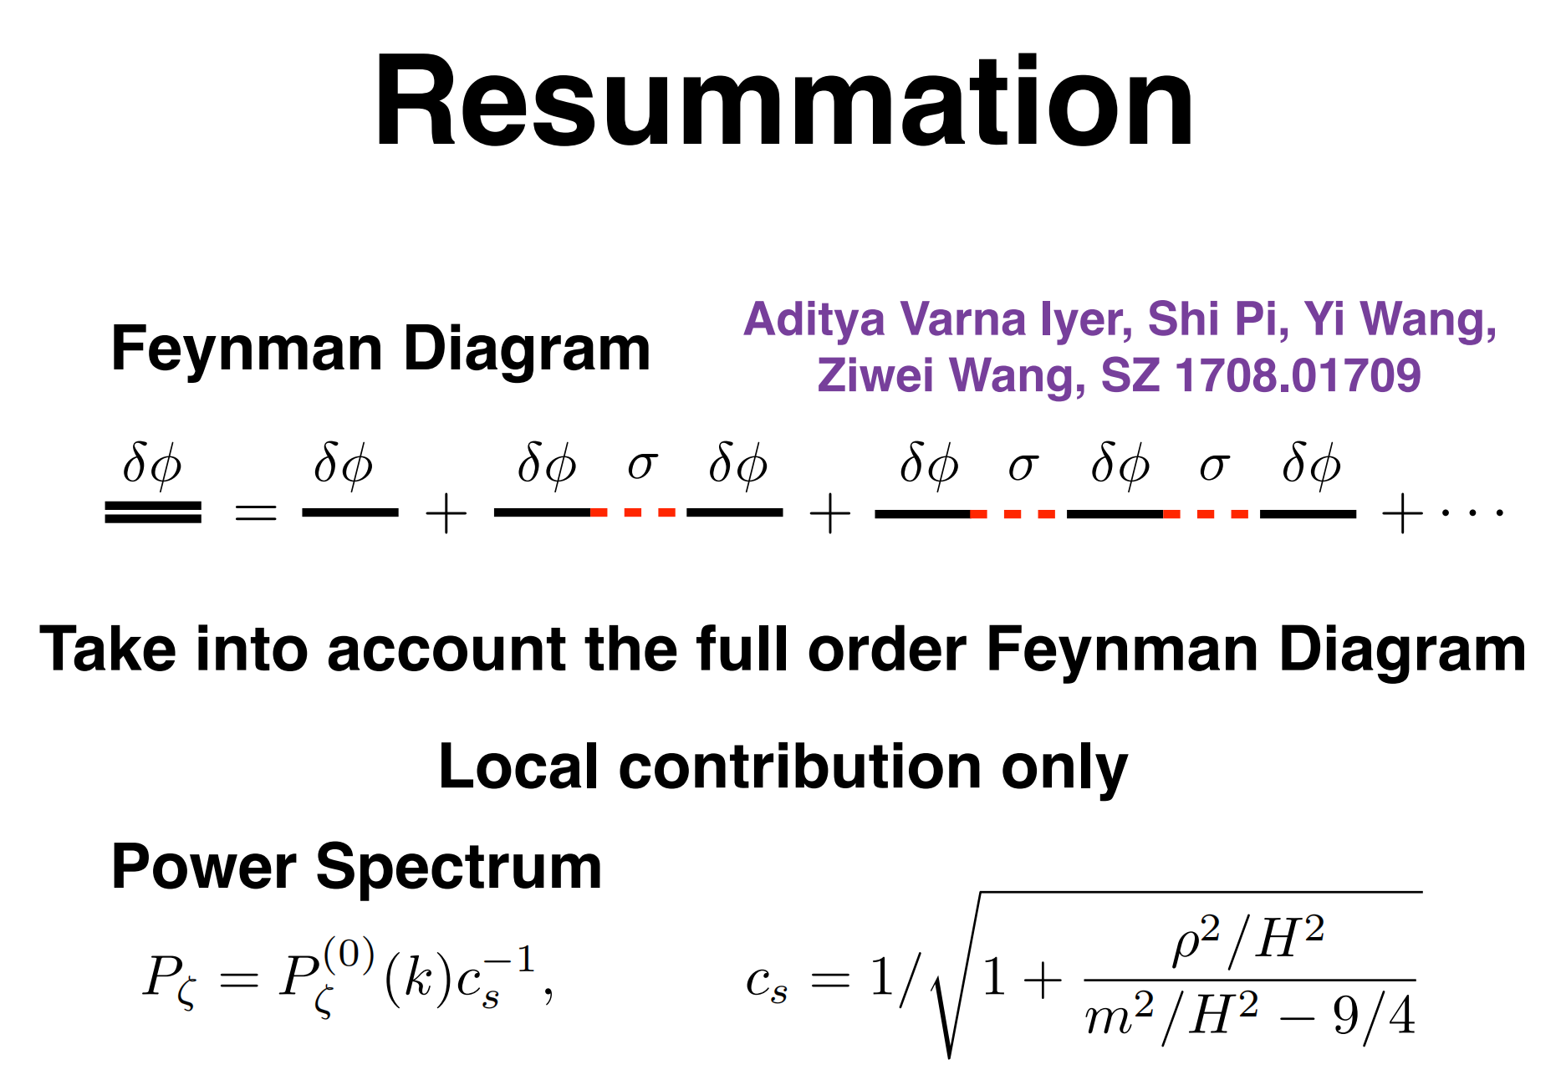

Slide 17

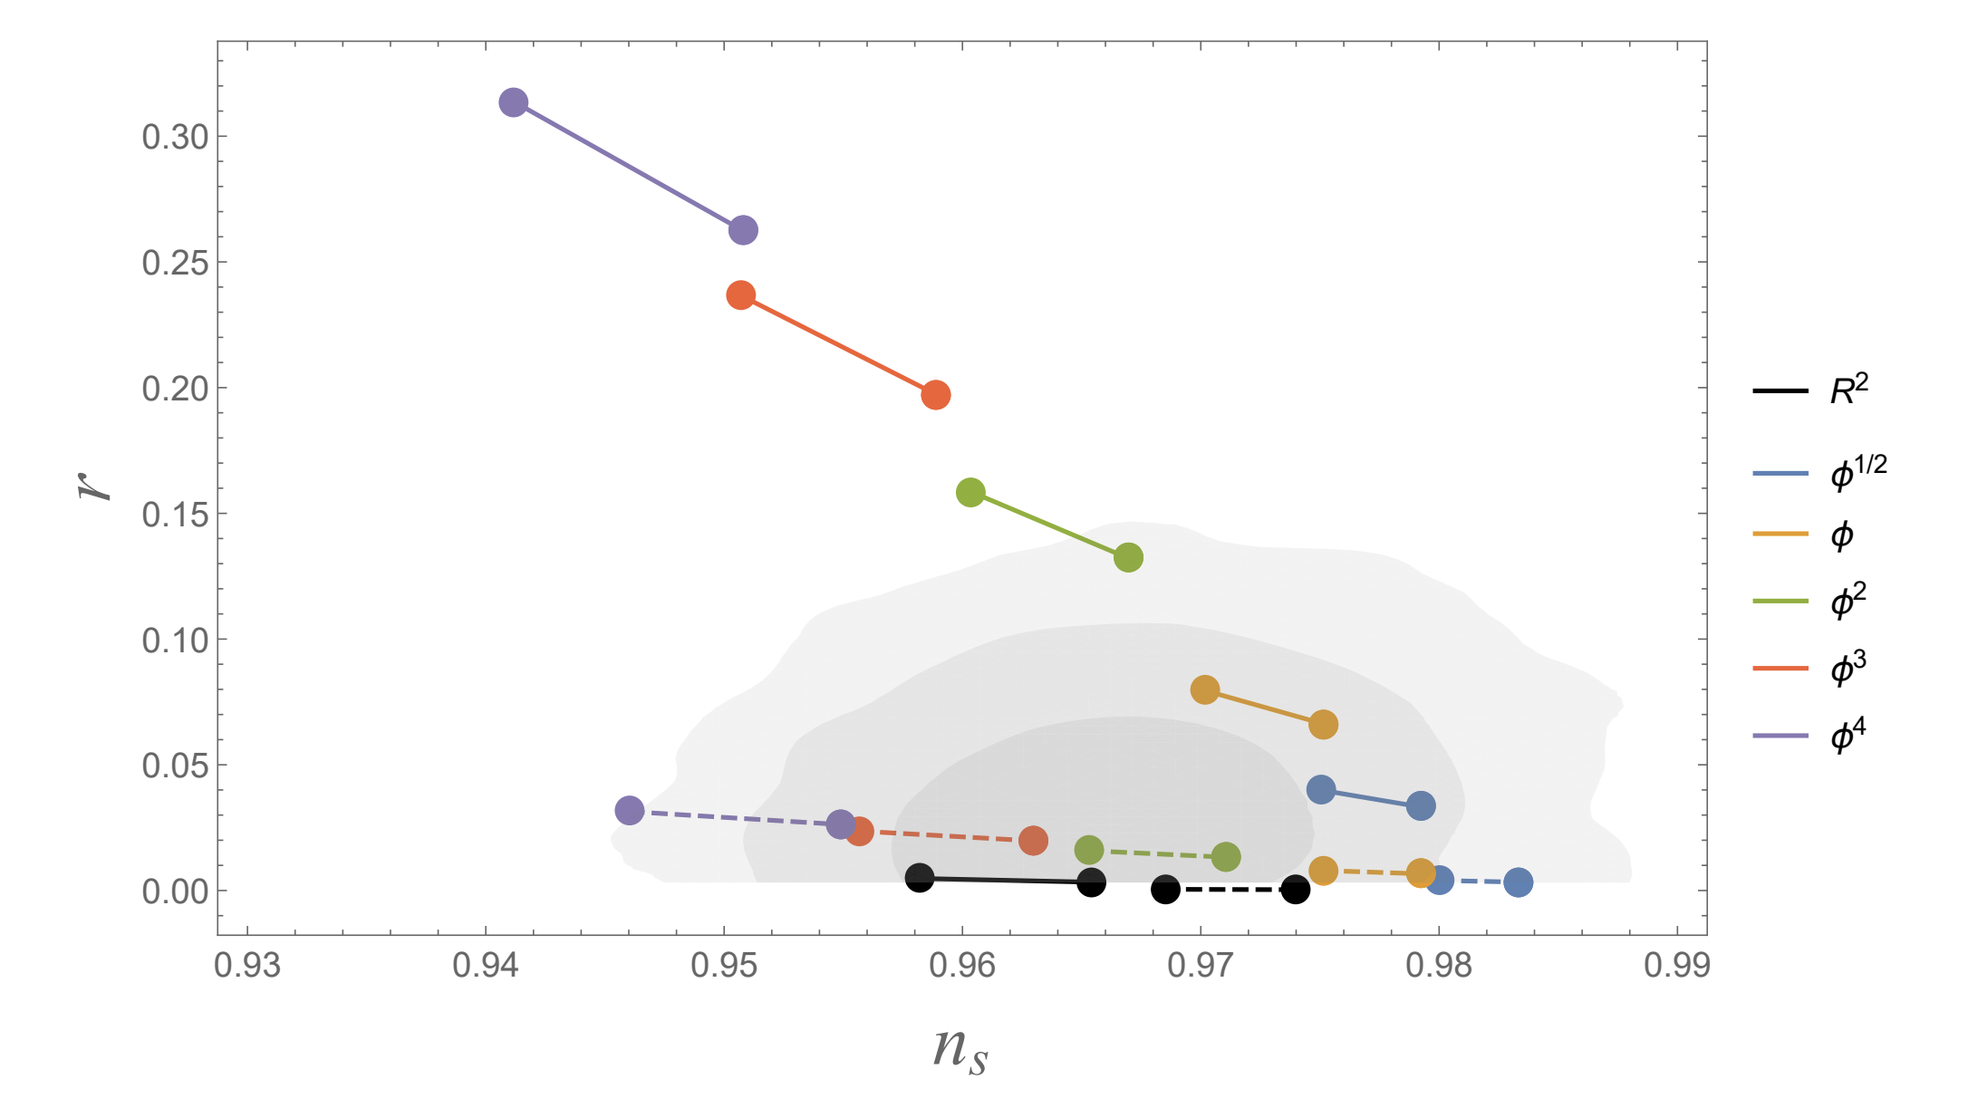
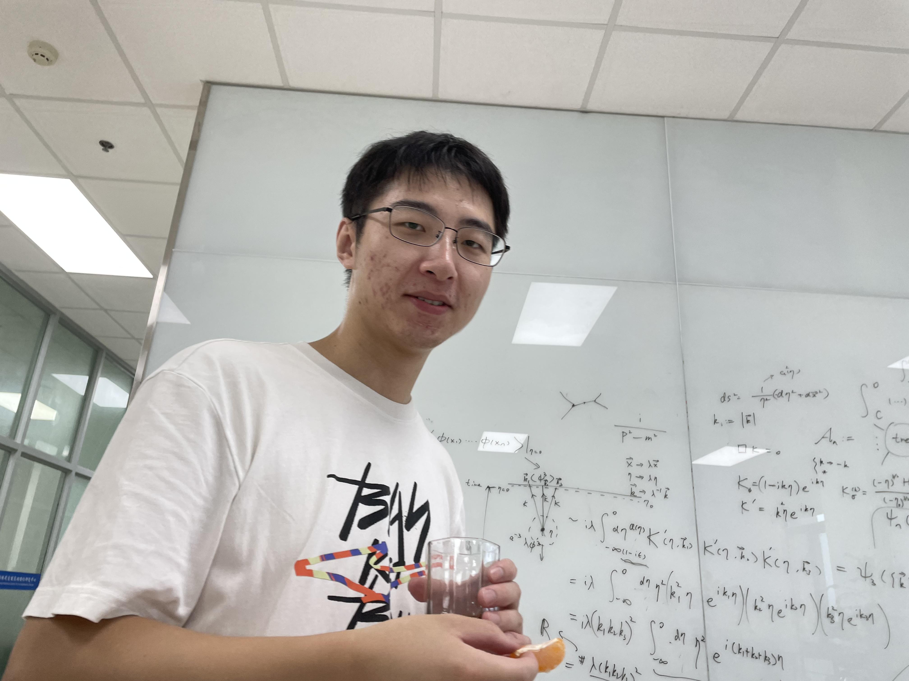
Power Spectrum

Slide 18
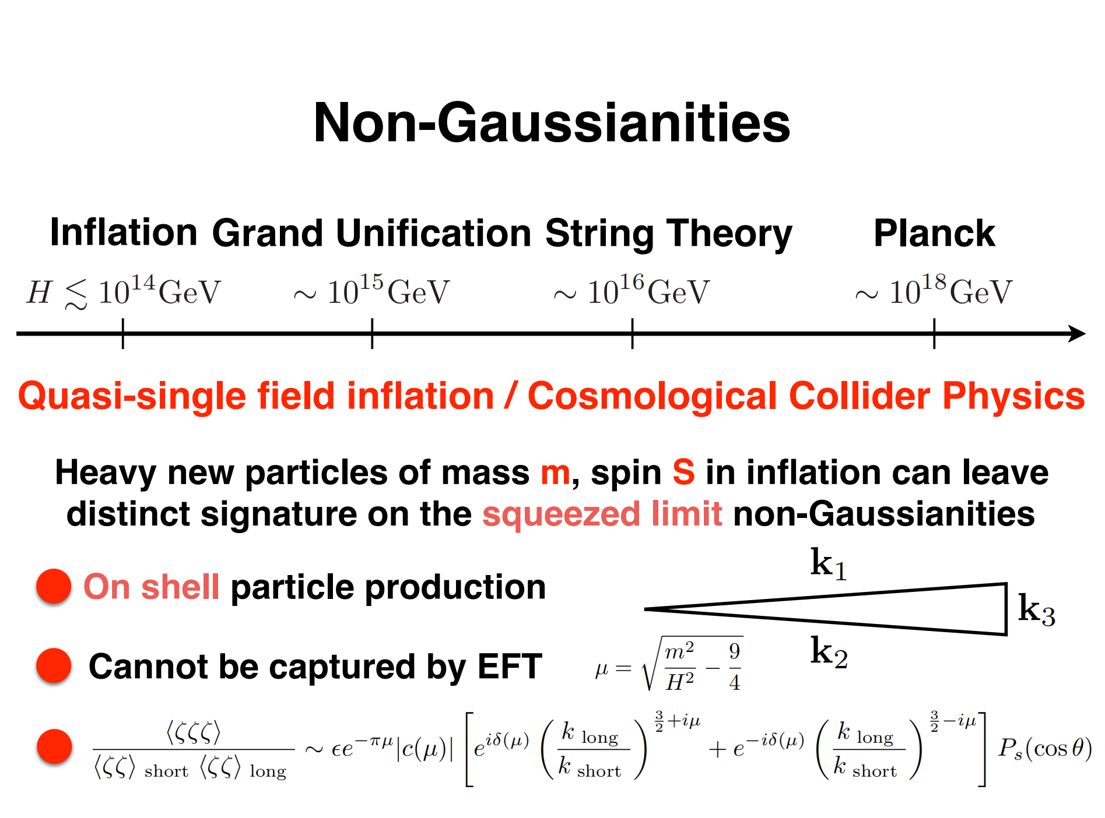

Slide 19
On the importance of heavy fields in pseudo-scalar inflation
Chongbin Chen, Ziwei Wang, Siyi Zhou
2308.15872

Slide 20
Axion
Axion particles are initially proposed to solve the strong CP problem in the QCD physics
Axion-like particles can be produced by string compactification to a low energy effective theory
Axions can lead to rich phenomenology in a wide range of periods in the universe

Slide 21
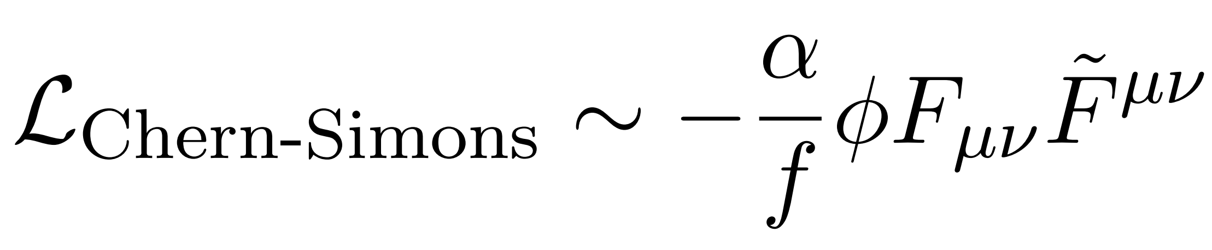
Axion Inflation
Axion can be one of the candidates of inflaton in the very early universe
Axion acting as inflaton

Slide 22
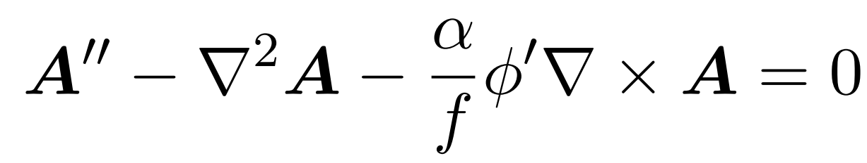
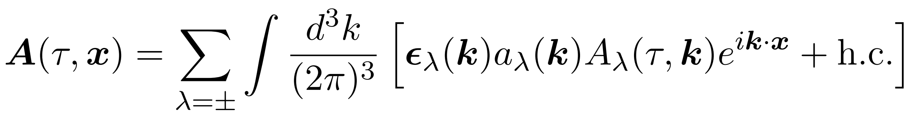
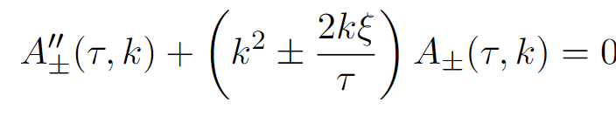
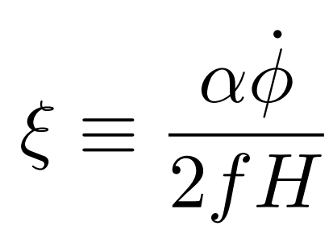

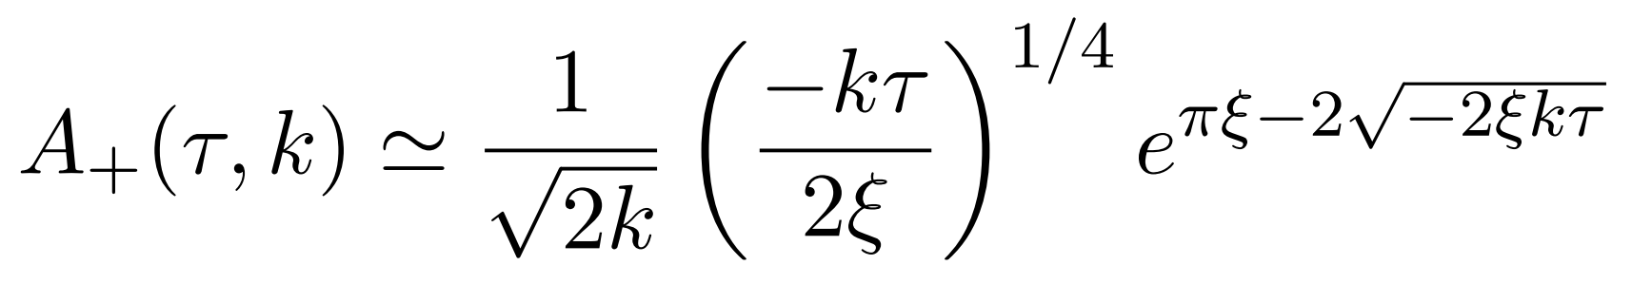
Quantization of Gauge Field
Equation of motion for gauge field
Quantization of gauge field
Equation of motion for the gauge field
Solution when

Slide 23
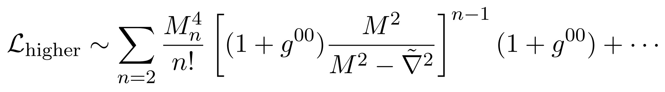
Axion Inflation + Massive field
Massive field is coupled with the inflaton
We use effective field theory of inflation to deal with it
We use the gauge where primordial curvature perturbation is coupled with the gauge field

Slide 24
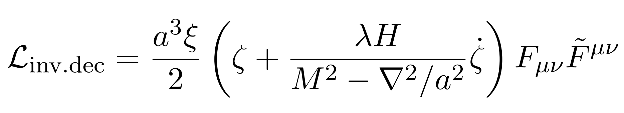
Effective Field Theory
We integrate out the massive field, then only zeta and the gauge field is left
Cubic coupling of zeta and gauge field

Slide 25
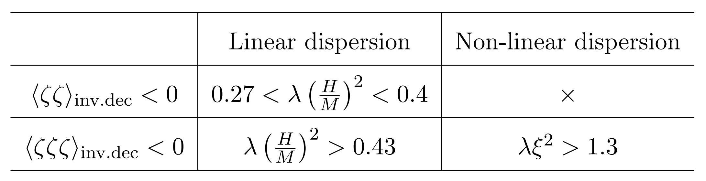
Linear and Non-Linear Dispersion Regime

Slide 26
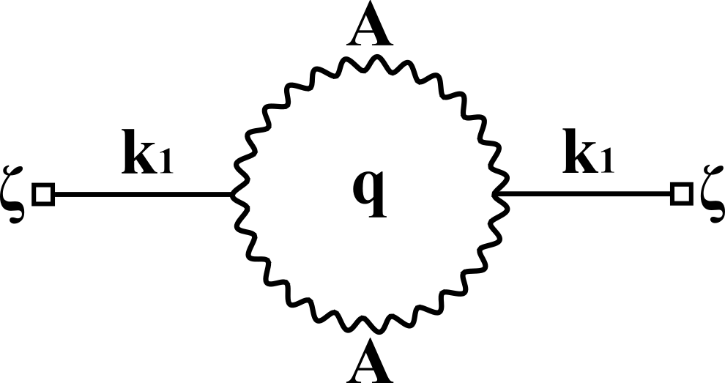
Power Spectrum
Feynman Diagram

Slide 27
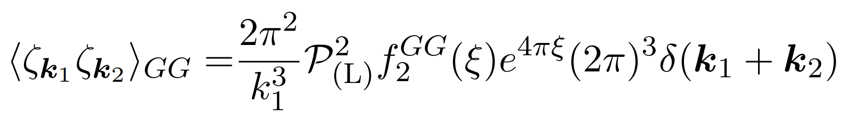
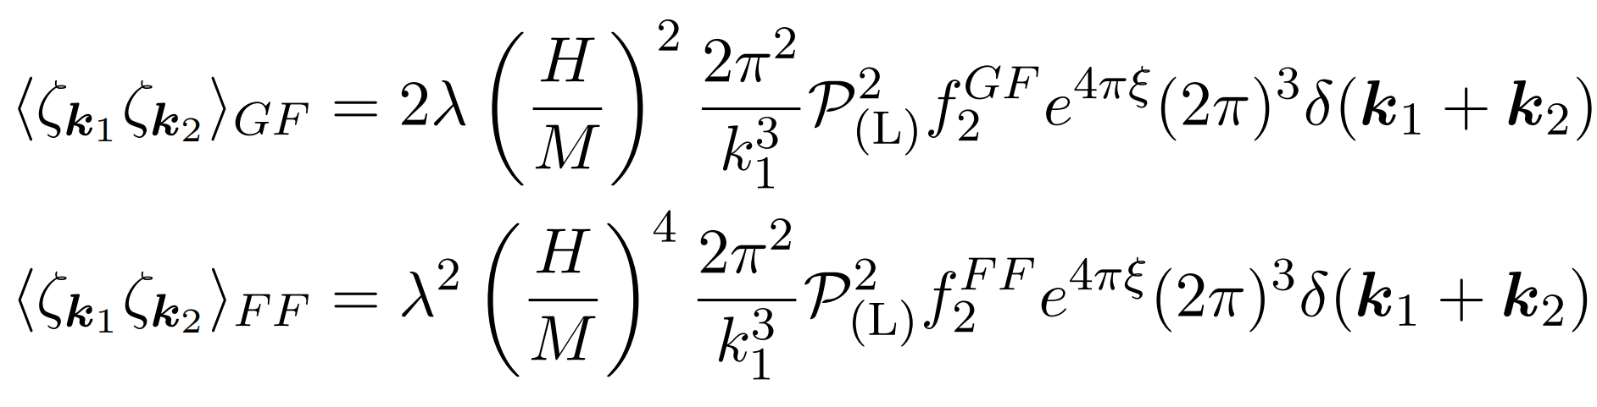
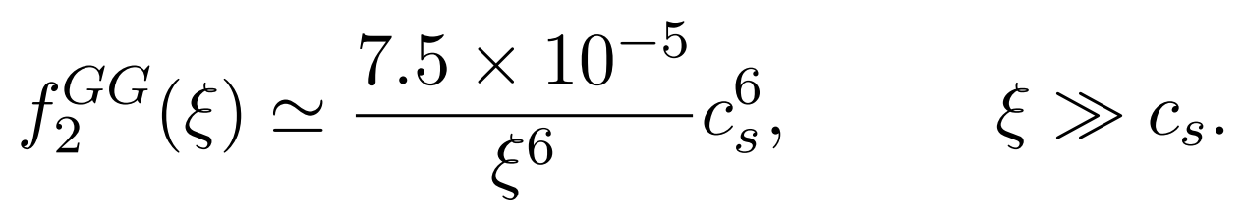
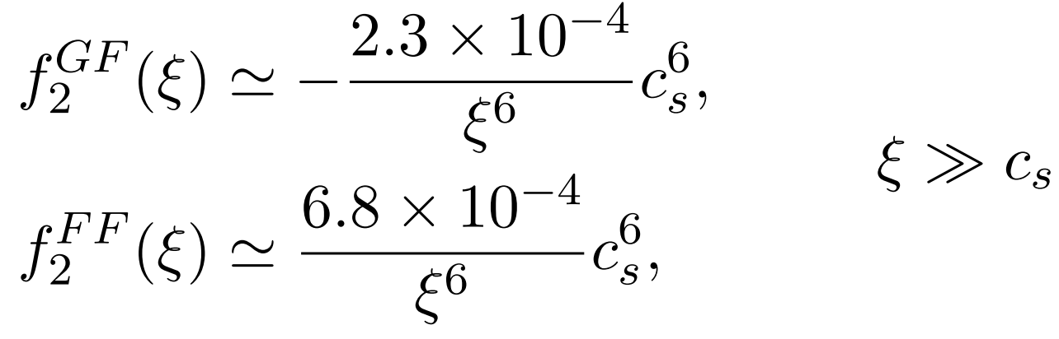
Power Spectrum (Linear Dispersion)
Our result is

Slide 28
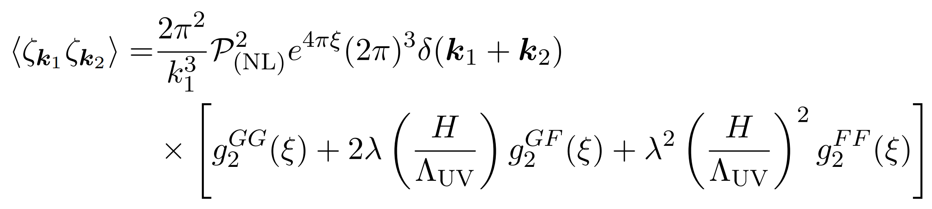
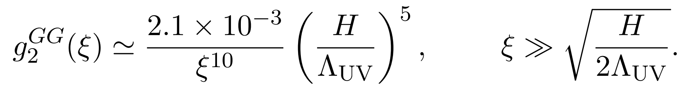
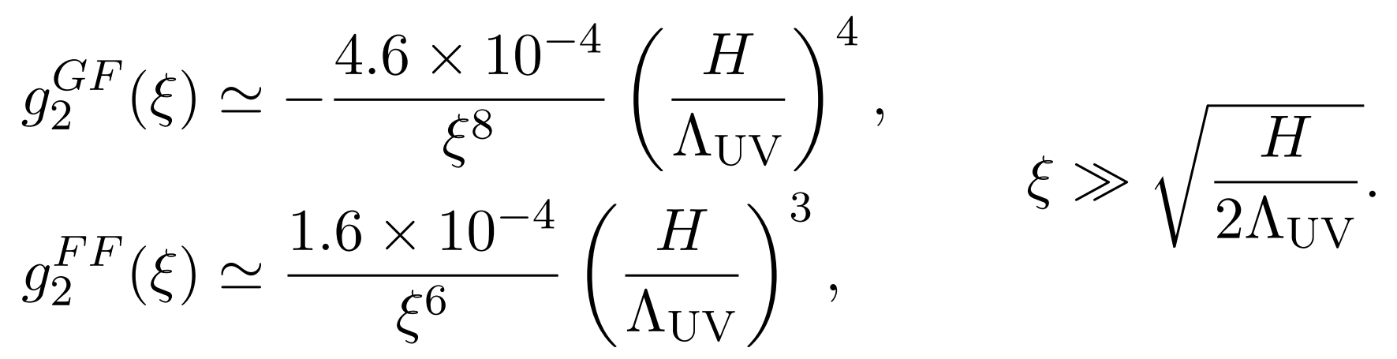
Power Spectrum (Non-Linear Dispersion)
Our result is

Slide 29
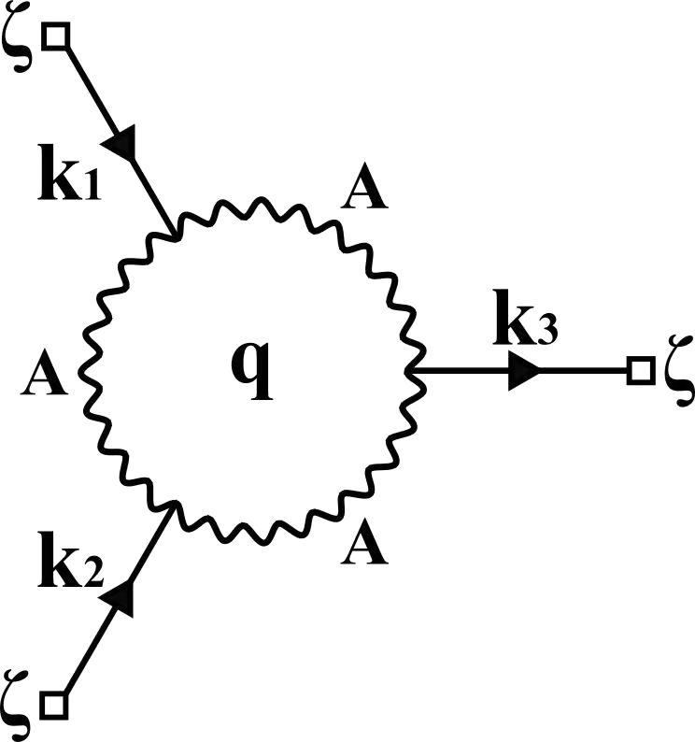
Non-Gaussianity
Feynman diagram

Slide 30
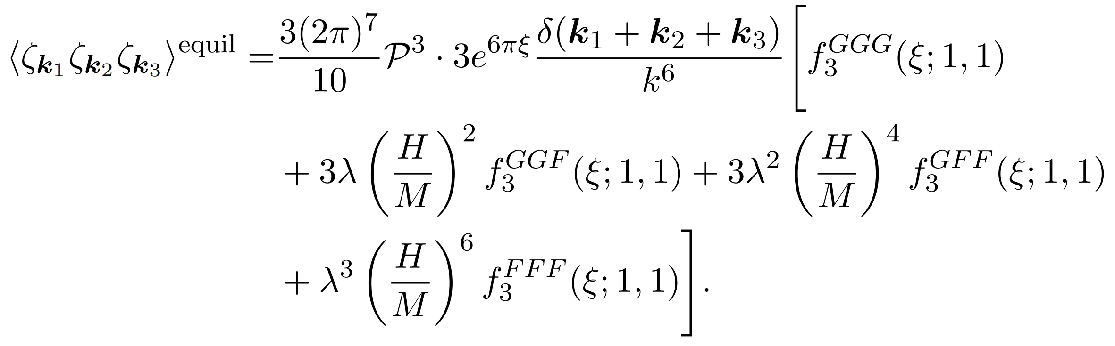
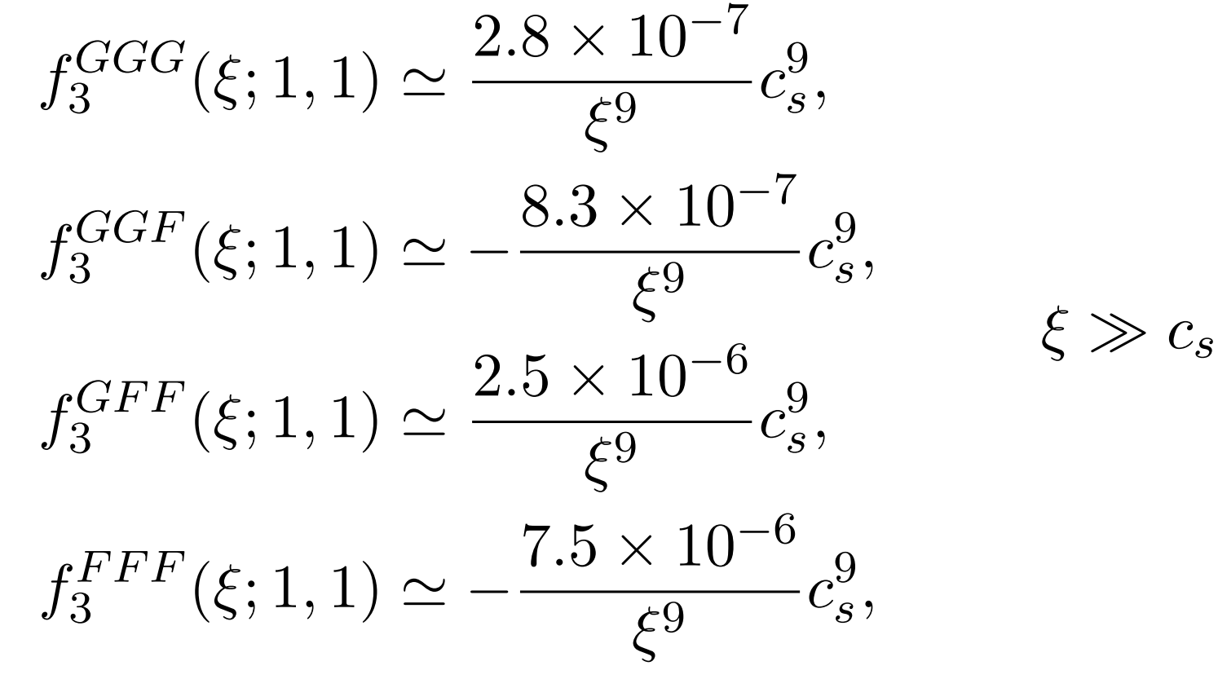
Non-Gaussianities
Equilateral non-Gaussianity is obtained

Slide 31
Axion Isocurvature Collider
Shiyun Lu
JHEP 04 (2022) 157 2103.05958 [hep-th]
Similar setup with us, but there axion act as dark matter, focus on isocurvature perturbation
Also she focuses on squeezed limit of non-Gaussianity
Implication on cosmic microwave background is obtained

Slide 32
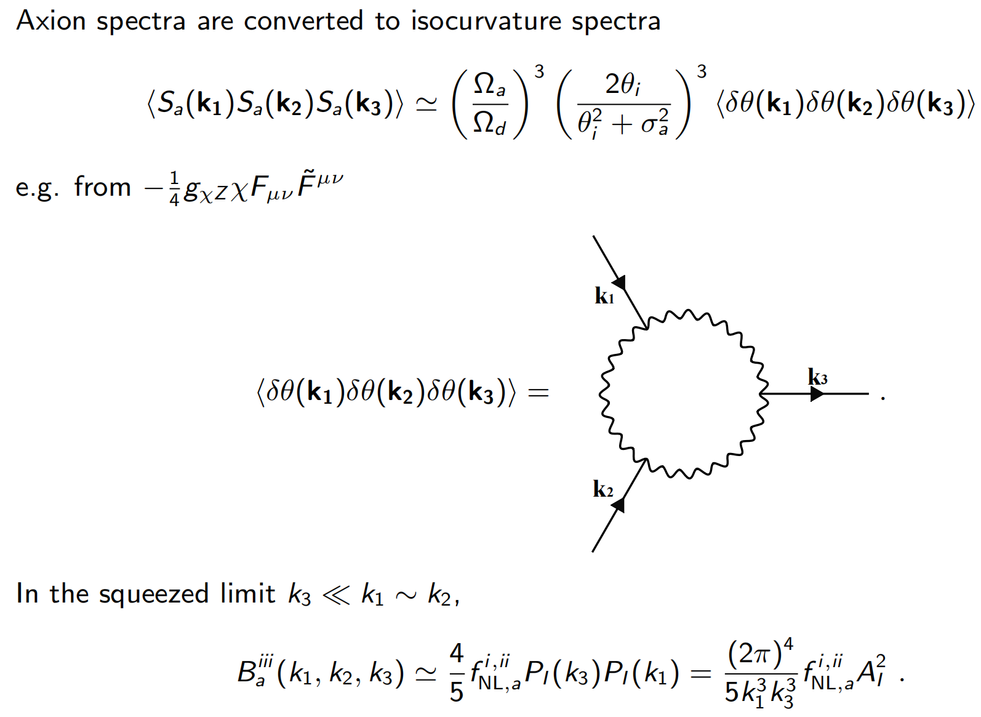
Effective Field Theory Approach to Axion Isocurvature Collider

Slide 33
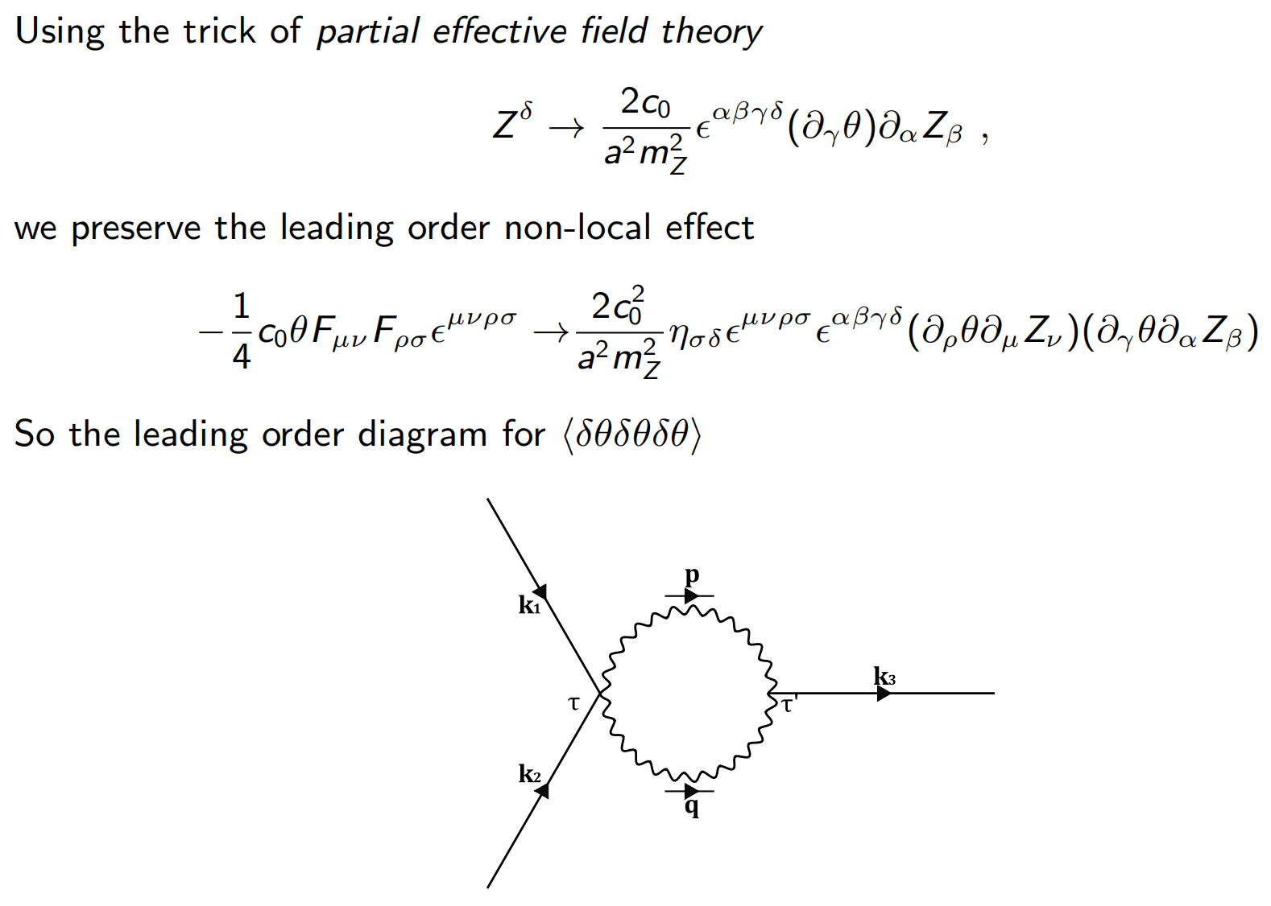
Effective Field Theory Approach to Axion Isocurvature Collider

Slide 34
Conclusion and Outlook
Detailed analysis on bispectrum should be investigated
  Full Numerical Solution of bispectrum
  Squeezed limit
Investigating whether partial effective field theory approach can be used in calculating bispectrum with loop
A model containing massive field axion inflaton and massive/massless gauge field

Slide 35
Conclusion and Outlook
A lot of works in this direction can be done and for some of them we already have some results
Please discuss with us if you are interested

Slide 36

Thank you for your attention and welcome to visit Chongqing U! Please contact me if you are interested!
Lecture/Seminar Series in Chongqing U
Yi Wang, Xi Tong, Chongbin Chen, Yuhang Zhu, Jianing Wang
Topic: Cosmological Correlators
Around August 26
Ziwei Wang and Sai Wang
Around August 9 & 11
Topic: Inflationary Cosmology

