Slide 1
High-Tc Superconductivity
by Metallizing Strong-bonding Electrons
Tao Xiang
Institute of Physics
Chinese Academy of Sciences
txiang@iphy.ac.cn

Slide 2
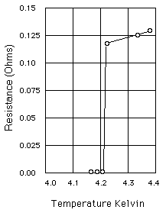
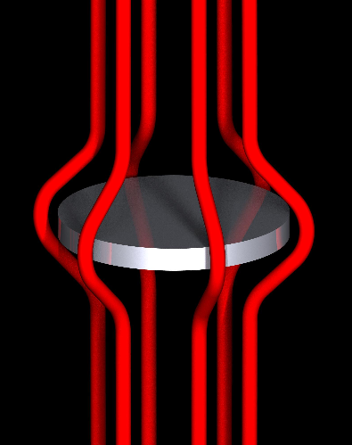
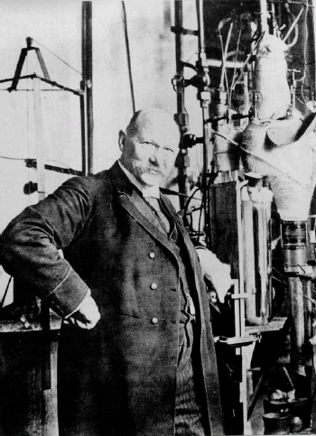
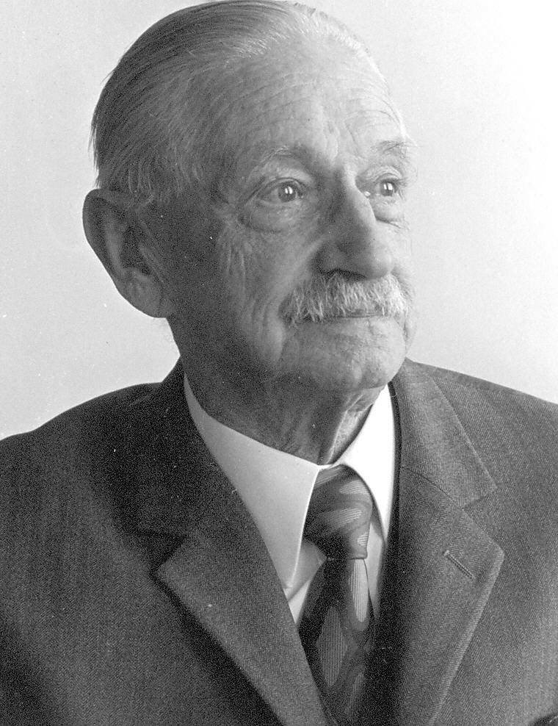
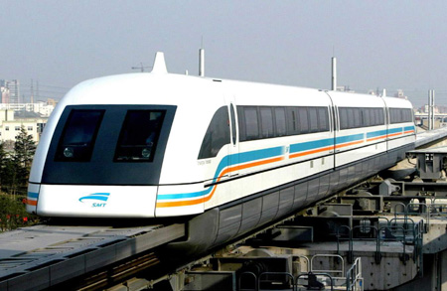
What is superconductor?
Ideal Conductor: zero resistance
Ideal Diamagnet: Messiner Effect
Heike Kamerlingh Onnes
Walther Meissner
Critical temperature

Slide 3
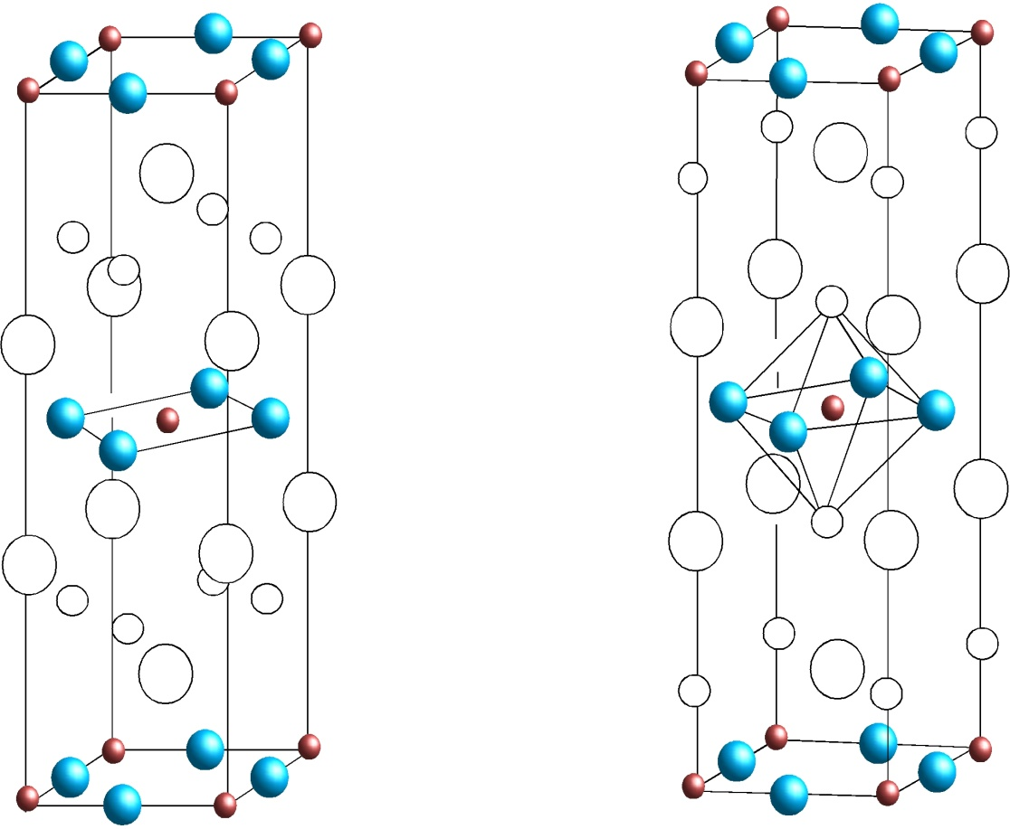
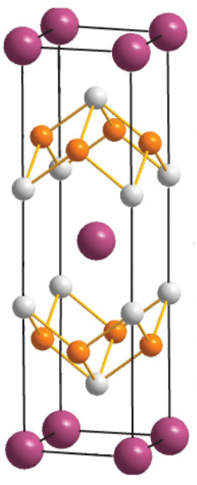
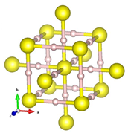
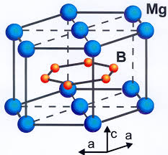
High-Tc Superconductors Discovered
It is not difficult to find superconductors
But it is difficult to find high-Tc superconductors
30~160 K
39 K
30~56 K
100~280K
H₃S and other H-enriched SC
Cuprate SC
MgB₂
Iron-based SC
Superconducting transition temperature ~ 40 K or higher

Slide 4
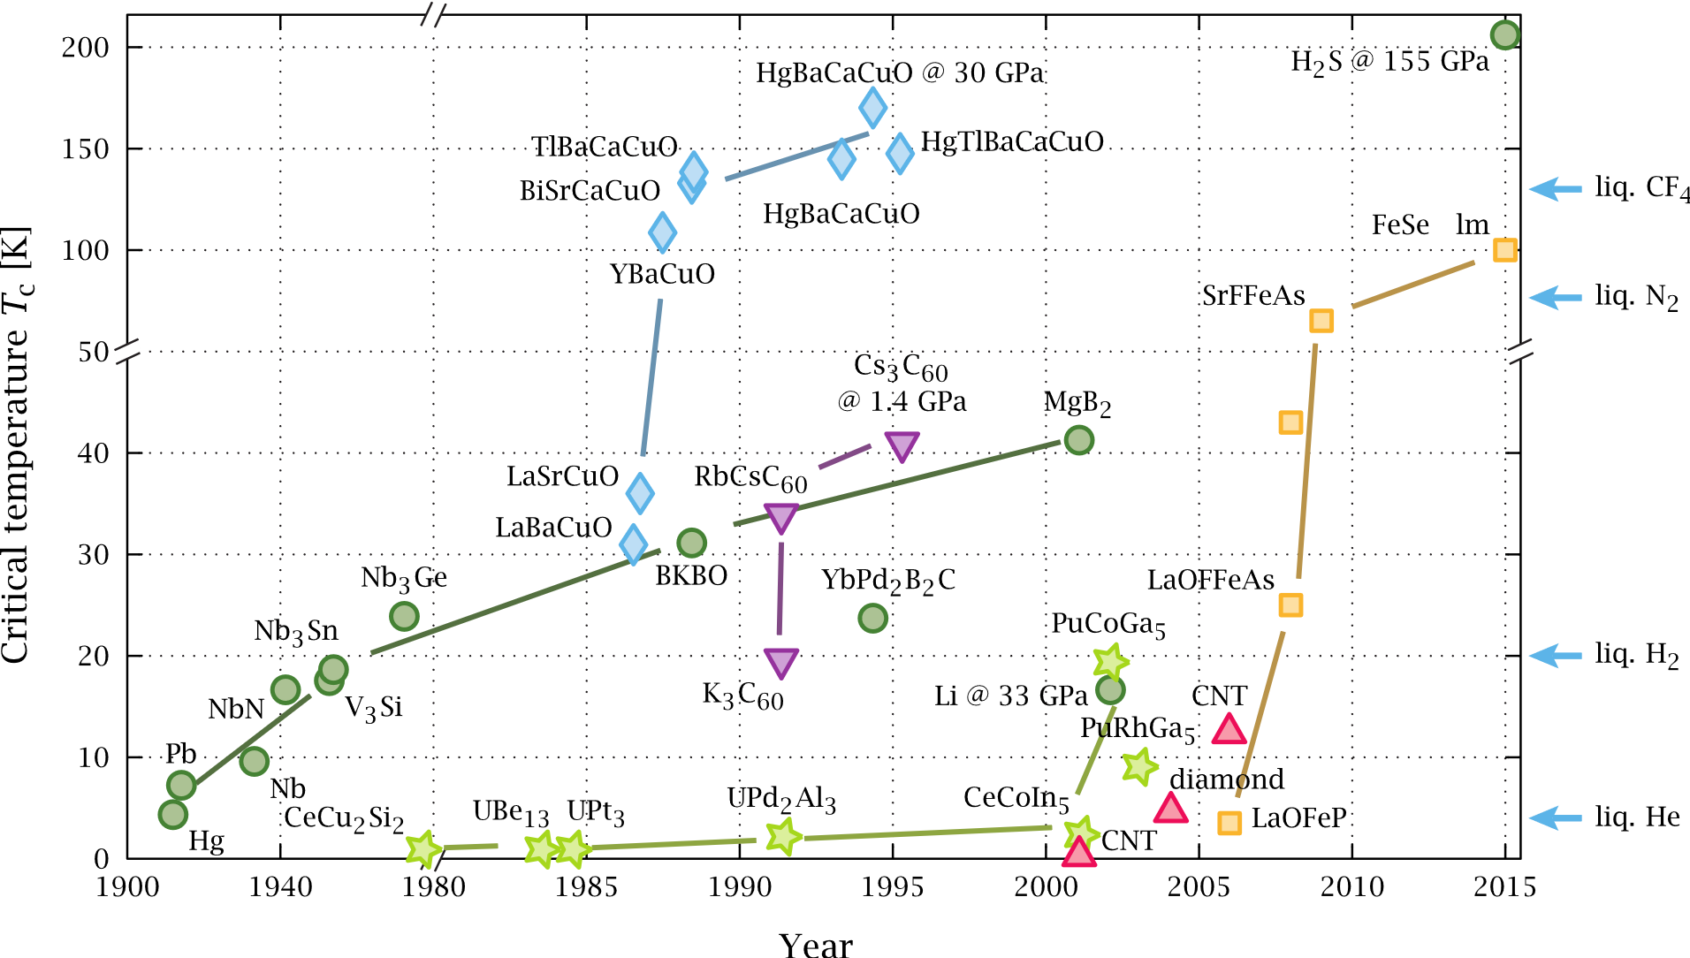
Timeline of Discovered Superconductors
cuprates
Fe-based
By PJRay, https://commons.wikimedia.org/w/index.php?curid=4619314

Slide 5
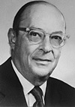

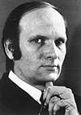
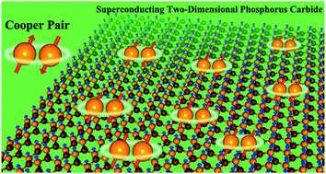
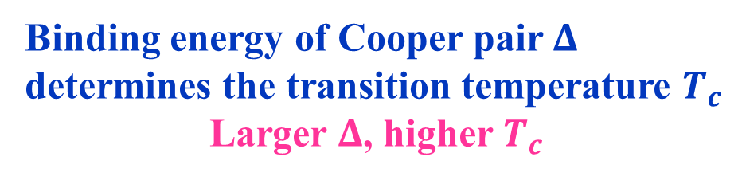
How to become a superconductor?
Electrons must form Cooper pairs: any two electrons should form a bound state
Cooper pairs must condense to form phase coherence
Bardeen Cooper Schrieffer
1957 / 1972
Binding energy of Cooper pair $Δ$
determines the transition temperature $T_{c}$
Larger $Δ$, higher $T_{c}$

Slide 6
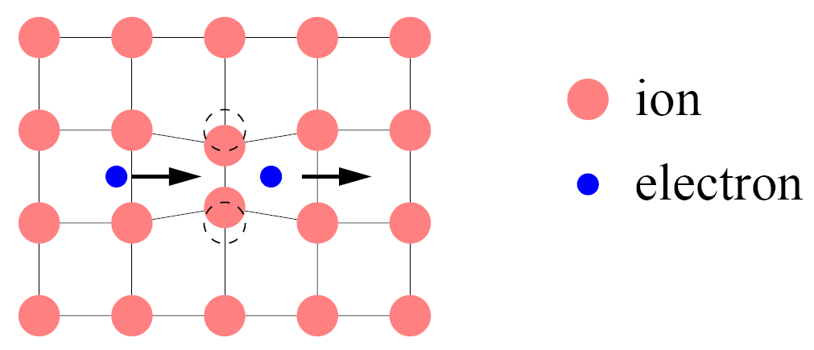
How can electrons form Cooper pairs? Typical Picture
Polarization of the lattice by one electron leads to an attractive potential for another electron, which binds two electrons to a bound state

Slide 7
Is there any guiding principle for hunting superconductors
Bernd Matthias rules：
high symmetry is good, cubic symmetry is the best
high density of electronic states is good
stay away from oxygen
stay away from magnetism
stay away from insulators
stay away from theorists.
Wrong except the 6th rule
Cava’s rule:
发现的超导体的临界温度和发现者经验的指数成反比

Slide 8
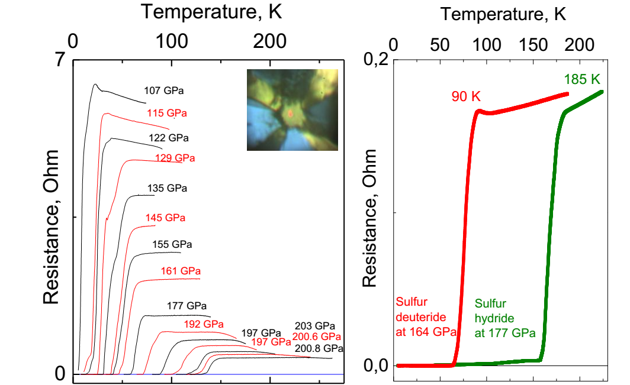
Conventional Wisdom of Raising T_{c}
To apply high pressure to light elements
Example: H enriched H₃S
T_{c} decreases with magnetic field
strong isotope shift of T_{c} in D₂S: Tc 185 K for H₂S, 90 K for D₂S
AP Drozdov, MI Eremets, IA Troyan, Nature 2015

Slide 9
Conventional Wisdom of Raising T_{c}
To apply high pressure to light elements
H enriched H₃S: possible 190K superconductor at 200 GPa
λ ω_{log} μ* T_{c} Pressure
2.19 1334.6 K 0.1~0.13 191-204 K 200 GPa
0.13 184 K 250 GPa
0.13 179 K 300 GPa
Agree with DFT prediction for H₃S
H₃S
D. Duan et al., Sci. Reports 4, 6968 (2014)

Slide 10
How to Hunt High-Tc Superconductors
  Guiding Principle:
  There is a big chance to find high-Tc superconductors if one can metallize σ- or other strong chemical bonding electrons

Slide 11
Common Features of High-Tc Superconducts Revealed
Cuprates still hold the record of highest-Tc at ambient pressure
30~160 K
39 K
30~56 K
100~280K
H₃S and other H-enriched SC
Cuprate SC
MgB₂
Iron-based SC

Slide 12
Common Features of High-Tc Superconducts Revealed
Quasi-two-dimensional?
Yes
Yes
Yes
No
30~160 K
39 K
30~56 K
100~280K
H₃S and other H-enriched SC
Cuprate SC
MgB₂
Iron-based SC

Slide 13
Common Features of High-Tc Superconducts Revealed
Strong antiferromagnetic fluctuations?
Yes
No
Yes
No
30~160 K
39 K
30~56 K
100~280K
H₃S and other H-enriched SC
Cuprate SC
MgB₂
Iron-based SC

Slide 14
Common Features of High-Tc Superconducts Revealed
Strong electron-phonon coupling?
probably
Yes
probably
Yes
30~160 K
39 K
30~56 K
100~280K
H₃S and other H-enriched SC
Cuprate SC
MgB₂
Iron-based SC

Slide 15
Common Features of High-Tc Superconducts Revealed
Some $σ$-bonding electrons become metallized?
Yes
Yes
Yes
Yes
30~160 K
39 K
30~56 K
100~280K
H₃S and other H-enriched SC
Cuprate SC
MgB₂
Iron-based SC

Slide 16
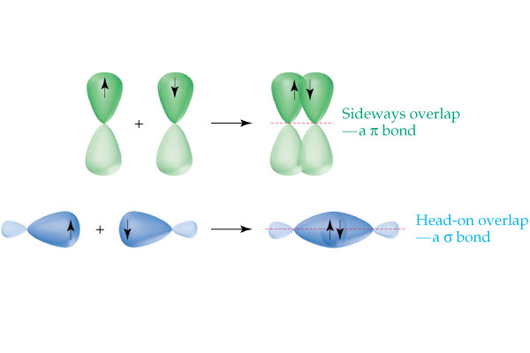
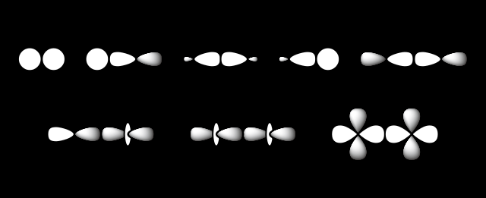
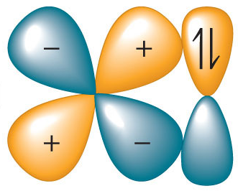
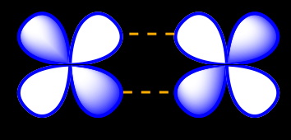
What are σ-bonding electrons?
π-bond: Sideways overlap
σ-bond: Head-on overlap
strongest covalent bonds
Crystal structure is generally stabilized by σ-bonds
Metallizing σ-bonding electrons generally mean melting the lattice

Slide 17
Why are σ-bonding electrons relevant to high-Tc SC?
Characteristic energy scale of σ-bond is very strong: ~ 3 eV
  the coupling between σ-bonding electrons and phonons is very strong in order to stabilize this bond
  σ-electrons are difficult to be metallized: this explains why high-Tc SC are so difficult to find
Metallzing σ-electrons reduces the coupling of these electrons, but the residual interaction can still be very large, which serves as a strong glue of Cooper pairs

Slide 18
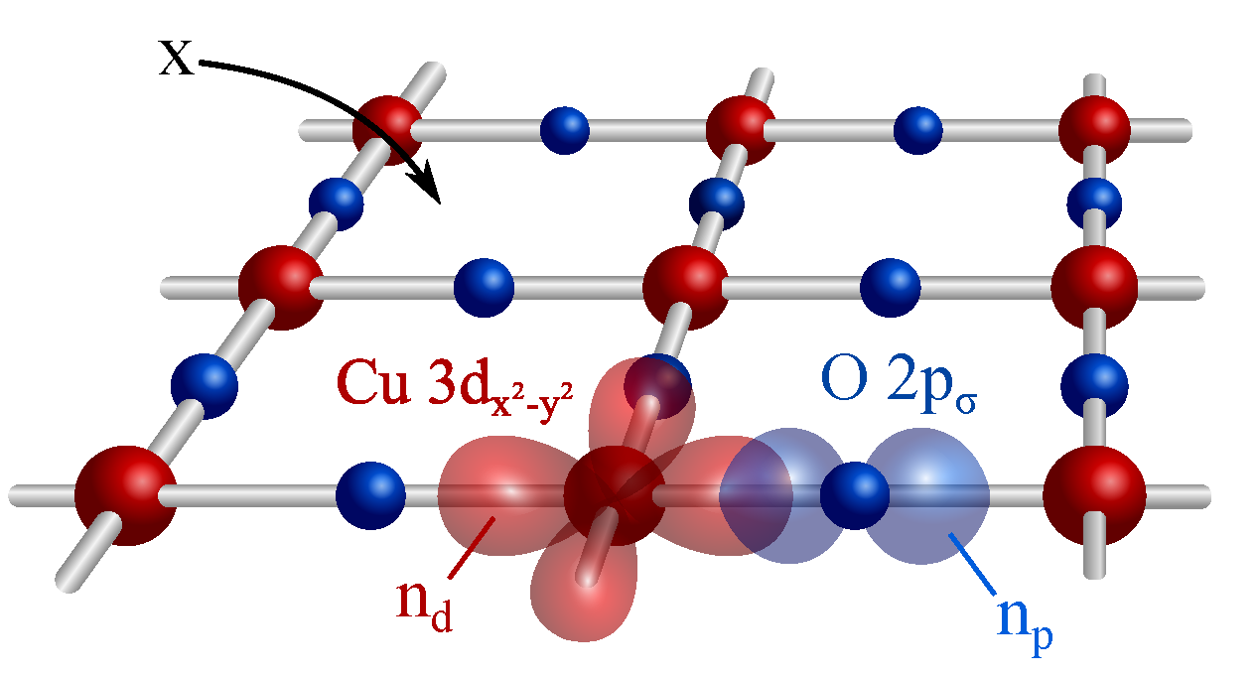
Metallizing σ-electrons: Cuprates
Cu 3d¹⁰
Fermi level
O 2p
On-site Coulomb
Repulsion
5-8 eV
σ-bond
σ-bond
Cu 3d(x²-y²) and O 2p form a σ-bond
Cu 3d⁹
Cuprate SC
Hole doping lifts the Cu-O σ-bonds to the Fermi level, leading to high-Tc SC

Slide 19
Metallizing σ-electrons: Hole Doping
Cu 3d¹⁰
Fermi level
O 2p
On-site Coulomb
Repulsion
5-8 eV
σ-bond
Zhang-Rice singlet
Cu 3d(x²-y²) and O 2p hole form a metallized Zhang-Rice singlet
Cu 3d⁹
Cuprate SC
Roles of antiferromagnetic fluctuations
    release the lattice instability induced by doping
    enforce the metallization

Slide 20
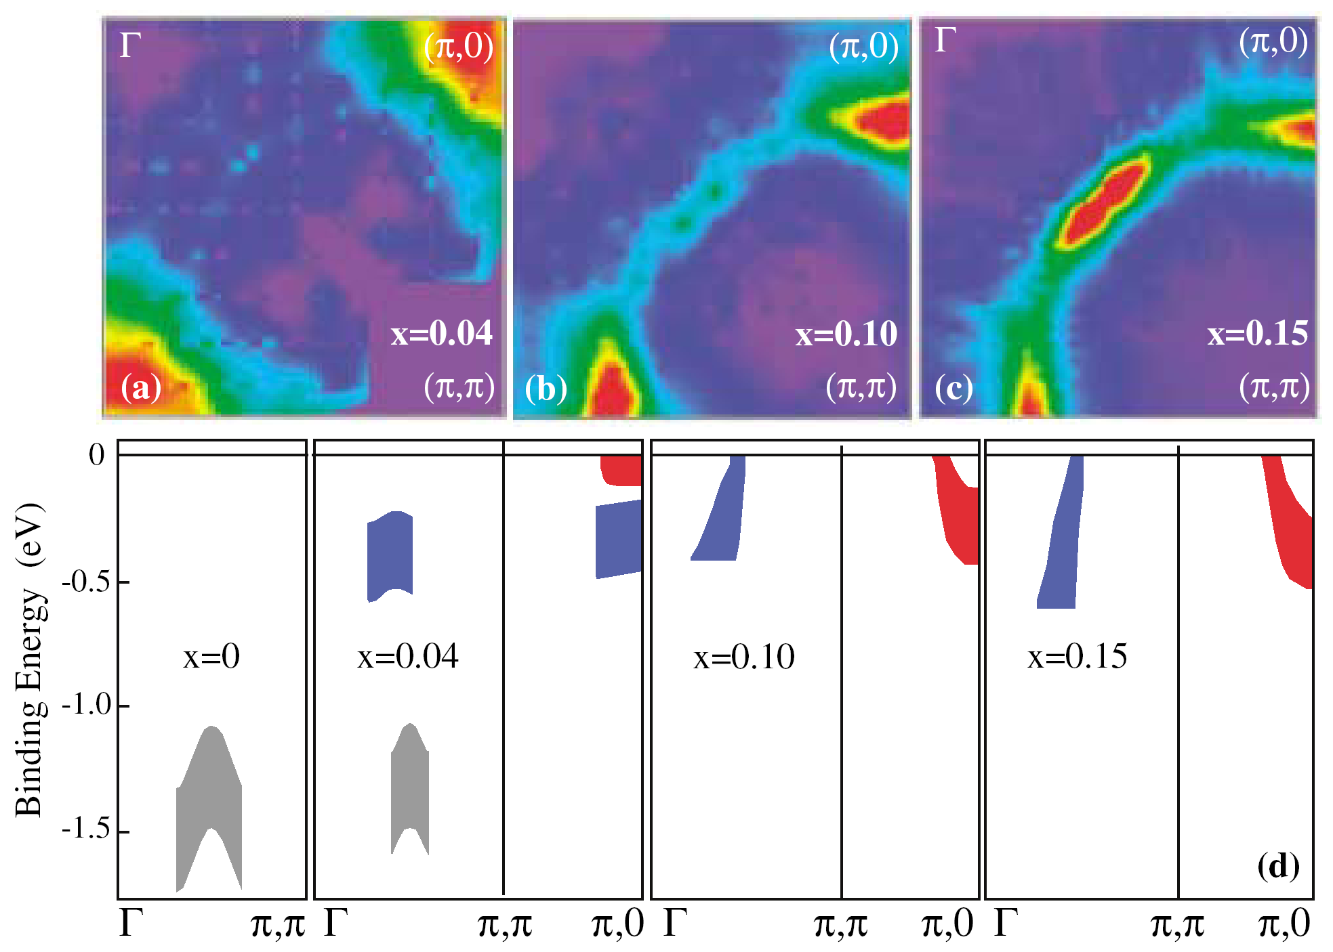
Experimental Evidence of Metallized σ-electrons
Cu 3d¹⁰
Fermi level
O 2p
On-site Coulomb
Repulsion
5-8 eV
Zhang-Rice singlet
Electron pocket
Hole pocket
Cu 3d⁹
Nd_{2-x}Ce_{x}CuO₄
Armitage et al., PRL 88, 257001 (2002)

Slide 21
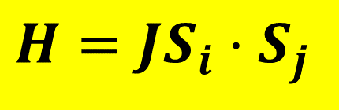
Role of Cu-Spin Antiferromagntic Fluctuations
Both the Cu-O σ-bonding electrons and Cu-Cu spins are coupled by the Heisenberg interaction
$$H=JS_{i}⋅S_{j}$$
  Cu-Cu spin antiferromagnetic fluctuations break the bonds and favor the metallization of σ-electrons

Slide 22
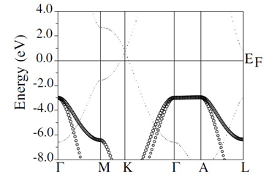
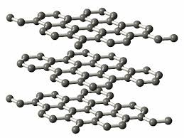
Metallizing σ-electrons: MgB₂
graphite
π-bands
σ-bands
σ-band is located below the Fermi level, no contribution to conductivity

Slide 23
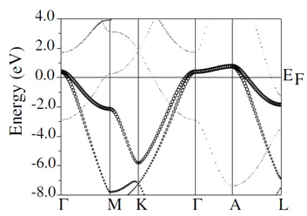
Can We Lift σ-electrons to the Fermi Level?
π-bands
σ-bands
σ-bands

Slide 24
Can We Lift σ-electrons to the Fermi Level?
MgB₂
σ-bands
Mg²⁺ couples stronger with the 2p π-electrons and the 2p σ-electrons, which lowers the Fermi level of π-bands --- effectively lifting the σ-bands
JM An & WE Pickett, PRL 86, 4366 (2001)

Slide 25
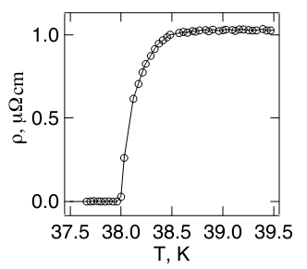
Can We Lift σ-electrons to the Fermi Level?
MgB₂
T_{c} = 39 K
Mg²⁺ couples stronger with the 2p π-electrons and the 2p σ-electrons, which lowers the Fermi level of π-bands --- effectively lifting the σ-bands
J. Nagamatsu et al., Nature 410, 63 (2001)

Slide 26
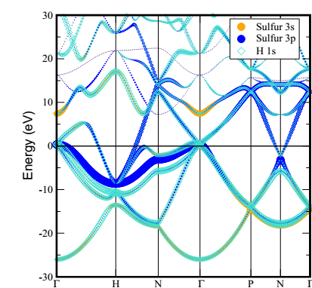
Metallizing σ-electrons: H-enriched Materials
“H₃S has a record high Tc due to its covalent bonds driven metallic”
H₃S
N. Bernstein, CS Hellberg, MD Johannes, II Mazin, MJ Mehl, PRB 91, 060511(R) (2015)

Slide 27
Theoretical predictions for a number of candidates of high-Tc superconductors

Slide 28
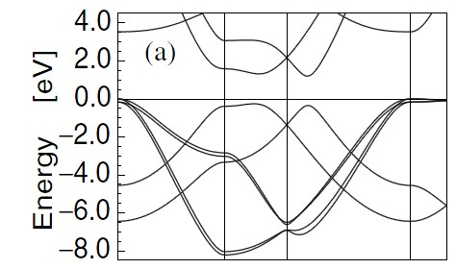
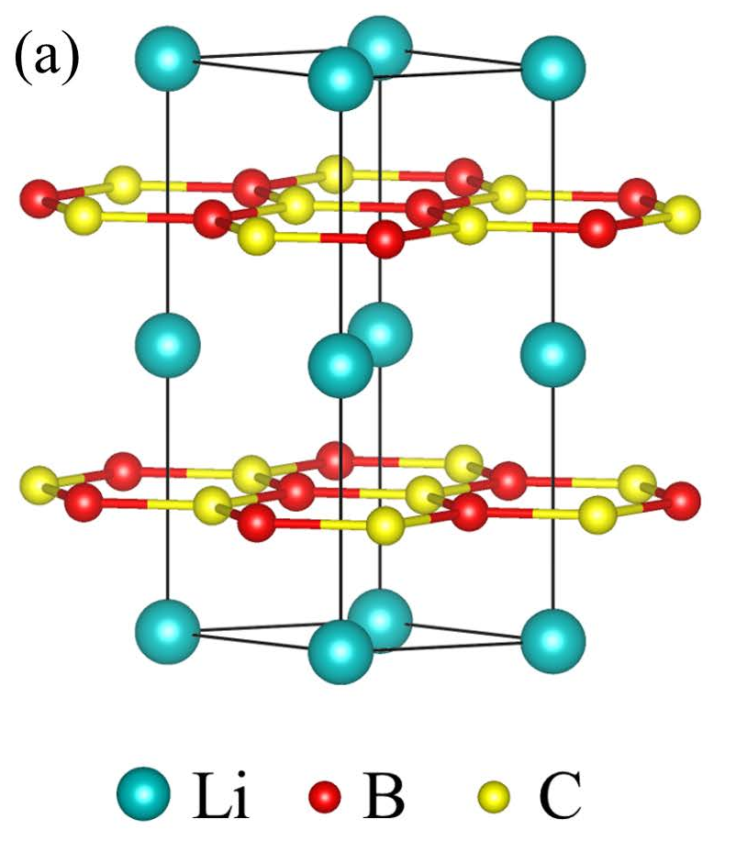
1. Hole doped LiBC
LiBC
gap 1.0 ~ 2.5 eV
σ-bands
LiBC: σ-electrons are on the top valence bands
JM An & WE Pickett, PRL 86, 4366 (2001)

Slide 29
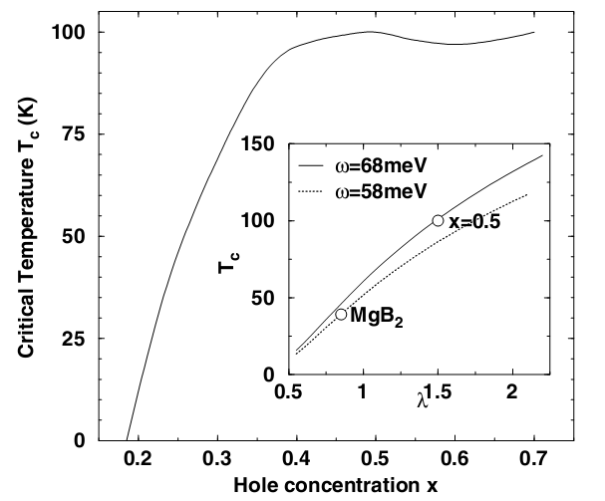
Predicted Tc
Li_{0.5}BC
Li_{0.5}BC:
λ = 1.5
μ* = 0.09
T_{c} = 100 K
JM An & WE Pickett, PRL 86, 4366 (2001)

Slide 30
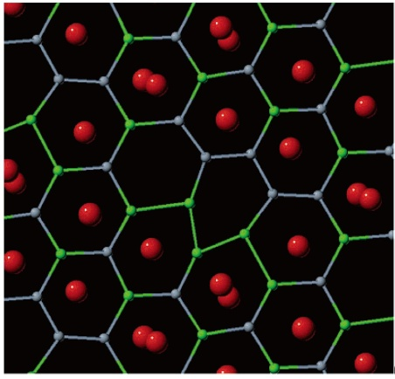
Li deficiency Distorts LiBC
Li_{0.5}BC
AM Fogg et al., JACS 128, 10043 (2006 )

Slide 31
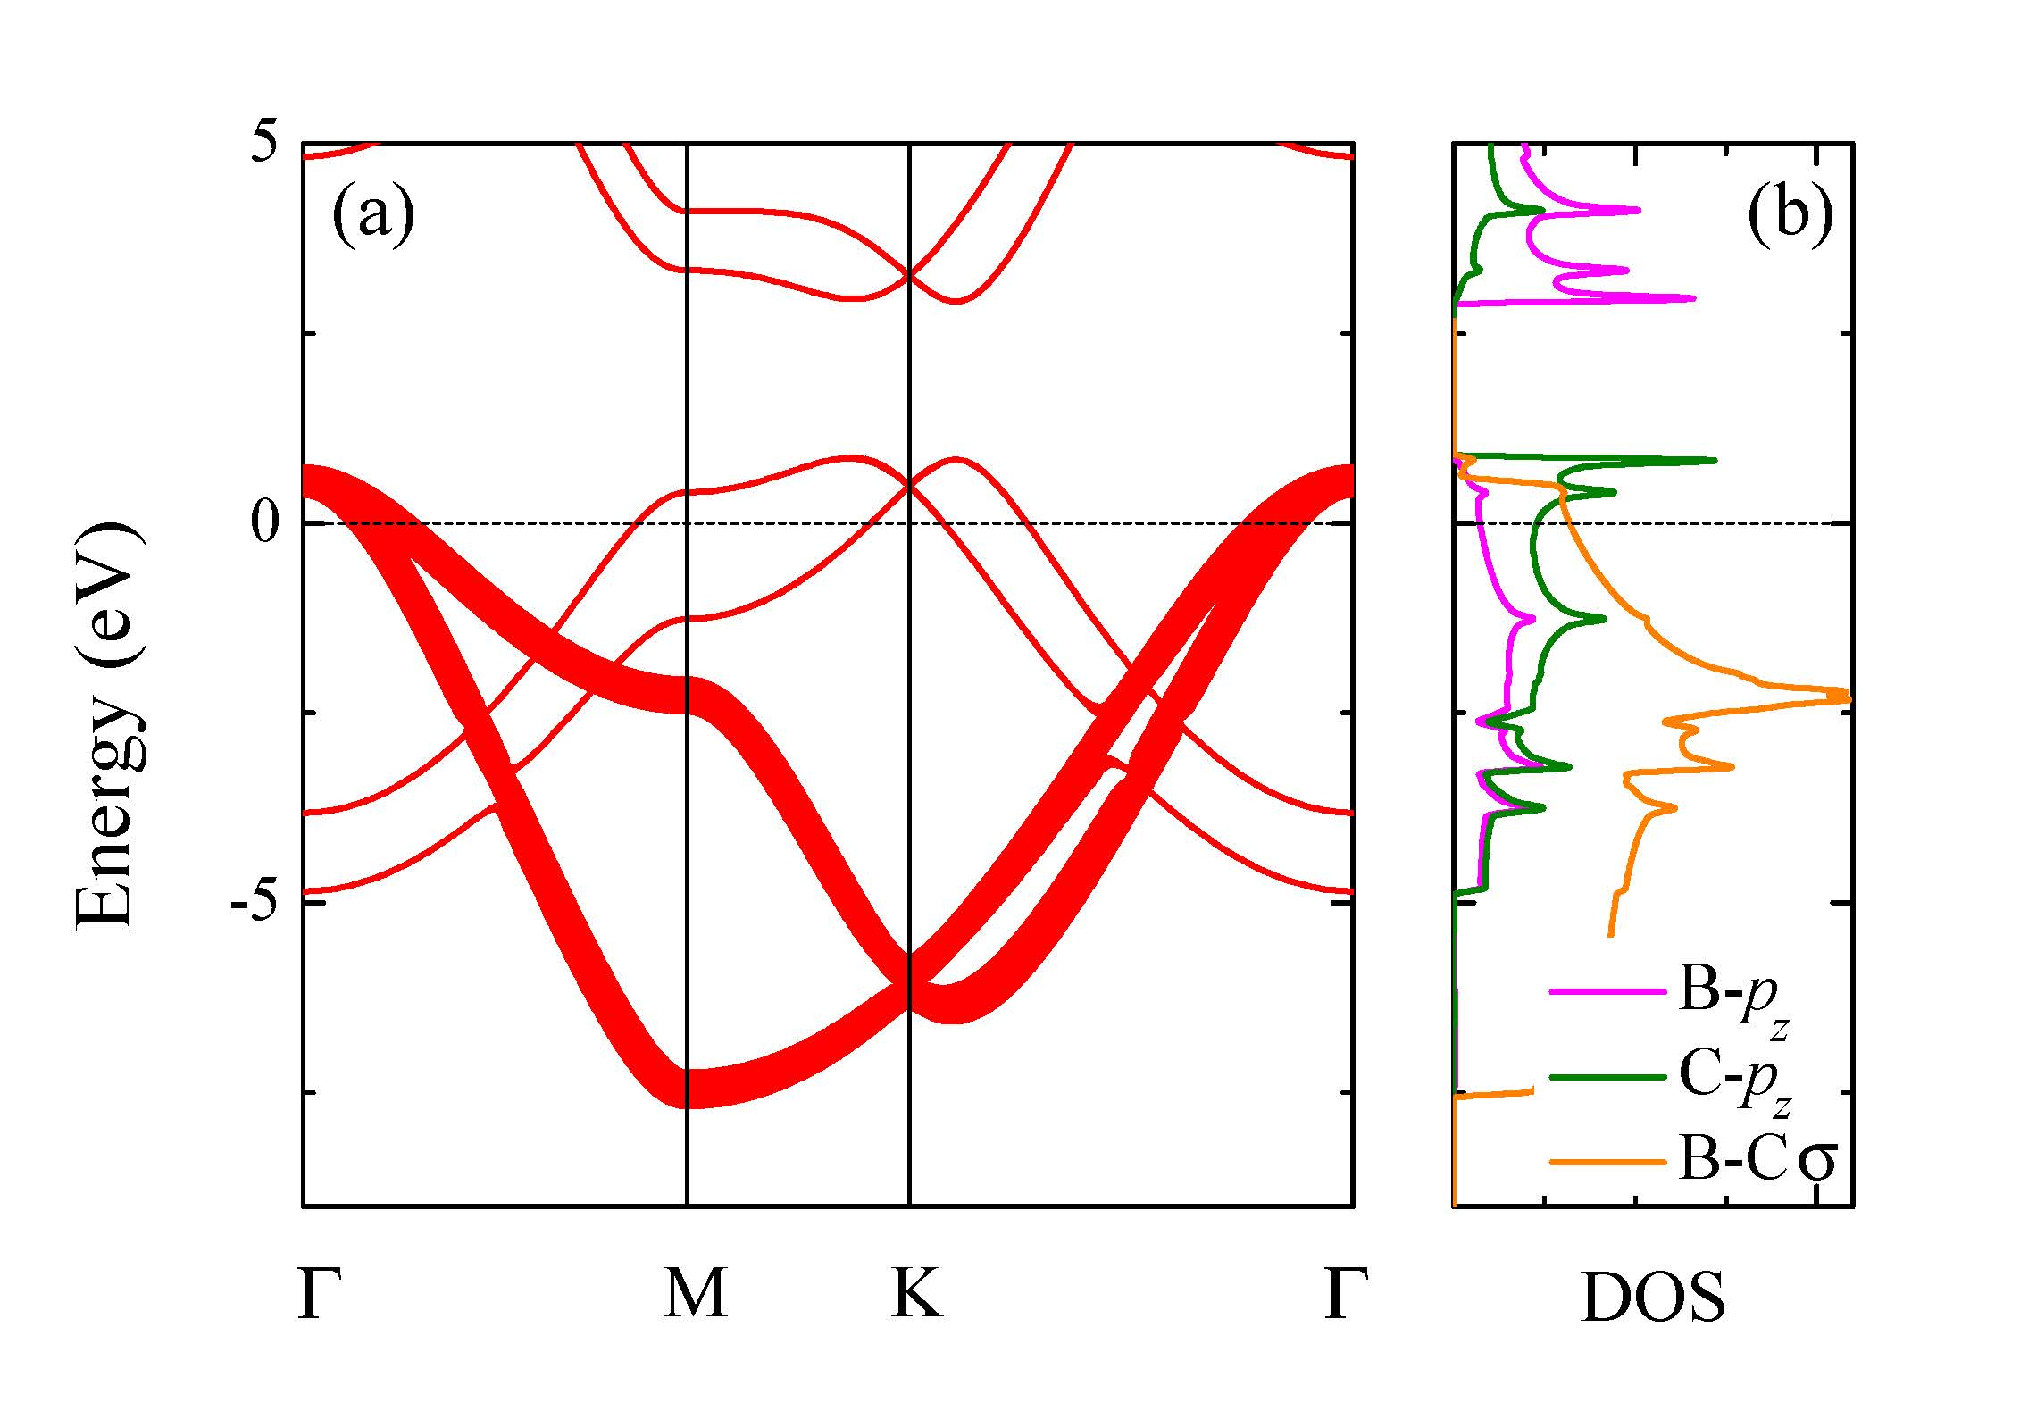
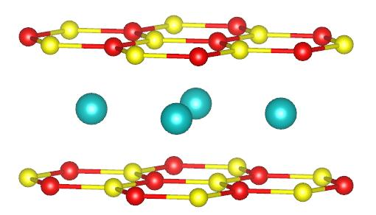
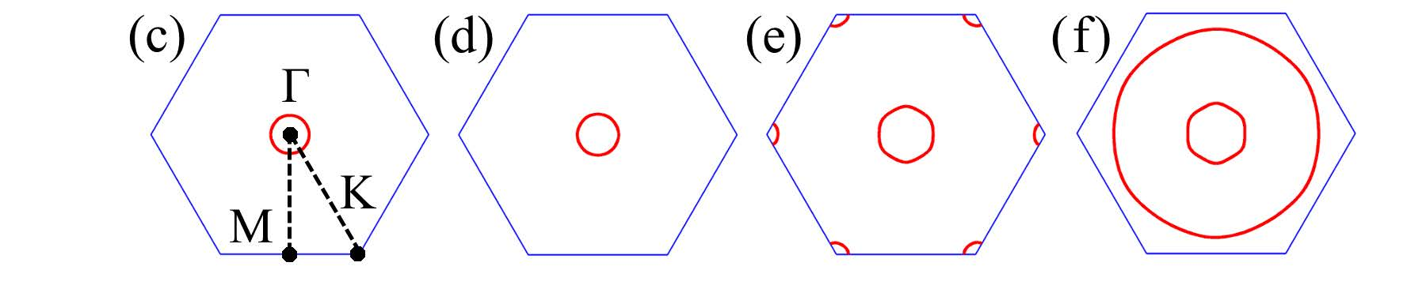
Can We Dope LiBC without Introducing Li Deficiency?
Trilayer LiB₂C₂
LiBC
σ-bands
Gao, Yan, Lu, Xiang, arXiv:1911.12690

Slide 32
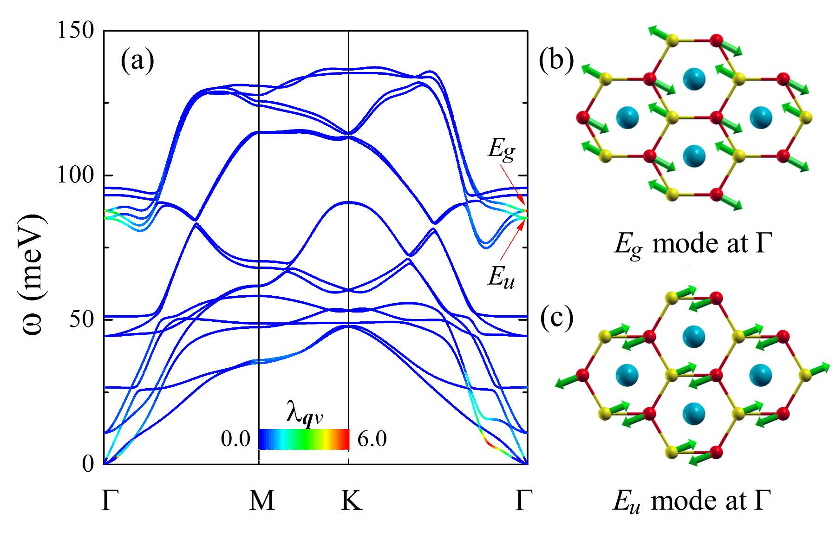
Trilayer LiB₂C₂ is structurally stable
Trilayer LiB₂C₂
Gao, Yan, Lu, Xiang, arXiv:1911.12690
No imaginary frequency in the spectrum

Slide 33
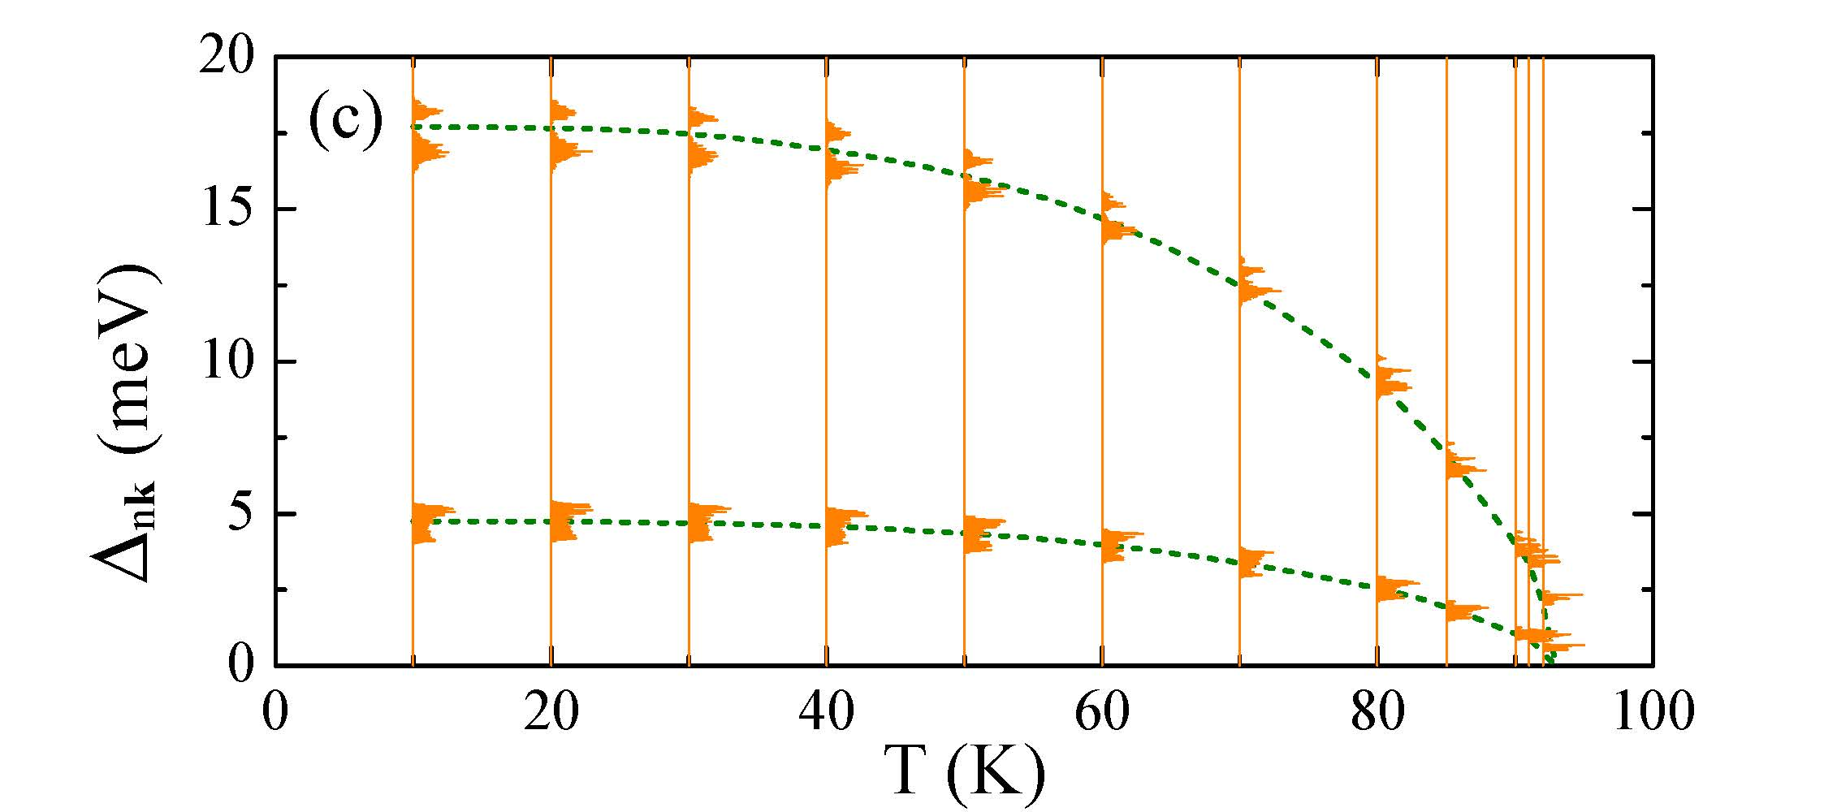
Trilayer LiB₂C₂ is a Good High-Tc Candidate
Trilayer LiB₂C₂
T_{c} ~ 92 K
Superconducting energy gap as a function of temperature
Obtained by solving Eliasberg equation
Gao, Yan, Lu, Xiang, arXiv:1911.12690

Slide 34
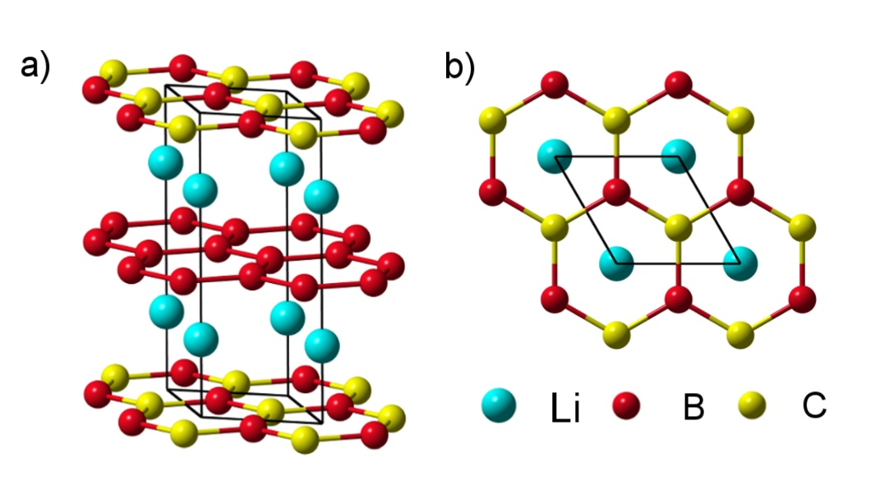
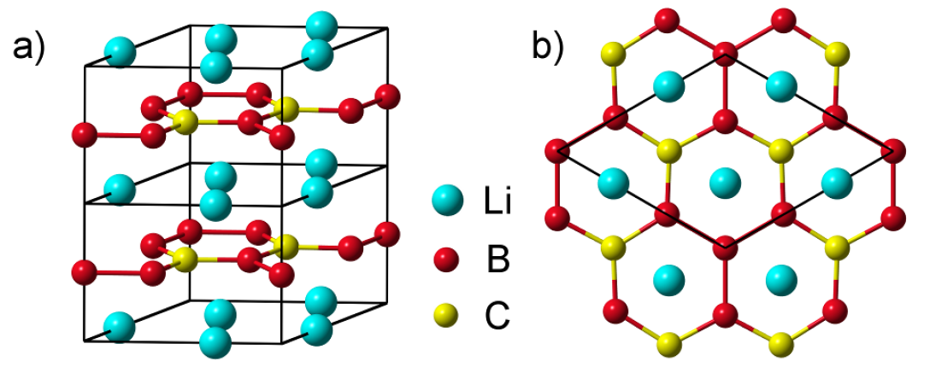
Hole doped LiBC: More suggestions
Li₃B₄C₂ : T_{c} ~ 50 K
Li₂B₃C: T_{c} ~ 55 K
Li₃B₄C₂ and Li₂B₃C: dope holes without introducing lattice distortions
M Gao, ZY Lu, T Xiang, PRB 91, 045132 (2015)

Slide 35
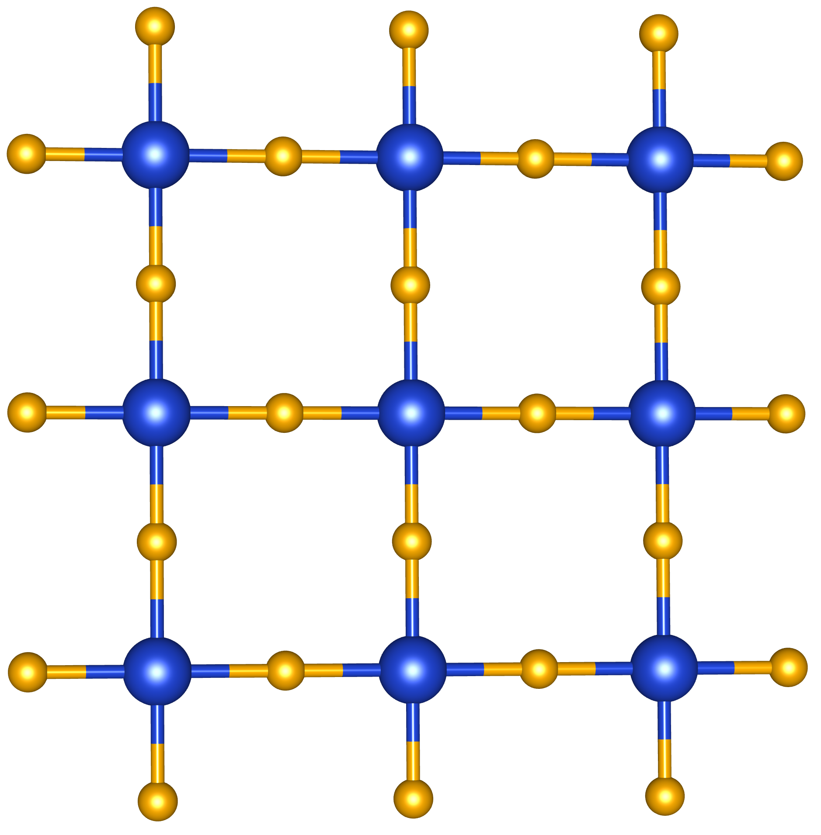

2. Materials analog to the cuprates
CuO₂ plane
Fe₂Se₂ layer
O
Se
Cu
Fe
Cuprate SC
Iron-based SC
There is high chance to find metallized σ-bonding electrons in materials isostructural and isoelectronic to cuprate superconductors
They may become high-Tc SC by doping

Slide 36
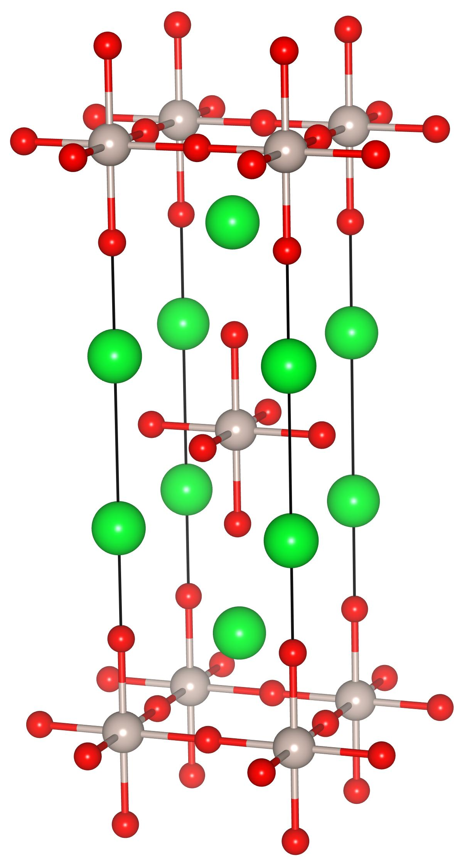
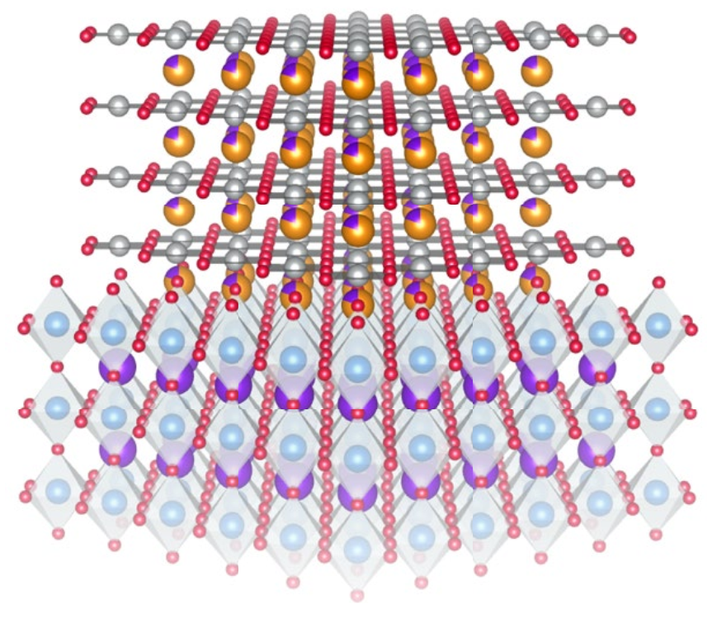
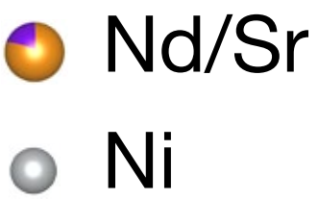
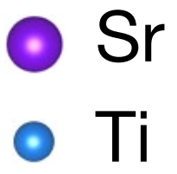

Superconducting materials isostructural to cuprates
Sr₂RuO₄
Sr₂IrO₄
Nd_{0.8}Sr_{0.2}NiO₂
T_{c} ~ 50 K ?
STM, no transport
T_{c} ~ 2 K
T_{c} ~ 9 - 15 K
Maeno et al., Nature (1994)
Kim et al, PRL (2012)
Li et al., Nature (2019)

Slide 37


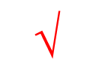
Are they electronically similar to cuprates?
$$×$$
$$$$
$$?$$
Sr₂RuO₄
Sr₂IrO₄
Nd_{0.8}Sr_{0.2}NiO₂
weak bonding
weak AFM fluctuation
spin-orbital coupling
AFM fluctuation
surface doping only
3d-4f hybridized
weak AFM fluctuation
weak Ni 3d-O 2p bond

Slide 38
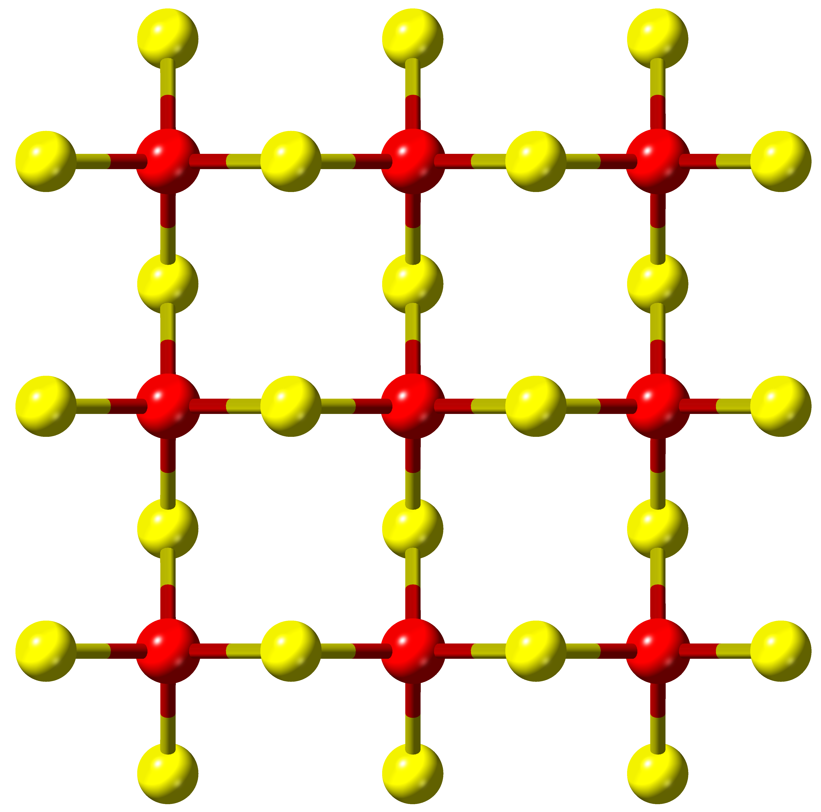
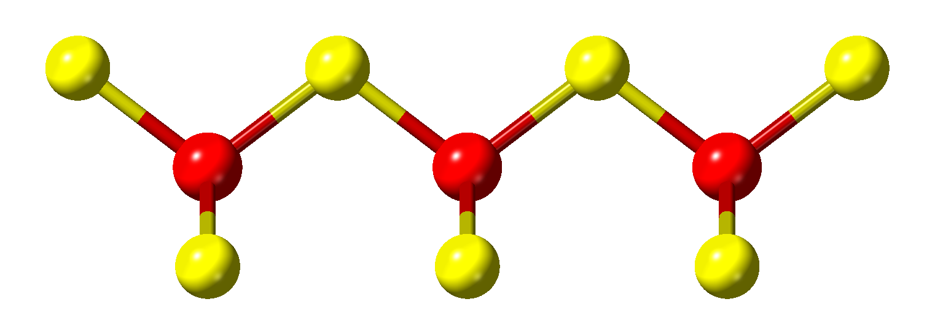
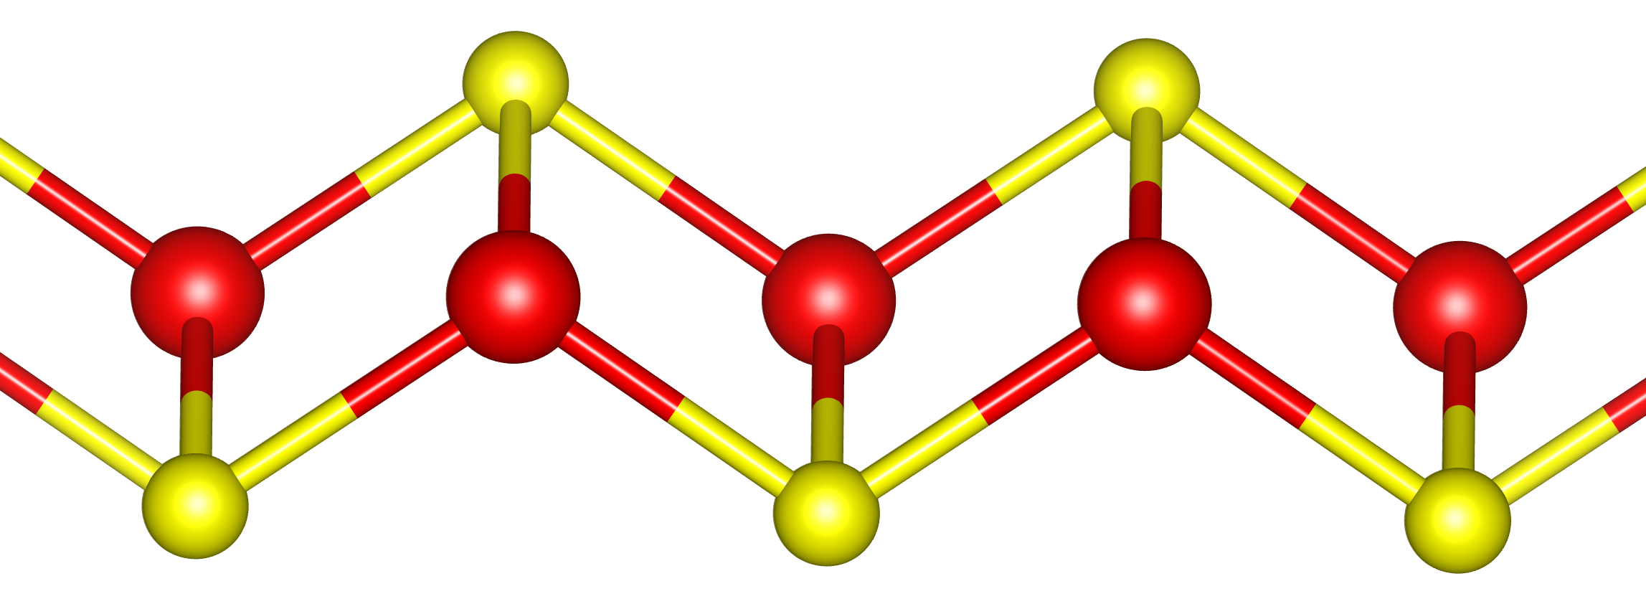
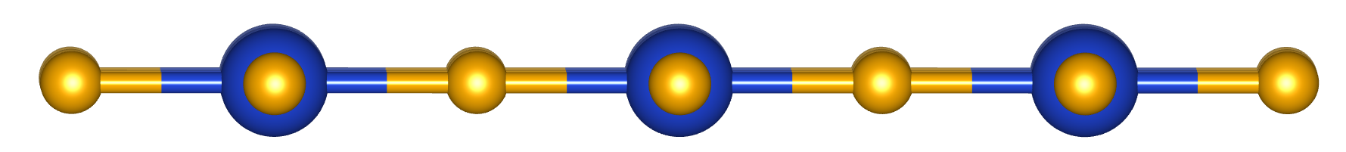
Can we find a Fe-based analog of the cuprate?
CuO₂ plane
FeSe₂ layer
Fe₂Se₂ layer
Zhao, Ma, Lu, Xiang, arXiv:1910.03545
AFeSe₂: Fe-based superconducting analogs of the cuprates,

Slide 39
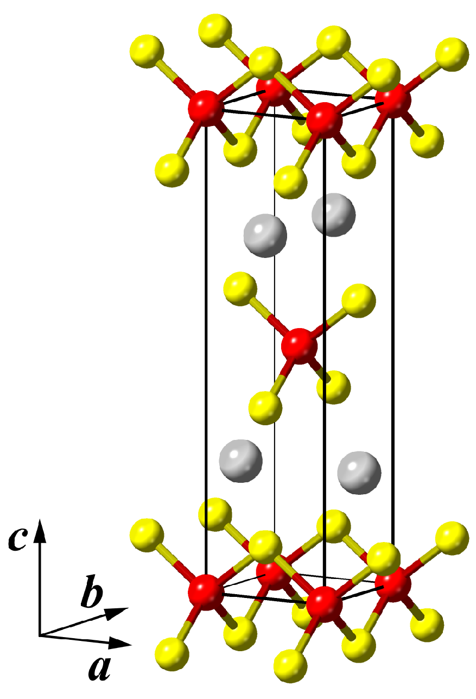




This kind of material exists: AFeSe₂ (A=Tl, K, Rb, Cs)
CuO₂ plane
FeSe₂ layer
AFeSe₂ (A=Tl, K, Rb, Cs)
TlFeSe₂ synthesis
A. Kutoglu, Naturwissenschaften 61, 125 (1974)
G. D. Guseinov et al., Inorg. Mat. 27, 377 (1991)
I-4m2 symmetry Group

Slide 40


Other Structures of AFeSe₂
v
AFeSe₂ (A=Tl, K, Rb, Cs)
Quasi-1D antiferromagnetic semiconductor
C2/m
C2/c
FeSe₄ chains
2-3 μ_{B}/Fe
TlFeSe₂: Klepp and Boller, Monatshefte fur Chemie/Chemical Monthly (1979)
CsFeSe₂: Stuble and Rohr, Zeitschrift fr anorganische und allgemeine Chemie (2017)
KFeSe₂, RbFeSe₂
Bronger et al., J. Solid State Chem. (1987
I-4m2 symmetry Group

Slide 41
AFeSe₂ is similar to the cuprate parent compounds
AFeSe₂ is an antiferromagnetic insulator
The ground state is Neel ordered
FeSe₂ layer
AFeSe₂: charge gap
Tl, K: 22meV
Rb: 56meV
Cs: 98meV
Cuprate: 2 eV

Slide 42




Antiferromagnetic coupling in AFeSe₂
FeSe₂ layer
$$H=\sum_{⟨ij⟩}{\left(J_{1}δ_{{\left\langle i,j\right\rangle }_{1}}+J_{2}δ_{{\left\langle i,j\right\rangle }_{2}}+J_{3}δ_{{\left\langle i,j\right\rangle }_{3}}\right)S_{i}⋅S_{j} }$$
meV/S²
3.6 $μ_{B}$/Fe
comparable to cuprates

Slide 43



AFeSe₂: Charge and Spin Density Distribution
FeSe₂ layer
Charge density
Spin density
Fe-Se: Strong covalent hybridized
Fe-Fe: No direct interaction
Magnetic interaction between Fe moments arises from Se-bridged AFM superexchange

Slide 44





Summary
Metallizing strong bonding electrons provides a universal route to high-Tc superconductivity
LiB₂C₂, Li3B4C2, Li2B3C, and doped AFeSe₂ (A=Tl,K,Rb,Cs) are good candidates of high-Tc SC
Zhongyi Lu
Renmin Univ China
Miao Gao
Ningbo University
Xunwang Yan
Qufu Normal Univ
Fengjie Ma Xinlei Zhao
Beijing Normal University

Slide 45
Thank you for your attention!

Slide 46


TlFeSe₂ : Band Structure in the Nonmagnetic Phase
4
1
2
3
No Fermi-surface nesting
1, 2, 3 electron-type FS 4 hole-type FS

Slide 47



Boron doped diamond
T_{c} = 4 K 2.8% B
Low density of states at Fermi level
E. A. Ekimov et al. , Nature (London) 428, 542 (2004).

Slide 48
Conventional Wisdom of Raising T_{c}
To apply high pressure to light elements
H enriched H₃S: possible 190K superconductor at 200 GPa
resistivity is 50 times lower than the copper resistivity
T_{c} decreases with magnetic field
strong isotope shift of T_{c} in D₂S: Tc 185 K for H₂S, 90 K for D₂S
AP Drozdov, MI Eremets, IA Troyan, Nature 2015

Slide 49
Conventional Wisdom of Raising T_{c}
To apply high pressure to light elements
H enriched H₃S: possible 190K superconductor at 200 GPa
λ ω_{log} μ* T_{c} Pressure
2.19 1334.6 K 0.1~0.13 191-204 K 200 GPa
0.13 184 K 250 GPa
0.13 179 K 300 GPa
Agree with DFT prediction for H₃S
H₃S
D. Duan et al., Sci. Reports 4, 6968 (2014)

Slide 50


What is a superconductor?
Perfect conductor
Perfect diamagnet
Resistivity vanishes in the superconducting state
Messiner effect
Anderson-Higgs Mechanism

Slide 51
How to become superconducting
Electrons form Cooper pairs
via electron-phonon or other interactions
Cooper pairs condense
to form phase coherence
Bardeen Cooper Schrieffer
1957
Superconductivity

